Slide 1
Psych 56L/ Ling 51: Acquisition of Language
Lecture 8
Phonological Development III
Notes:
1

Slide 2
Announcements
HW1 graded
Be preparing for the midterm on 2/07/13 (review questions, HW1, first part of HW2)
- Given through EEE
- Can be taken either in RH 101, the computer lab in SBSG G240, or wherever there’s an internet connection
Midterm review 2/05/13 in class: Remember to bring questions!
HW2 due 2/21/13
Notes:
2

Slide 3
Phonological development once speech begins
Notes:
3

Slide 4
Word production
First words: simple syllable structure, often single syllables or reduplicated syllables (baba, dada). Usually involve the sounds that appear in the noncanonical babbling stage.
Phonological idioms: words the child produces in a very adultlike way while still incorrectly producing other words that use the very same sounds. This demonstrates that children don’t really understand that words are broken down into sounds (phonemes), and are just producing some words as unanalyzed chunks (like idioms).
Ex: “ball” [correct: ball, [bɑl]] vs. “wi’w” [correct: little, [lɪɾəl]]
Notes:
4

Slide 5
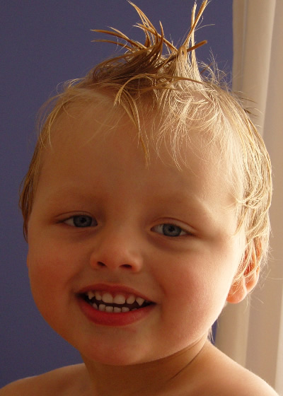
Phonological process development
18 months: children have developed systematic ways to alter the target language so it fits the sounds they’re able to produce (baby accent). These systematic transformations are called phonological processes. Most often children either drop the tough sounds (deletion) or replace them with sounds they can produce (substitution).
This happens a lot! More than 90% of words produced by some children show deletion or substitution processes.
Notes:
5

Slide 6
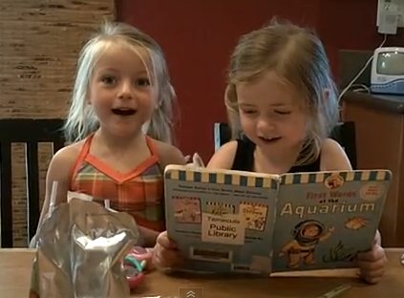
Example of altered pronunciation
http://www.youtube.com/watch?v=4azD_gNz0rw&feature=player_embedded
Pronouncing “popsicle”

Slide 7
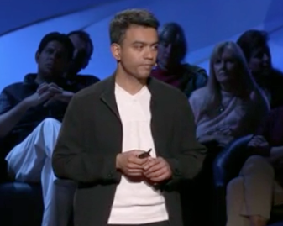
Example of phonological development
The evolution of “water”
http://www.ted.com/talks/deb_roy_the_birth_of_a_word.html
(4:19 - 5:40 of 19:52)

Slide 8
Deletion Processes
Deletion happens a lot to word-final consonants.
Final consonant deletion examples:
“dog” /dɑg/ → “dah” /dɑ/ “bus” /bʌs/ → “buh” /bʌ/
“boot” /but/ → “boo” /bu/ “because” /bikʌz/ → “becah” /bikʌ/

Slide 9
Deletion Processes
Deletion happens a lot to word-final consonants.
Final consonant deletion examples:
“dog” /dɑg/ → “dah” /dɑ/ “bus” /bʌs/ → “buh” /bʌ/
“boot” /but/ → “boo” /bu/ “because” /bikʌz/ → “becah” /bikʌ/

Slide 10
Deletion Processes
Deletion can also happen when more than one consonant appears together (consonant clusters).
Consonant cluster deletion examples:
“blanket” /blejŋkət/ → “banket” /bejŋkət/
“bring” /brɪŋ/ → “bing” /bɪŋ/
“bump” /bʌmp/ → “bup” /bʌp/
“stop” /stɑp/ → “top” /tɑp/
“desk” /dɛsk/ → “dek” /dɛk/
“school” /skul/ → “kool” /kul/

Slide 11
Deletion Processes
Deletion can also happen when more than one consonant appears together (consonant clusters).
Consonant cluster deletion examples:
“blanket” /blejŋkət/ → “banket” /bejŋkət/
“bring” /brɪŋ/ → “bing” /bɪŋ/
“bump” /bʌmp/ → “bup” /bʌp/
“stop” /stɑp/ → “top” /tɑp/
“desk” /dɛsk/ → “dek” /dɛk/
“school” /skul/ → “kool” /kul/

Slide 12
Deletion Processes
Deletion of unstressed syllables:
Delete a syllable (usually more than one sound, and includes a vowel-like sound) if it is unstressed. (Unstressed syllables in English usually have the ə as their vowel.)
Unstressed syllable deletion process examples:
“giRAFFE” /dʒəɹæf/ → “raffe” /ɹæf/
“aWAY” /əwe/ → “way” /wej/
“AlliGAtor” /æləgetəɹ/ → “agay” /ægej/
“baNAna” /bənænə/ → “nana” /nænə/
“BUtterFLY” /bʌtəɹflaj/ → “bufly” /bʌflaj/

Slide 13
Deletion Processes
Deletion of unstressed syllables:
Delete a syllable (usually more than one sound, and includes a vowel-like sound) if it is unstressed. (Unstressed syllables in English usually have the ə as their vowel.)
Unstressed syllable deletion process examples:
“giRAFFE” /dʒəɹæf/ → “raffe” /ɹæf/
“aWAY” /əwe/ → “way” /we/
“AlliGAtor” /æləgetəɹ/ → “agay” /æge/
“baNAna” /bənænə/ → “nana” /nænə/
“BUtterFLY” /bʌtəɹflaj/ → “bufly” /bʌflaj/

Slide 14
Substitution Processes
Substitution: Stopping process
Replace a fricative (consonant produced with continuous flowing air) with a stop (consonant where air flow is completely stopped). Note that the place of articulation (lips, alveolar ridge, velum, etc.) and voicing (vocal cords vibrating or not) does not change.
Stopping process examples:
“church” /tʃəɹtʃ/ → “turt” /təɹt/
“sing” /sɪŋ/ → “ting” /tɪŋ/
“zebra” /zibrə/ → “debra” /dibrə/
“thing” /ɵɪŋ/ → “ting” /tɪŋ/
“this” /ðɪs/ → “tis” /tɪs/
“shoes” /ʃuz/ → “tood” /tud/

Slide 15
Substitution Processes
Substitution: Stopping process
Replace a fricative (consonant produced with continuous flowing air) with a stop (consonant where air flow is completely stopped). Note that the place of articulation (lips, alveolar ridge, velum, etc.) and voicing (vocal cords vibrating or not) does not change.
Stopping process examples:
“church” /tʃəɹtʃ/ → “turt” /təɹt/
“sing” /sɪŋ/ → “ting” /tɪŋ/
“zebra” /zibrə/ → “debra” /dibrə/
“thing” /ɵɪŋ/ → “ting” /tɪŋ/
“this” /ðɪs/ → “dis” /dɪs/
“shoes” /ʃuz/ → “tood” /tud/

Slide 16
Substitution Processes
Substitution: Gliding process
Replace a liquid sound like /l/ or /ɹ/ with a glide sound like /j/ or /w/.
Gliding process examples:
“lion” /lajən/ → “yion” /yaj´n/
“rabbit” /ɹæbət/ → ”wabbit” /wæbət/
“look” /lʊk/ → “wook” /wʊk/
“rock” /ɹɑk/ → “wock” /wɑk/
“story” /stɔɹi/ → “stowy” /stɔwij/

Slide 17
Substitution Processes
Substitution: Gliding process
Replace a liquid sound like /l/ or /ɹ/ with a glide sound like /j/ or /w/.
Gliding process examples:
“lion” /lajən/ → “yion” /jajən/
“rabbit” /ɹæbət/ → ”wabbit” /wæbət/
“look” /lʊk/ → “wook” /wʊk/
“rock” /ɹɑk/ → “wock” /wɑk/
“story” /stɔɹi/ → “stowy” /stɔwi/

Slide 18
Substitution Processes
Substitution: Denasalization process
Replace a nasal sound with a non-nasal sound. Note that the place of articulation (ex: labial), manner of articulation (ex: stop) and the voicing (ex: +voice) do not change. (You can get this effect yourself by holding your nose when you say words.)
Denasalization process examples:
“jam” /dʒæm/ → “jab” /dʒæb/
“spoon” /spun/ → “spood” /spud/
“sing” /sɪŋ/ → “sig” /sɪg/

Slide 19
Substitution Processes
Substitution: Denasalization process
Replace a nasal sound with a non-nasal sound. Note that the place of articulation (ex: labial), manner of articulation (ex: stop) and the voicing (ex: +voice) do not change. (You can get this effect yourself by holding your nose when you say words.)
Denasalization process examples:
“jam” /dʒæm/ → “jab” /dʒæb/
“spoon” /spun/ → “spood” /spud/
“sing” /sɪŋ/ → “sig” /sɪg/

Slide 20
Substitution Processes
Substitution: Fronting process
Replace a sound with a sound that is made more towards the front of the mouth. Note that the manner of articulation and the voicing do not change – just the place of articulation does.
Fronting process examples:
“thumb” /ɵʌm/ → “fumb” /fʌm/
“ship” /ʃɪp/ → “sip” /sɪp/
“jump” /dʒʌmp/ → “dzump” /dzʌmp/
“chalk” /tʃɔk/ → “tsalk” /tsɔk/
“key” /ki/ → “tey” /tij/
“go” /go/ → “doe” /dow/

Slide 21
Substitution Processes
Substitution: Fronting process
Replace a sound with a sound that is made more towards the front of the mouth. Note that the manner of articulation and the voicing do not change – just the place of articulation does.
Fronting process examples:
“thumb” /ɵʌm/ → “fumb” /fʌm/
“ship” /ʃɪp/ → “sip” /sɪp/
“jump” /dʒʌmp/ → “dzump” /dzʌmp/
“chalk” /tʃɔk/ → “tsalk” /tsɔk/
“key” /ki/ → “tey” /ti/
“go” /go/ → “doe” /do/

Slide 22
Substitution Processes
Substitution: Assimilation process
A sound becomes more like another (usually nearby) sound by taking on one or more of that other sound’s features – voicing, place of articulation, manner of articulation. This is sometimes called consonant harmony or vowel harmony.
Assimilation (consonant harmony) process examples:
“pig” /pɪg/ → “big” /bɪg/ (/p /takes on +voice of /g/)
“push” /pʊʃ/ → “bush” /bʊʃ/ (/p/ takes on +voice of vowel)
“duck” /dʌk/ → “guck” /gʌk/ (/d/ takes on +velar of /k/)
“doggy” /dɑgi/→ “goggy /gɑgi/ (/d/ takes on +velar of /g/)
“self” /sɛlf/ → “felf” /fɛlf/ (/s/ takes on +labiodental of /f/)
“Kathleen” /kæɵlin/ → “Kakleen” /kæklin/ (/ɵ/ takes on +stop, +velar of /k/)

Slide 23
Substitution Processes
Substitution: Assimilation process
A sound becomes more like another (usually nearby) sound by taking on one or more of that other sound’s features – voicing, place of articulation, manner of articulation. This is sometimes called consonant harmony or vowel harmony.
Assimilation (consonant harmony) process examples:
“pig” /pɪg/ → “big” /bɪg/ (/p /takes on +voice of /g/)
“push” /pʊʃ/ → “bush” /bʊʃ/ (/p/ takes on +voice of vowel)
“duck” /dʌk/ → “guck” /gʌk/ (/d/ takes on +velar of /k/)
“doggy” /dɑgi/→ “goggy /gɑgi/ (/d/ takes on +velar of /g/)
“self” /sɛlf/ → “felf” /fɛlf/ (/s/ takes on +labiodental of /f/)
“Kathleen” /kæɵlin/ → “Kakleen” /kæklin/ (/ɵ/ takes on +stop, +velar of /k/)

Slide 24
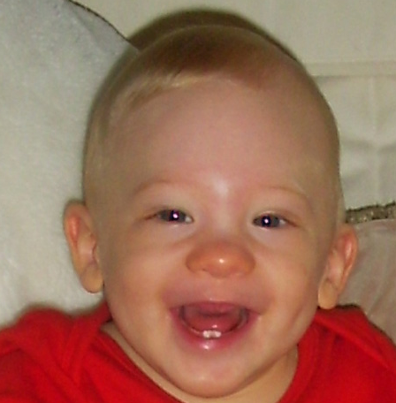
Phonological Process Development
Often, more than one process will apply to a word - which makes the original word harder to decipher.
/bu/ = ???? (referent in world = poop)
/pup/ ---> final consonant deletion = /pu/
---> assimilation with vowel = /bu/
Notes:
24

Slide 25
Multiple process examples
“giraffe” /dʒəɹæf/ → “faffe” /fæf/
/dʒəɹæf/ → /ɹæf/
[unstressed syllable deletion]
/ɹæf/ → /fæf/
[consonant harmony: /ɹ/ picks up +labiodental, -voice from /f/]
“room” /ɹum/ → “woob” /wub/
/ɹuwm/ → /ɹuwb/
[stopping]
/ɹuwb/ → /wuwb/
[gliding]

Slide 26
Multiple process examples
“giraffe” /dʒəɹæf/ → “faffe” /fæf/
/dʒəɹæf/ → /ɹæf/
[unstressed syllable deletion]
/ɹæf/ → /fæf/
[assimilation: /ɹ/ picks up +labiodental, -voice from /f/]
“room” /ɹum/ → “woob” /wub/
/ɹum/ → /ɹub/
[stopping or denasalization]
/ɹub/ → /wub/
[gliding]

Slide 27
Multiple process examples
“tent” /tɛnt/ → “det” /dɛt/
/tɛnt/ → /dɛnt/
[assimilation: /t/ picks up +voice of vowel (or /n/)]
/dɛnt/ → /dɛt/
[consonant cluster deletion]
“cracker” /kɹækəɹ/ → “gwa” /gwæ/
/kɹækəɹ/ → /gɹækəɹ/
[assimilation: /g/ picks up +voice of /ɹ/ (or vowel)]
/gɹækəɹ/ → /gwækəɹ/
[gliding]
/gwækəɹ/ → /gwæ/
[unstressed syllable deletion]

Slide 28
Multiple process examples
“tent” /tɛnt/ → “det” /dɛt/
/tɛnt/ → /dɛnt/
[assimilation: /t/ picks up +voice of vowel (or /n/)]
/dɛnt/ → /dɛt/
[consonant cluster deletion]
“cracker” /kɹækəɹ/ → “gwa” /gwæ/
/kɹækəɹ/ → /gɹækəɹ/
[assimilation: /k/ picks up +voice of /ɹ/ (or vowel)]
/gɹækəɹ/ → /gwækəɹ/
[gliding]
/gwækəɹ/ → /gwæ/
[unstressed syllable deletion]

Slide 29
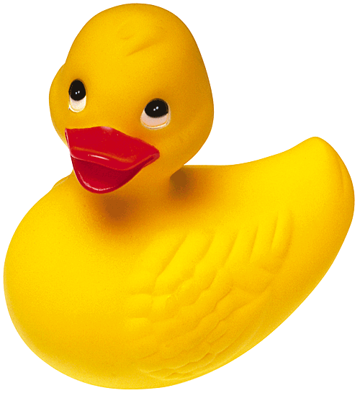
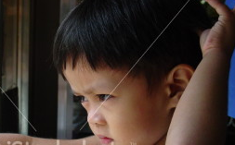
Why do they make these errors?
Idea: Just a motor limitation. They can’t physically produce it all fast enough, but they can perceive the differences.
Child: “Gimme my guk!”
Father: “You mean your duck?”
Child: “Yes, my guk!”
Father (hands child the duck): “Okay, here’s your guk.”
Child (annoyed): “No, Daddy - I say it that way, not you.”
Notes:
29

Slide 30
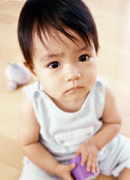
Why do they make these errors?
Idea: Just a motor limitation. They can’t physically produce it all fast enough, but they can perceive the differences.
But some contrasts are actually difficult for them to distinguish, such as /ɵ/ from /f/ and /ɹ/ from /w/. Production errors for these may have a basis in perception - their speech sound representation isn’t quite right yet.
The jury is still out on the interaction between speech perception and speech production…
Notes:
30

Slide 31
Recap: Phonological Development
Given children’s incomplete development and lesser experience with the words of the language, they often make mistakes producing even words they’re familiar with. However, they make systematic mistakes, reflecting the underlying system they have for representing sounds.
Most of children’s errors may stem from motor limitations, since they seem able to perceive incorrect pronunciations but not correct their own. However, there are also some sounds that children have trouble perceiving correctly – which makes errors on those sounds likely due to perception issues.
Notes:
31

Slide 32
Questions?
You should be able to do up through question 5 on HW2, and all of the questions from the phonological development review sheet.
Notes:
32

