Slide 1
Psych 56L/ Ling 51:
Acquisition of Language
Lecture 7
Phonological Development II
Notes:
1

Slide 2
Announcements
Be preparing for the midterm on 2/07/13 (review questions, HW1, first part of HW2)
Midterm review 2/05/13 in class
HW2 due 2/21/13
Message board created for class:
Link available on class website
https://eee.uci.edu/boards/w13/AcqOfLangW13/
Notes:
2

Slide 3
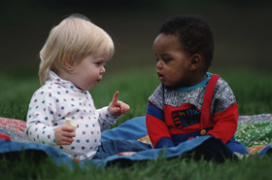
Prelinguistic “Speech” Production
Notes:
3

Slide 4
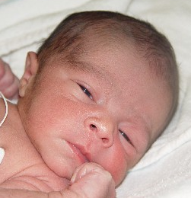
Stages of Prespeech Vocal Development
Newborns make biologically-related sounds: reflexive crying, burping, breathing, sucking
Helpful: infants’ vocal cords vibrate & airflow through the vocal apparatus is stopped and started
Notes:
4

Slide 5


Stages of Prespeech Vocal Development
Around 6-8 weeks: infants start cooing (sounds that result from being happy).
First coos sound like one long vowel - but over many months, they acquire a variety of different vowel sounds.
Notes:
5

Slide 6
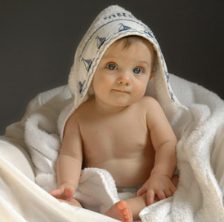
Stages of Prespeech Vocal Development
Around 16-30 weeks: vocal play. Infants use a variety of different consonant-like and vowel-like sounds. At the end of this stage, infants form long combinations of the sounds (marginal babbling).
Recognizable vowel sounds heard at the beginning, while recognizable consonant sounds (usually velars like k/g) are usually heard around 2-3 months. Recognizable consonant sounds occurring near the front of the mouth (n/m/p/b/d) come in around 6 months of age.
Notes:
6

Slide 7

Stages of Prespeech Vocal Development
Around 6-9 months: canonical/reduplicated babbling, with actual syllables in the sounds produced (ex: [dadada]). These syllables are often repeated in a row.
Social aspect: babies don’t give any indication that they’re babbling to communicate (no intentionality at this point) even though sometimes it may look like it. They babble in the car and their crib, showing no sign that they expect any reply.
http://www.youtube.com/watch?v=_JmA2ClUvUY
Note: even deaf infants babble, but they tend to produce marginal babbling instead of canonical babbling.
Notes:
7

Slide 8
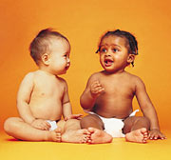
Stages of Prespeech Vocal Development
After canonical babbling: nonreduplicated/variegated babbling, with non-repetitive syllables and more variety in consonant and vowel sounds. Infants also incorporate prosody (the rhythm of the language) into their babbling, which makes it sound much more like they’re trying to talk. However, the “words” in this kind of babbling are usually only 1 or 2 syllables.
Notes:
8

Slide 9
Stages of Prespeech Vocal Development
0 weeks
reflexive crying, biological-based sounds
6-8 weeks
cooing
16 weeks
vocal play begins
36 weeks
reduplicated/canonical babbling
48 weeks
nonreduplicated babbling
First Word
Notes:
9

Slide 10
Is all babbling the same?
Besides the differences between the vocal babbling of deaf children and non-deaf children, babies’ babbling is also influenced by the language they hear.
How do we know?
Test competent native speakers.
Record the babbling of babies who are learning to speak different languages (ex: French, Arabic, Chinese). See if native speakers can identify which baby’s babble is from their language (ex: asking French mothers to choose between Arabic babble and French babble as French.)
De Boysson-Bardies, Sagart, and Durand (1984): recordings of 8-month-olds can be recognized by language.
Notes:
10

Slide 11
Is all babbling the same?
Besides the differences between the vocal babbling of deaf children and non-deaf children, babies’ babbling is also influenced by the language they hear.
How do we know?
(2) See if babbling features accord with language features
Determine which vowels and consonants appear in babbling, and how frequently they appear. Compare to target language’s vowels and consonants. (Can be subtle, though.)
Ex: Japanese & French words contain more nasal sounds than Swedish & English words; Japanese & French babbles contain more nasal sounds than Swedish & English babbles.
Notes:
11

Slide 12
Is all babbling the same?
Besides the differences between the vocal babbling of deaf children and non-deaf children, babies’ babbling is also influenced by the language they hear.
How do we know?
(2) See if babbling features accord with language features
Determine which vowels and consonants appear in babbling, and how frequently they appear. Compare to target language’s vowels and consonants. (Can be subtle, though.)
Ex: Mandarin Chinese uses tone-like pitches to distinguish meaning, and Mandarin babbles also use these tone-like pitches while English babbles do not (Meltzoff et al. 2009).

Slide 13
Processes underlying speech sound development
Three main factors
Physical growth & development of the vocal tract
Development of brain & other neurological structures responsible for vocalization
Experience
Notes:
13

Slide 14
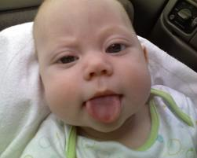
Processes underlying speech sound development
Physical growth & development of the vocal tract
A newborn’s vocal tract is smaller & shaped differently from an adult’s. (Ex: The tongue fills the entire mouth, limiting range of motion.)
As the facial skeleton grows, the tongue gets more room. This happens during the vocal play stage, and the exploration of this new vocal freedom may be the cause of the vocal play itself.
Notes:
14

Slide 15
Processes underlying speech sound development
Development of brain & other neurological structures responsible for vocalization
Later neurological developments in higher brain structures correlate with developments in vocalization.
Ex: Onset of cooing at 6-8 weeks coincides with development of limbic system (associated with expression of emotion in both humans and other animals).
Maturation of areas in the motor cortex may be required for the onset of canonical babbling.
Notes:
15

Slide 16
Processes underlying speech sound development
Experience
Experience 1: Hearing the speech adults produce (influences the sounds children choose to babble and prosodic character of later babbling)
Important: There appears to be a social component involved.
- Infants increase the complexity of their vocal output when mother provides immediate social feedback (Goldstein, King, & West 2003).
- Infants learn foreign sounds (ex: American infants learning Mandarin phonemes) only when the input comes from a live speaker interacting with them (and not from a television broadcast of that same speaker, for example.) (Kuhl, Tsao, & Liu 2003)
Notes:
16

Slide 17
Processes underlying speech sound development
Experience
Experience 2: Hearing their own vocal output (allows for calibration - matching what they produce to what they hear). Absence of auditory feedback may explain why deaf infants produce less elaborate vocal play than hearing infants, and reach the canonical babbling stage later.

Slide 18
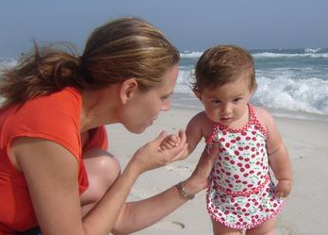
Prelinguistic Speech Perception
Notes:
18

Slide 19
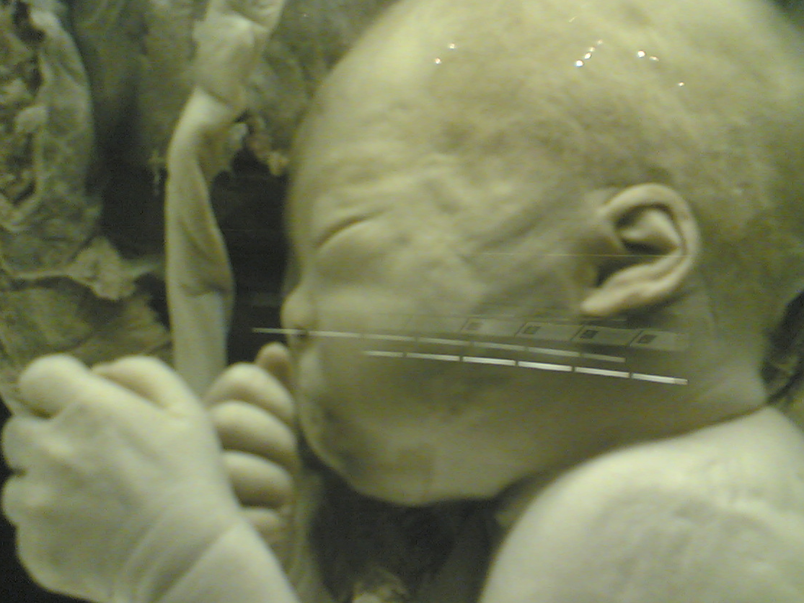
Infants’ Hearing
Infants’ hearing is not quite as sensitive as adults’ - but they can hear quite well and remember what they hear.
Ex 1: Fetuses 38 weeks old
A loudspeaker was placed 10cm away from the mother’s abdomen. The heart rate of the fetus went up in response to hearing a recording of the mother’s voice, as compared to hearing a recording of a stranger’s voice.
Notes:
19

Slide 20
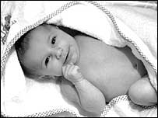
Infants’ Hearing
Infants’ hearing is not quite as sensitive as adults’ - but they can hear quite well and remember what they hear.
Ex 2: newborns
Pregnant women read a passage out loud every day for the last 6 weeks of their pregnancy. Their newborns showed a preference for that passage over other passages read by their mothers.
Notes:
20

Slide 21
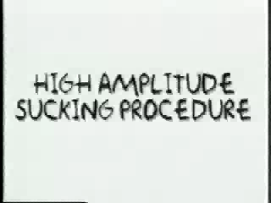
Studying Infant Speech Perception
Researchers use indirect measurement techniques.
High Amplitude Sucking (HAS)
video ~4 minutes long
Notes:
21

Slide 22
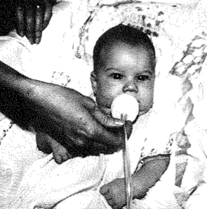
Studying Infant Speech Perception
Researchers use indirect measurement techniques.
High Amplitude Sucking (HAS)
Infants are awake and in a quietly alert state. They are placed in a comfortable reclined chair and offered a sterilized pacifier that is connected to a pressure transducer and a computer via a piece of rubber tubing. Once the infant has begun sucking, the computer measures the infant’s average sucking amplitude (strength of the sucks).

Slide 23
Studying Infant Speech Perception
Researchers use indirect measurement techniques.
High Amplitude Sucking (HAS)
A sound is presented to the infant every time a strong or “high amplitude” suck occurs. Infants quickly learn that their sucking controls the sounds, and they will suck more strongly and more often to hear sounds they like the most. The sucking rate can also be measured to see if an infant notices when new sounds are played.
Notes:
23

Slide 24
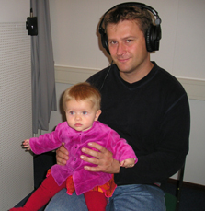
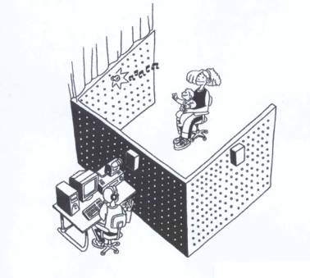
Studying Infant Speech Perception
Researchers use indirect measurement techniques.
Head Turn Preference Procedure
Infant sits on caretaker’s lap. The wall in front of the infant has a green light mounted in the center of it. The walls on the sides of the infant have red lights mounted in the center of them, and there are speakers hidden behind the red lights.
Notes:
24

Slide 25
Studying Infant Speech Perception
Researchers use indirect measurement techniques.
Head Turn Preference Procedure
Sounds are played from the two speakers mounted at eye-level to the left and right of the infant. The sounds start when the infant looks towards the blinking side light, and end when the infant looks away for more than two seconds.
Notes:
25

Slide 26
Studying Infant Speech Perception
Researchers use indirect measurement techniques.
Head Turn Preference Procedure
Thus, the infant essentially controls how long s/he hears the sounds. Differential preference for one type of sound over the other is used as evidence that infants can detect a difference between the types of sounds.
Notes:
26

Slide 27
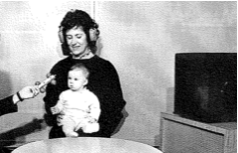
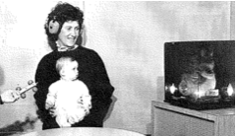
Studying Infant Speech Perception
Researchers use indirect measurement techniques.
Head-Turn Technique
Babies tend to be interested in moving toys. Using the presentation of a moving toy as a reward, babies are trained to turn their heads when they hear a change in the sound being presented.
Notes:
27

Slide 28
Studying Infant Speech Perception
Researchers use indirect measurement techniques.
Head-Turn Technique
A sound is played over and over, and then the sound is changed followed immediately by the presentation of the moving toy. After several trials, babies turn their heads when the sounds change even before the moving toy is activated.
Notes:
28

Slide 29
Categorical Perception
One feature of infants’ speech perception: categorical perception. Categorical perception occurs when a range of stimuli that differ continuously are perceived as belonging to only a few categories with no degrees of difference within those categories.
Actual stimuli
Perception of stimuli
Notes:
29

Slide 30
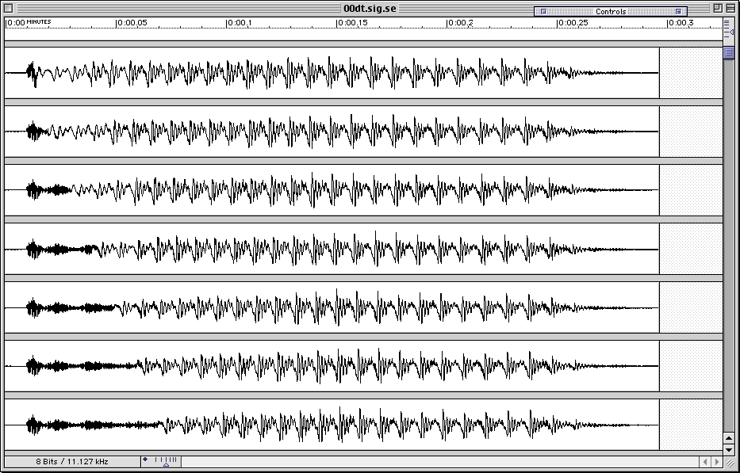

Categorical Perception
Adult categorical perception: Voice Onset Time (VOT)
60 ms
Notes:
30

Slide 31
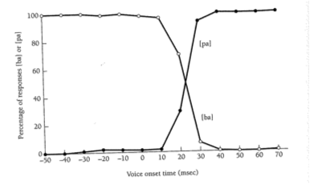
Categorical Perception
Adult categorical perception: Voice Onset Time (VOT)
[tæ]
% of responses as either [tæ] or [dæ]
[dæ]
Voice onset time in msec
Notes:
31

Slide 32
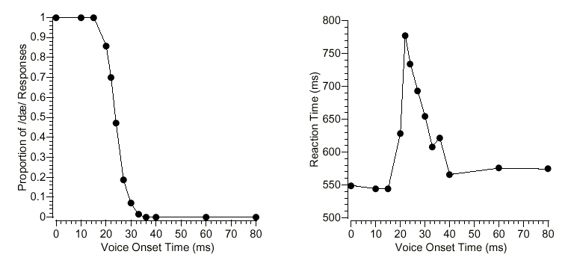
Categorical Perception
Adult categorical perception: Voice Onset Time (VOT)
Decision between dæ/tæ
Time to make decision
Notes:
32

Slide 33
Categorical Perception
Adult categorical perception: Voice Onset Time (VOT)
Uncertainty at category boundary
Decision between dæ/tæ
Time to make decision

Slide 34
Categorical Perception
Adult categorical perception: Voice Onset Time (VOT)
Within-category discrimination is hard, across-category discrimination is easy
D
0ms
20ms
D
D
20ms
40ms
T
T
40ms
60ms
T
Notes:
34

Slide 35
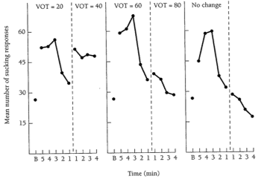
Categorical Perception
Infant categorical perception: Voice Onset Time (VOT)
Eimas et al. 1971: HAS technique
across
category
within
category
control
(baseline)
Notes:
35

Slide 36
Categorical Perception
Infant categorical perception: Voice Onset Time (VOT)
Eimas et al. 1971: HAS technique
across
category
within
category
control
(baseline)
Infants notice, compared to control
Notes:
36

Slide 37
Categorical Perception
Infant categorical perception: Voice Onset Time (VOT)
Eimas et al. 1971: HAS technique
across
category
within
category
control
(baseline)
Infants don’t notice, compared to control
Notes:
37

Slide 38
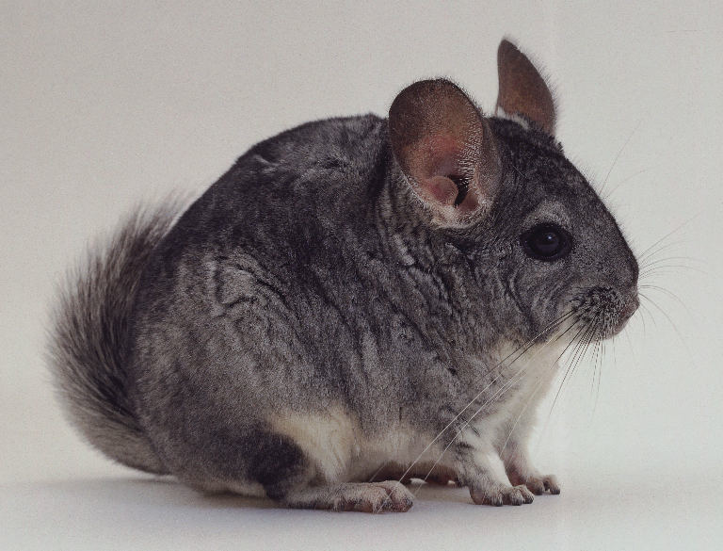
Categorical Perception
Categorical perception: a special human ability?
Categorical perception is not specific to the human ear, though - it’s a feature shared with other mammals like chinchillas (tested with an Avoidance Conditioning Procedure)!
Notes:
38

Slide 39
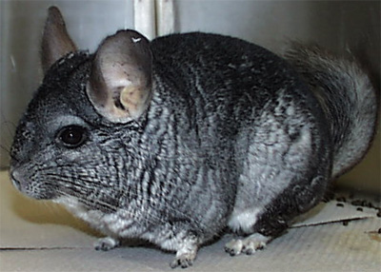
Avoidance Conditioning Procedure
Speech sound at one end of the continuum
paired with shock
Other end paired with safety
Safety
Shock
0
20
40
60
80
VOT

Slide 40
Avoidance Conditioning Procedure
Animals learn to “avoid” shock.
What will they do for between cases?
= FLEE
Safety
?
?
?
?
?
?
Shock
= STAY
0
20
40
60
80
VOT

Slide 41
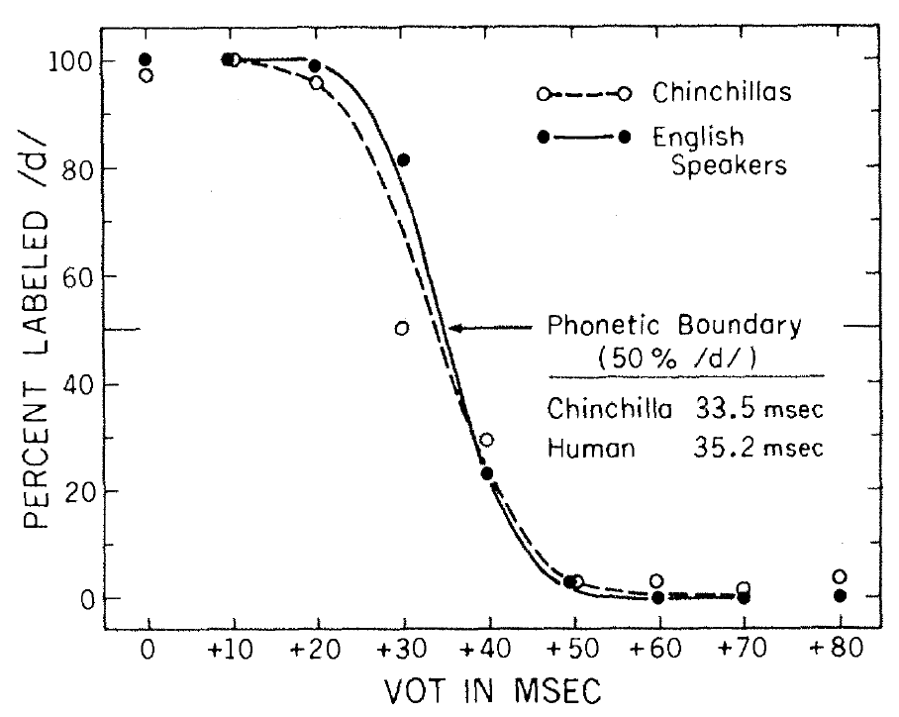
Kuhl & Miller (1978)

Slide 42
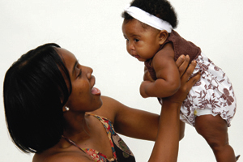
Infant-directed speech
Notes:
42

Slide 43
The nature of infant-directed speech
Motherese/infant-directed speech/child-directed speech
Intonational contour is greatly exaggerated:
higher-pitched voice, wider range of pitches, longer pauses, shorter phrases, slower tempo (vowels are prolonged)
Motherese could be helpful for language learning: likely to highlight important features of speech, and provide more prototypical examples of a language’s speech sounds
Notes:
43

Slide 44
How motherese helps
Greater discriminability of phonemes (contrasting sounds in a language) in child-directed speech may help children establish phonemic categories (that signal meaning contrasts)
[b] and [p] are distinct phonemic categories in English.
We know because “big” is a different word from “pig”.
Support: Mothers who produce more discriminable vowels in their infant-directed speech have infants who demonstrate better speech perception skills in laboratory tests.
Notes:
44

Slide 45

How motherese helps…adults?
Golinkoff & Alioto 1995: adults learned words in a foreign language better if the words were presented in infant-directed rather than adult-directed speech
Notes:
45

Slide 46
Why babies like motherese
Children like the exaggerated pitch contours the most?
Fernald & Kuhl (1987): 4-month-olds prefer to hear infant-directed speech over adult-directed speech when only the melody is left (everything else has been filtered out)
However, this may be due to positive interactions with their caretakers, as 1-month-olds actually only prefer child-directed speech when the entire speech signal is present.
Notes:
46

Slide 47

But not motherese for everyone…
While motherese may be very useful, it can’t be required for language acquisition (even if it’s really helpful) since not all cultures use it. Some cultures (ex: Samoans, Papua New Guineans, Mayans, US African Americans in the rural south) do not address speech to prelinguistic children at all - so those children must learn some other way.
Notes:
47

Slide 48
Recap: Speech Sound Development
Infants go through different stages of pre-speech production, which allows them to develop the motor skills to produce the speech sounds in their native language.
There are several experimental techniques that can be used to examine infant speech perception. One useful ability infants seem to have is categorical perception.
Infant-directed speech (motherese) tends to have several properties that make it helpful for learning the sounds of the language.
Notes:
48

Slide 49

Questions?
You should be able to do up through question 12 on the phonological review questions and up through question 4 on HW2.
Notes:
49

