Slide 1
Psych 56L/ Ling 51:
Acquisition of Language
Lecture 6
Phonological Development I
Notes:
1

Slide 2
Announcements
HW1 due at the end of class today
Review questions for phonological development available
HW2 available (not due till 2/21/13 – after midterm), but helpful for studying for the midterm
All kinds of useful sound charts available (including interactive ones, in case you forget what sound corresponds to what symbol).
Resources available for typing IPA characters (useful for HW2) – if all else fails, you can always copy and paste from the IPA virtual keyboard (linked in the references).
Notes:
2

Slide 3
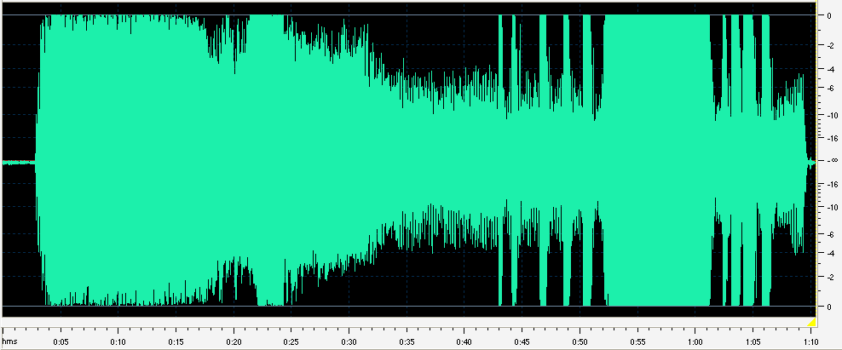
Sounds of Language

Slide 4
Forget Spelling!
Sounds ≠ Spelling

Slide 5
Courtesy of http://www.spellingsociety.org/news/media/poems.php
Our Strange Lingo, by Lord Cromer (1902)
When the English tongue we speak.
Why is break not rhymed with freak?
Will you tell me why it's true
We say sew but likewise few?
And the maker of the verse,
Cannot rhyme his horse with worse?
Beard is not the same as heard
Cord is different from word.
Cow is cow but low is low
Shoe is never rhymed with foe.
Think of hose, dose, and lose
And think of goose and yet with choose
…

Slide 6
Courtesy of http://www.spellingsociety.org/news/media/poems.php
…
Think of comb, tomb and bomb,
Doll and roll or home and some.
Since pay is rhymed with say
Why not paid with said I pray?
Think of blood, food and good.
Mould is not pronounced like could.
Wherefore done, but gone and lone -
Is there any reason known?
To sum up all, it seems to me
Sound and letters don't agree.

Slide 7
One Sound - Many Characters
he e seas ea
believe ie amoeba oe
Caesar ae key ey
see ee machine i
people eo seize ei
International Phonetic Alphabet: [i]

Slide 8
One Sound - Many Characters
too oo threw ew
to o lieu ieu
clue ue shoe oe
through ough beautiful eau
IPA: [u]

Slide 9
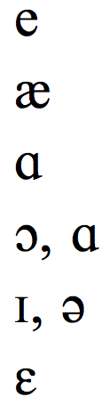
One Character - Many Sounds
dame e
dad Q
father ɑ
call ɔ , ɑ
village ɪ , ə
many ɛ

Slide 10

One Sound - Multiple Letters
shoot ʃ
either
character k
deal i
Thomas t
physics f
rough

Slide 11

One Letter - 0, 1, 2 Sounds
mnemonic
psychology
resign
ghost
island
whole
debt
cute [kjuwt]
= no sound!
= 2 sounds!

Slide 12
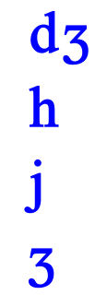
Differences across Languages
English: judge, juvenile, Jesus [dʒ]
Spanish: jugar, Jesus [h]
German: Jugend, jubeln, Jesus [j]
French: Jean, j’accuse, jambon [ʒ]

Slide 13
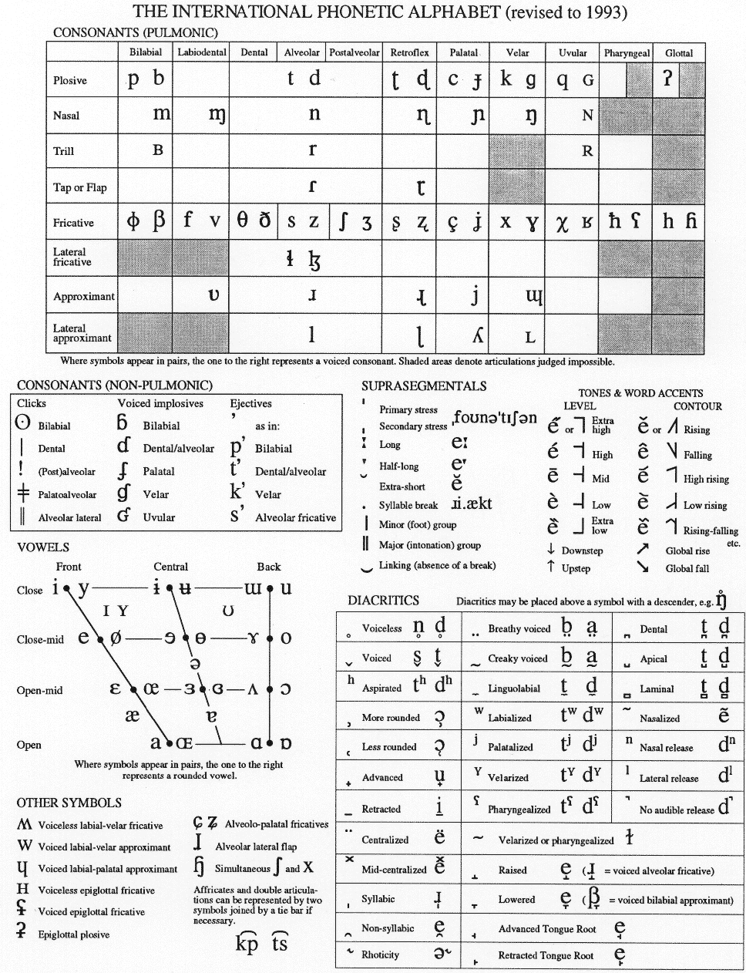
International Phonetic Alphabet

Slide 14
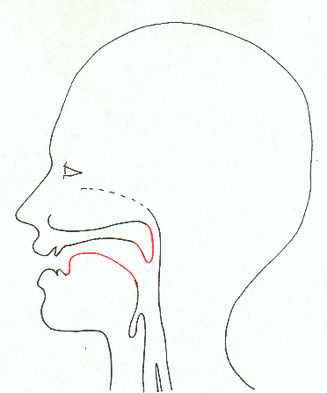
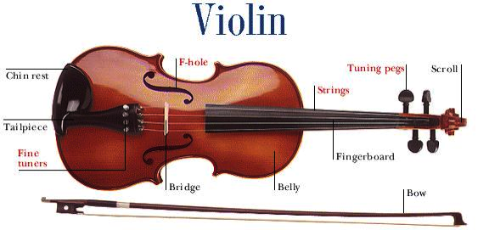
Sounds: Speech Production
Notes:
14

Slide 15
How you look to a phonetician
Palate
Velum
Tongue
Glottis
(vocal folds)
Lips, teeth etc.
Notes:
15

Slide 16
How you look to a phonetician
Nasal
Cavity
Oral
Cavity
Notes:
16

Slide 17
Major division: consonants vs vowels
Consonantal sounds: narrow or complete closure somewhere in the vocal tract.
Vowels: very little obstruction in the vocal tract. Can form the basis of syllables (also possible for some consonants).
Notes:
17
First major division of sounds:
CONSONANTAL sounds have a narrow or complete CLOSURE somewhere in the vocal tract. Air is either blocked momentarily, or it has to get through such a narrow passage that a characteristic turbulence is created.
VOWELS, on the other hand, are produced with very little obstruction in the vocal tract. They are generally more SONOROUS than consonants—they are perceived as louder and longer lasting.
Vowels can form the basis of SYLLABLES, where each syllable can be defined as a peak of sonority surrounded by less sonorous segments. There are, however, consonants that can also form the NUCLEUS of a syllable as well.

Slide 18
Describing Speech Sounds
Where/how is the air flowing? (manner of articulation)
nasal/oral, stop, fricative, liquid, tap/flap etc.
Where is the air-flow blocked? (place of articulation)
labial, alveolar, palatal, velar etc.
What are the vocal folds doing? (voicing)
voiced vs. voiceless

Slide 19
Where is the air flow blocked?
Notes:
19

Slide 20
Where is the air flow blocked?
(bi)labial
[b] [p] [m]
Notes:
20

Slide 21
Where is the air flow blocked?
labiodental
[v] [f]
Notes:
21

Slide 22
Where is the air flow blocked?
interdental
[θ] [ð]
(thought) (the)
Notes:
22

Slide 23
Where is the air flow blocked?
alveolar
[d] [t] [n] [s] [z] [l] [ɹ]
right
Notes:
23

Slide 24
Where is the air flow blocked?
postalveolar and palatal
[ʒ] [ʃ] [dʒ] [tʃ]
azure shut judge church
Notes:
24

Slide 25
Where is the air flow blocked?
velar
[g] [k] [ŋ]
Notes:
25

Slide 26
Where is the air flow blocked?
uvular
Notes:
26

Slide 27
Where is the air flow blocked?
laryngeal
Notes:
27

Slide 28
Manner - How the Air is Flowing
Stops
[p] [t] [k] [b] [d] [g] [m] [n] [ŋ]
Fricatives
[f] [v] [θ] [ð] [s] [z] [ʃ] [ʒ]
Approximants/Glides
[w] [j] (Like in “water” and “you”)
Liquids
[ɹ] [l]
Tap/Flap
[ɾ] (Like in “water” and “butter”)

Slide 29
Fricatives & Affricates
Palatal sounds [ʒ] [ʃ] [dʒ] [tʃ]
Palatal Fricatives – [ʒ] [ʃ]
[note: according to IPA chart these are strictly ‘post-alveolar’]
Affricates - combination of stop + fricative - [dʒ] [tʃ], as in judge, church
Ex: affricate in fast speech: “What should…?”,
“What did you do? = Whad ja do)
[t ʃ] [d ʒ]
Said fast, this sounds like “Whachould…?” or “Whajado?”

Slide 30
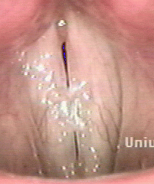
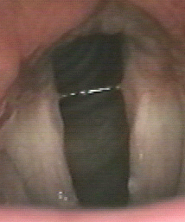
What are the vocal folds doing?
closed open
voiced voiceless

Slide 31
Voiced & Voiceless Consonants
Consonants either voiced or voiceless.
English pairs:
  b p v f d t
  z s ð θ ʃ ʒ tʃ dʒ

Slide 32
Describing Sounds

Slide 33
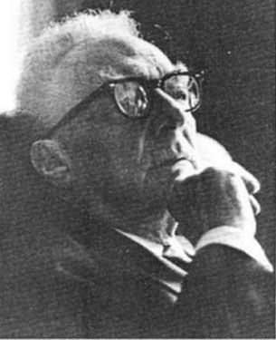
Features
Ways of describing sounds
e.g., [t] = voiceless, alveolar, stop
Stronger claim: features are the smallest building blocks of language, used to store sounds in the mind
Atoms of Speech
Roman Jakobson, 1896-1982

Slide 34
Features
Prediction: by combining a small number of atomic features, it should be possible to create a larger number of speech sounds
Goal: a set of universal features should make it possible to describe the speech sounds of all of the languages of the world
Different languages choose different feature combinations

Slide 35
ɹ

Slide 36
?
?
?
?
ɹ

Slide 37
?
?
“Fuji”
“Cuba”
?
ɹ

Slide 38
“año”
?
?
ɹ

Slide 39
“Bach”
“agua”
?
?
?
ɹ

Slide 40
?
?
ɹ
“caballo”

Slide 41
?
?
ɹ

Slide 42
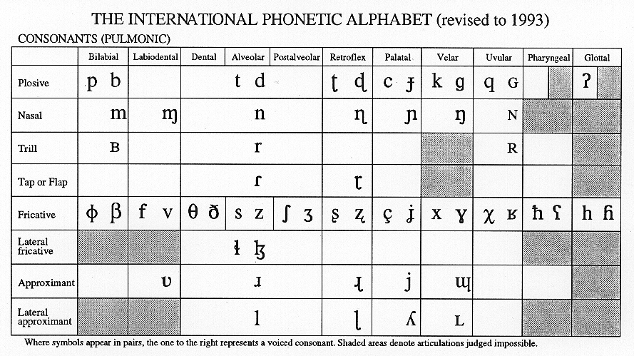
IPA full(er) chart

Slide 43
The parts we care about for this class
ñ
tʃ dʒ
w

Slide 44
Vowels

Slide 45
What can you do to alter the shape of your vocal tract?

Slide 46
Notes:
46

Slide 47

Notes:
47

Slide 48

Notes:
48

Slide 49
Notes:
49

Slide 50

Notes:
50

Slide 51
You can....
(1) Raise or lower your tongue
(2) Advance or retract your tongue
(3) Round or spread your lips
(4) Tense or not tense your mouth

Slide 52

So what vowels do you have?
i
“sheep, sleep”
ɪ
“ship, slip”

Slide 53


So what vowels do you have?
i
ɪ
“laid, spade, trade”
e
ɛ
“led, sped, tread”

Slide 54

So what vowels do you have?
i
ɪ
e
ɛ
“bat, lad”

Slide 55

So what vowels do you have?
i
“Luke, who’d, suit”
u
ɪ
ʊ
“look, hood, soot”
e
ɛ

Slide 56


So what vowels do you have?
i
u
ɪ
ʊ
“coat, wrote, hoed”
e
o
ɛ
“caught, wrought, hawed”

Slide 57

So what vowels do you have?
i
u
ɪ
ʊ
e
o
ɛ
ʌ
“cut, rut, hut”

Slide 58

So what vowels do you have?
i
u
ɪ
ʊ
e
o
ɛ
“bah, father, cot, Don”
ɑ

Slide 59

So what vowels do you have?
i
u
ɪ
ʊ
“metallic, Texas”
e
ə
o
ɛ
ʌ
ɑ

Slide 60
So here they are!
i
u
ɪ
ʊ
e
ə
o
ɛ
ʌ
ɑ

Slide 61
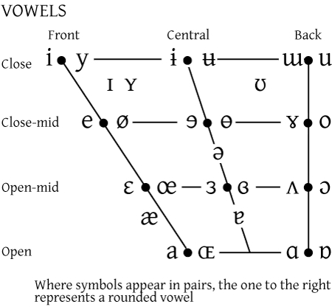
The full(er) vowel chart

Slide 62
The parts we care about for this class

Slide 63
Cross-language Differences
Feature Combinations
  English: back vowels are rounded, others are not
  German/French has high, front, rounded vowel [y]
  Russian has high back unrounded vowel [ɯ]
  Many languages don’t make the tense/lax distinction found in English (ex: Spanish [i], rather than [i] and [ɪ])
  Many languages distinguish short and long vowels (unlike English), ex: Japanese [i] vs. [i:]

Slide 64
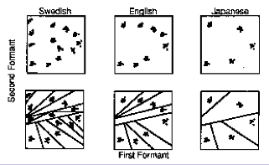
Cross-language Differences
Languages carve up the acoustic space in different ways. Children find these categories (called phonemes), based on the distributions of sounds they hear in their linguistic environment (using statistical learning).

Slide 65
Diphthongs: Two vowel-ish sounds together
a

Slide 66
Diphthongs: Two vowel-ish sounds together
“side, my, kind”
aj or aɪ

Slide 67
Diphthongs: Two vowel-ish sounds together
a

Slide 68
Diphthongs: Two vowel-ish sounds together
“loud, brow, hour”
aw or aʊ

Slide 69
Diphthongs: Two vowel-ish sounds together
ɔ

Slide 70
Diphthongs: Two vowel-ish sounds together
“boy, annoy, toil”
ɔj or ɔɪ

Slide 71
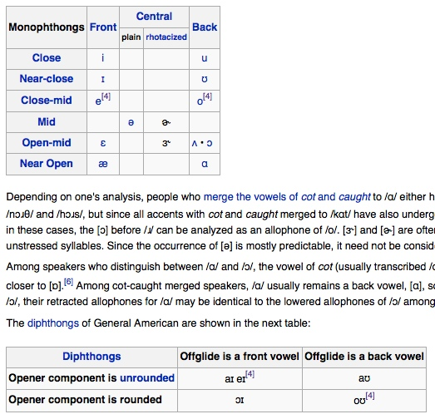
More details of American English pronunciation
http://en.wikipedia.org/wiki/General_American

Slide 72
Speech Production - Summary
Airflow set in vibration by vocal folds
Airflow modified by vocal tract
Consonants: narrowing or blocking of oral/nasal cavity
Vowels: shaping of oral cavity
Different languages choose different selections of these

Slide 73
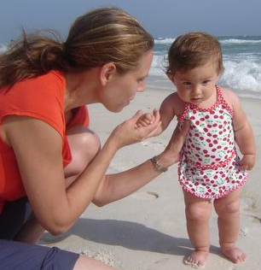
Speech Perception
Speech production processes must be undone by the ear
Motions of articulators must be reconstructed from patterns of air vibration
Requires extremely precise hearing, possibly a system specialized for hearing speech
Substantially developed at birth

Slide 74

Questions?
You should be able to do question 3 on HW2, and up through question 3 on the phonological review questions.
Notes:
74

