Slide 1
Psych 56L/ Ling 51:
Acquisition of Language
Lecture 3
Biological Bases of Language I
Notes:
1

Slide 2
Announcements
Review questions for biological bases of languages available
Be working on HW1 (due 1/24/13) – remember that collaboration is highly encouraged
Notes:
2

Slide 3

Language as a Human Universal
Notes:
3

Slide 4

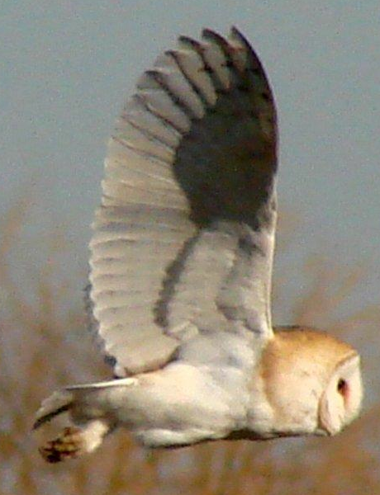

Language as a Human Instinct
Fish pretty much always swim.
Birds pretty much always fly.
Humans pretty much always….talk.
Notes:
4

Slide 5
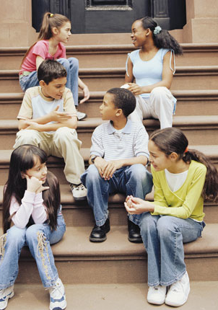
More than culture
Language is more than simply a cultural habit that one generation copies from previous ones.
If there is no language model to learn from, humans will spontaneously create language.
pigdins & creoles
the case of Nicaraguan Sign Language
Notes:
5

Slide 6
Pidgins
Pidgin: language created by adults from different language backgrounds who need to communicate with each other
Example:
Hawaiian Pidgin English: created by immigrant workers from Japan, Korea, and the Phillipines who worked for English speakers
Ifu laik meiki, mo beta make time, mani no kaen hapai.
If like make, more better die time, money no can carry.
“If you want to build (a temple), you should do it before you die - you can’t take it with you!”
(More than 100 pidgin languages currently in use)
Notes:
6

Slide 7
Creoles
Pidgins tend to be structurally simple (often just nouns and verbs).
However, when children born into a community where a pidgin is the only language acquire that pidgin as their native language, they create a creole.
Creoles are grammatically more complex, containing structures that are not in the pidgin language the children had as a model such as consistent word order, tense marking, and multi-clause sentences. Creoles often share the same features.
http://en.wikipedia.org/wiki/Syntactic_similarities_of_creoles#Syntactic_similarities
Put simply: children add something that wasn’t already there!
Notes:
7

Slide 8
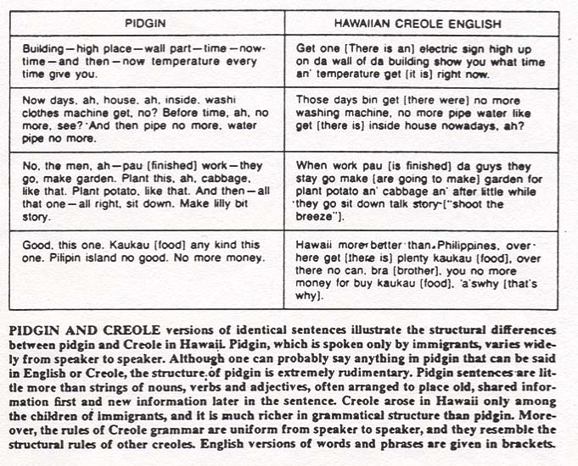
Derek Bickerton (Scientific American, July 1983)

Slide 9
Pidgins & Creoles
http://www.youtube.com/watch?v=O7X9AAeDCr4
A detailed look at the development of a pidgin in Hawaii
(start around 0:57)
http://www.youtube.com/watch?v=_VFXoqfoi6I
A detailed look at the development of a pidgin in Suriname

Slide 10
What creoles tell us
The existence of language in a community does not depend on someone importing a language for a community to learn. (Vocabulary may be borrowed, grammar seems not to be.)
When children acquire language, they sometimes add something extra, which is sometimes thought to be universal to human languages and part of children’s innate endowment for language.
Creoles tend to share the same features - which suggests human minds may tend to construct languages the same way.
Notes:
10

Slide 11
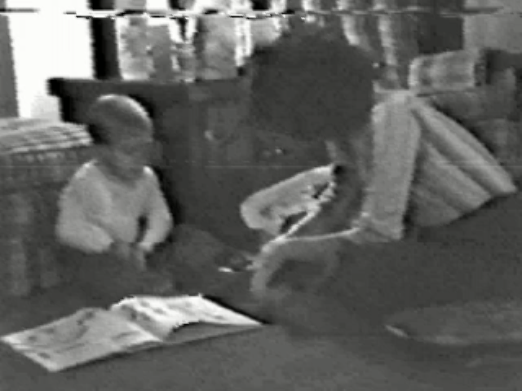
From pidgin to creole:
Nicaraguan Sign Language
In 1978, the Nicaraguan government opened the nation’s first public schools for the deaf. The deaf children who entered had no common sign language, but did have their own individual home sign systems.
Example English home signer:
http://goldin-meadow-lab.uchicago.edu/Images/shovel.mov
Notes:
11

Slide 12
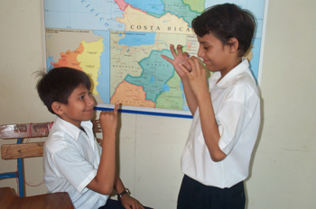
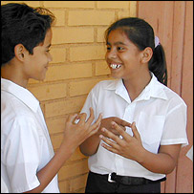
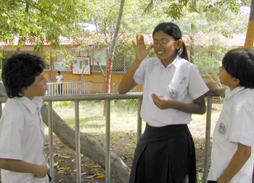
From pidgin to creole:
Nicaraguan Sign Language
Once the children were in contact with each other, a new common sign language emerged: Nicaraguan Sign Language.
http://www.pbs.org/wgbh/evolution/library/07/2/l_072_04.html

Slide 13
From pidgin to creole:
Nicaraguan Sign Language
Ann Senghas (Senghas & Coppola 2001) studied the language of children who arrived to the school at a young age vs. children who arrived when they were older.
Language of younger children: structurally complex (more like creole)
Language of older children: structurally simpler (more like pidgin)
Notes:
13

Slide 14
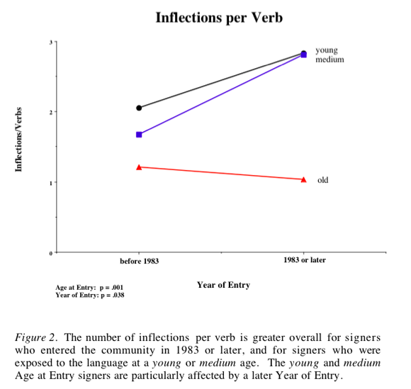
Inflection:
He likes me.
(as opposed to “he like me”)
Notes:
14

Slide 15
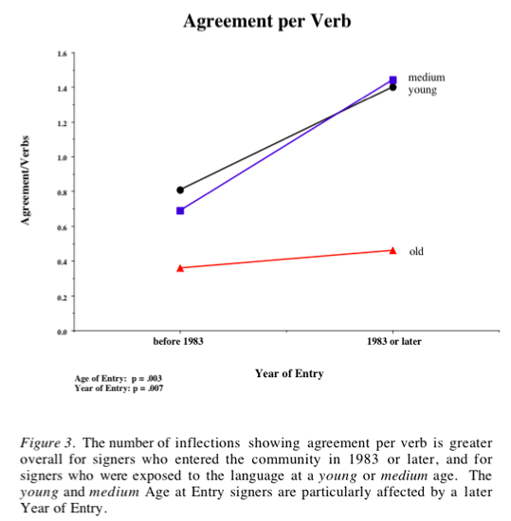
Agreement:
He is smiling.
(as opposed to “he are smiling”)
Notes:
15

Slide 16
From pidgin to creole:
Nicaraguan Sign Language
Use of spatial modification: if two signs are made in the same spatial location, it indicates that one sign modifies the other (ex: “tall” in same location as “king” = “tall king”
Language of younger children: more spatial modification (the younger they were, the more they used it)
Language of older children: less spatial modification
Notes:
16

Slide 17
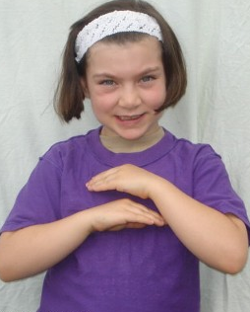
From pidgin to creole:
Nicaraguan Sign Language
Implication: (young) children are the driving force of language creation here; they are the innovators and the ones who retain the more complex structures that result from these innovations
Notes:
17

Slide 18

Language Bioprogram Hypothesis
Proposed by Derek Bickerton: the capacity for language creation seen in creolization and the development of NSL is the same capacity that underlies language acquisition.
Humans have an innate core knowledge about the structural properties human languages have.
(domain-specific knowledge)
In accord with the generativist approach to language acquisition.
Notes:
18

Slide 19
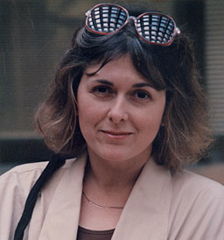
Language Bioprogram Hypothesis
Proposed by Derek Bickerton: the capacity for language creation seen in creolization and the development of NSL is the same capacity that underlies language acquisition.
But that “knowledge” may not be language-specific! It could be statistical learning or pattern analysis abilities.
(domain-general abilities)
Support for differences between children & adult responses, given inconsistent input: Hudson Kam & Newport (2005), Hudson Kam & Newport (2009)
Elizabeth Bates
Notes:
19

Slide 20
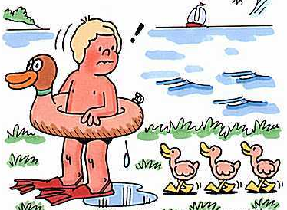
The Critical Period Hypothesis
Notes:
20

Slide 21
Critical & sensitive periods
“critical period for language” = biologically determined period during which language acquisition must occur in order for language to be learned fully and correctly
Other biologically determined deadlines:
- imprinting: chicks & ducklings follow first thing they see forever (it’s likely their mommy)
- visual cells in humans: if cells for both eyes don’t receive visual input during the first year or so of life, they lose the ability to respond to visual input
“sensitive period”: biologically determined period during which learning must occur for development to happen correctly, but development can still occur partially after this period
Notes:
21

Slide 22

Critical & sensitive periods
How do we test for a critical/sensitive period for language acquisition?
Notes:
22

Slide 23
Critical & sensitive periods
How do we test for a critical/sensitive period for language acquisition?
Ideal experiment: deprive children of all linguistic
input during the purported critical period and see
how language development occurs.
Problem: ideal experiment isn’t so ideal ethically or logistically
Notes:
23

Slide 24
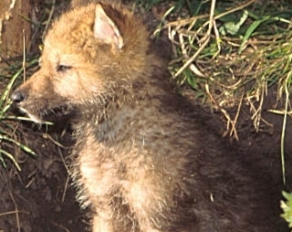
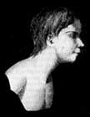
Critical & sensitive periods
How do we test for a critical/sensitive period for language acquisition?
Some historical cases that have unintentionally
provided lack of linguistic input to children:
“wild children”: like Victor of Aveyron
Problem: the lack of language may be due to other reasons
Notes:
24

Slide 25
Critical & sensitive periods
How do we test for a critical/sensitive period for language acquisition?
One success story for lack of linguistic input with a young child: Isabelle
1930s: 6-year-old Isabelle discovered hidden away in a dark room with a deaf-mute mother as her only contact.
She was taught to speak and by age 8, appeared to be normal. Potential implication: Isabelle discovered before critical period was over.
Notes:
25

Slide 26
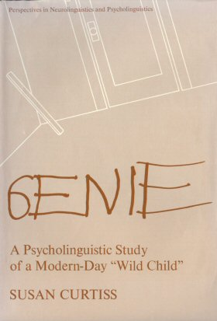


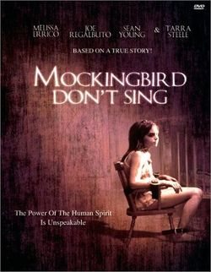
Critical & sensitive periods
How do we test for a critical/sensitive period for language acquisition?
A more thorough study: Genie
Notes:
26

Slide 27
Critical & sensitive periods
How do we test for a critical/sensitive period for language acquisition?
A more thorough study: Genie
1970s: 13-year-old Genie brought by her mother to social services after escaping mentally ill father; until mother’s escape, had no language input (and very horrific living conditions)
By age 17, she had a 5-year-old’s vocabulary, and could express meanings by combining words together.

Slide 28
Critical & sensitive periods
How do we test for a critical/sensitive period for language acquisition?
A more thorough study: Genie
However…syntactic skills lagged far behind - deficient in both production and comprehension.
“Mama wash hair in sink.” “Like go ride yellow school bus.”
“At school scratch face.” “Father take piece wood. Hit. Cry.”
“I want Curtiss play piano.” “Applesauce buy store”
“Man motorcycle have.” “Father hit Genie cry long time ago.”
Dichotic listening tasks showed language was a right-hemisphere activity for her (while it’s a left-hemisphere activity for most adults).
Notes:
28

Slide 29
Critical & sensitive periods
How do we test for a critical/sensitive period for language acquisition?
A more thorough study: Genie
Potential Implication: Genie discovered after critical period was over.
However, Genie may have had other cognitive disabilities…
Notes:
29

Slide 30
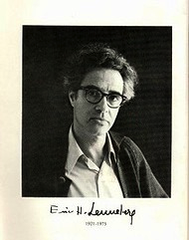
Critical & sensitive periods
How do we test for a critical/sensitive period for language acquisition?
Lenneberg (1967):
“the only safe conclusions to be drawn from the multitude of reports is life in dark closets, wolves’ dens, forests, or sadistic parents’ backyards is not conducive to good health or normal development”
Notes:
30

Slide 31
Critical & sensitive periods
How do we test for a critical/sensitive period for language acquisition?
Another study: Chelsea (Curtiss 1988)
Family background: A partially deaf woman incorrectly diagnosed as “retarded”. From a loving home.
Discovered at age 31, and fitted with hearing aids
Outcome: Learned a large vocabulary, but syntax and morphology worse than Genie.

Slide 32
Critical & sensitive periods
How do we test for a critical/sensitive period for language acquisition?
Another study: Chelsea (Curtiss 1988)
Sample speech from Chelsea:
  The small a the hat
  (2) Orange Tim car in
  (3) I Wanda be drive come
  (4) Breakfast eating girl
  (5) They are is car in the Tim

Slide 33
Critical & sensitive periods
How do we test for a critical/sensitive period for language acquisition?
Late acquisition of sign language (ASL): deaf-of-hearing children whose parents don’t know sign language. Children are eventually exposed to sign language when they encounter other deaf children.
Good: individuals have normal early childhood experience, except for lack of language input
Notes:
33

Slide 34
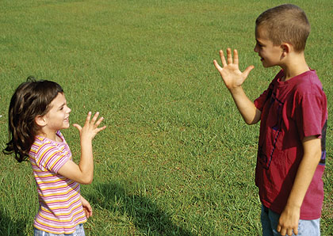
Critical & sensitive periods
How do we test for a critical/sensitive period for language acquisition?
If critical or sensitive period is true, children who learn from infancy should be better than children who learned later - this is what Newport (1990) found. Children who were 4-6 when first exposed were far superior in their sign language ability to children who were exposed after age 12.
Notes:
34

Slide 35
Critical & sensitive periods
How do we test for a critical/sensitive period for language acquisition?
Late acquisition of sign language (ASL): deaf-of-hearing children whose parents don’t know sign language. Children are eventually exposed to sign language when they encounter other deaf children.
Also important: not just about how long sign language speakers had known the language. Speakers who had been signing for more than 30 years showed this same difference: those exposed younger were far superior in their language skills to those exposed when they were older.
Notes:
35

Slide 36

Critical & sensitive periods
How do we test for a critical/sensitive period for language acquisition?
Look at second language learning.
Why? Children who learn a second language when they are young often become indistinguishable from their native-born peers.
Notes:
36

Slide 37
Critical & sensitive periods
How do we test for a critical/sensitive period for language acquisition?
Testing age differences in second language acquisition:
- Oyama (1976): testing Italian immigrants learning English
age of arrival was better predictor of accent than how many years the immigrant had been speaking English
- Oyama (1978): age of arrival was better predictor of comprehension than number of years speaking the language (not just about motor skill learning ability)
Notes:
37

Slide 38
Critical & sensitive periods
How do we test for a critical/sensitive period for language acquisition?
Testing age differences in second language acquisition:
Johnson & Newport (1989): testing grammatical competency of Chinese & Korean natives living in the US
Heard recorded voices speaking sentences, and had to judge whether they were correct or not.
“The farmer bought two pig at the market.”
“Tom is reading book in bathtub.”
Notes:
38

Slide 39
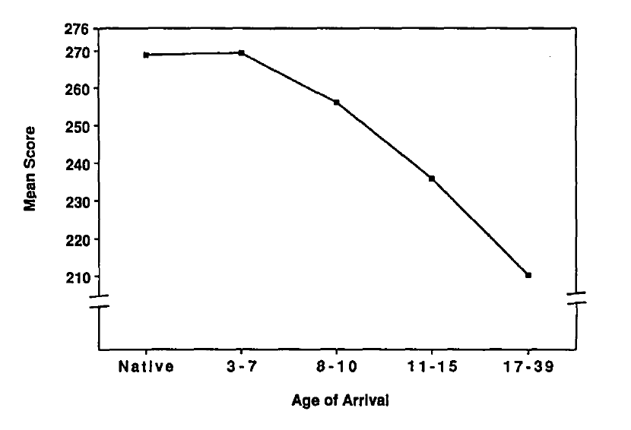
Second-language proficiency dependent on age of initial language exposure (even with same number of years of exposure total)

Slide 40
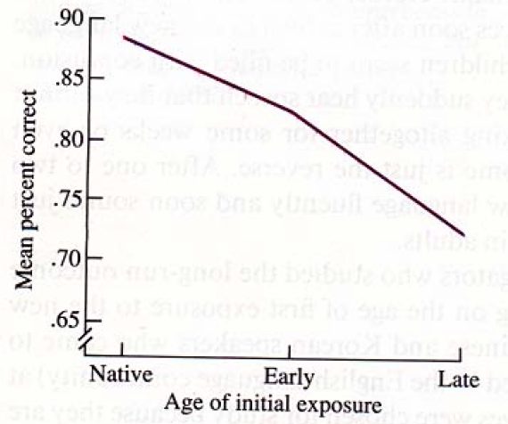
Second-language proficiency dependent on age of initial language exposure
Morphology:
e.g. verb agreement in production
Tom is/*are reading book in bathtub
(birth on)
(4-6 yrs on)
(12 yrs on)
Age of Initial Language Exposure
Notes:
40

Slide 41
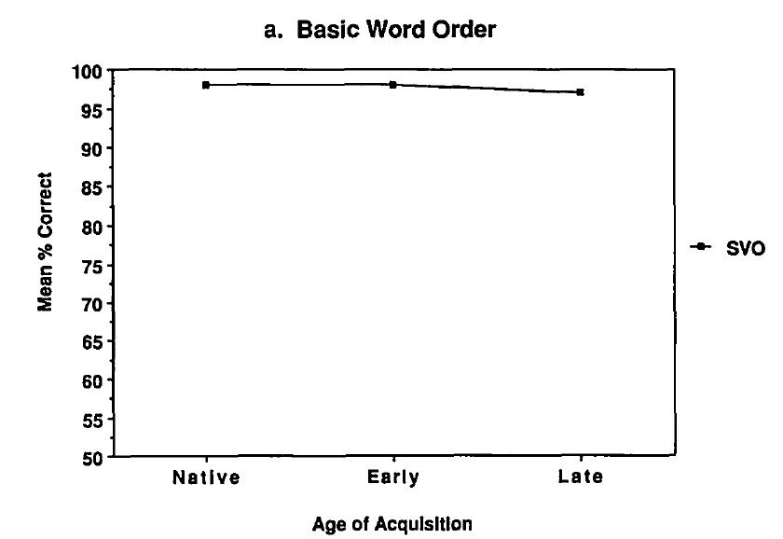
Second-language proficiency dependent on age of initial language exposure – but not all aspects are dependent
Basic word order: SVO
Subject Verb Object
Ex: “Penguins like fish.”
As opposed to
“Fish penguins like”
(Object Subject Verb)
birth on
(4-6 yrs on)
(12 yrs on)
Age of initial exposure

Slide 42
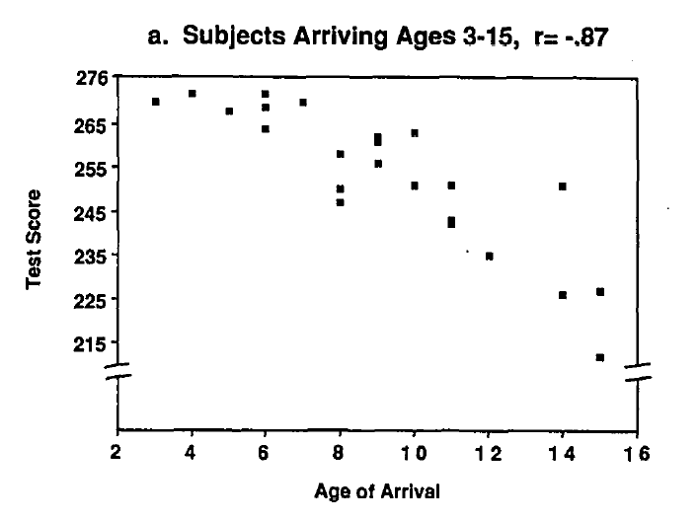
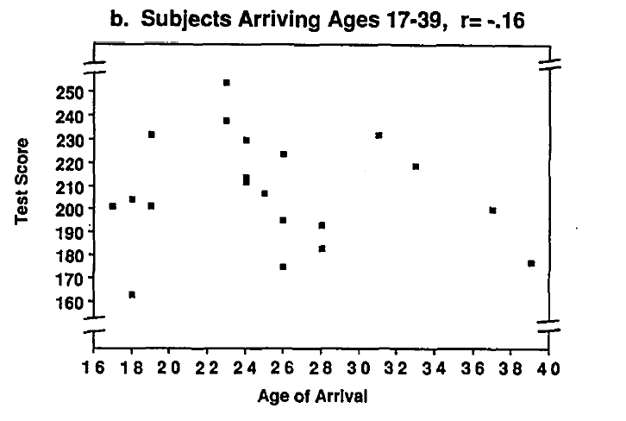
Before and after the critical/sensitive period (sometimes called “maturation”)
  During Maturation
  Decline in ability with maturation.
  After Maturation
  No relationship between Age of Arrival and Test Score

Slide 43
Some Evidence for Critical/Sensitive Period
Johnson & Newport also found that performance was not correlated with:
    Formal instruction in English
    Amount of initial exposure to English
    Reported motivation to learn English
    Self-consciousness in English
    Identification with American culture

Slide 44
Sum Up: Critical/Sensitive Period
Language learning is comparatively effortless before puberty, extremely effortful after
Applies to both first and second language learning
Applies to spoken and signed languages
Critical/sensitive periods similar to other biologically-programmed abilities in humans and other species

Slide 45
Critical vs. sensitive, revisited
If there is truly a critical period of language acquisition, people learning language after this period should not succeed very well at all (they should be equally bad). In contrast, people within the critical period should do very well (they should be equally native-like).
Expectation: discontinuous function of performance
critical period
language acquisition
performance
age
Notes:
45

Slide 46
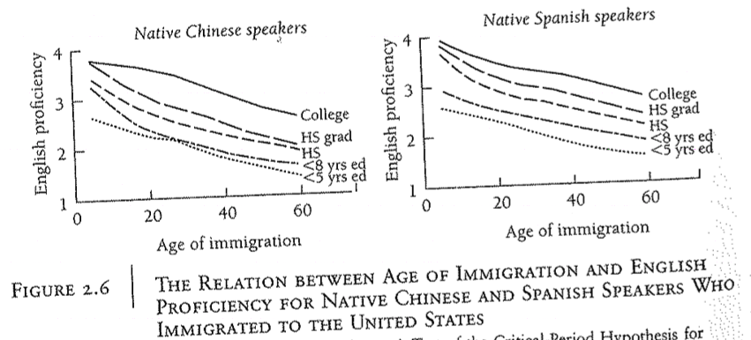
Critical vs. sensitive, revisited
However, most of the evidence we’ve seen (including the one below) suggests that there is a smoother drop-off. (support for sensitive period)
Hakuta, Bialystok, & Wiley 2003
Notes:
46

Slide 47
So why are younger children better?
“Less is more” hypothesis: Newport 1991
Children can remember less than adults (and have other cognitive limitations, like less attention). Perhaps language is actually easier to figure out if the input is limited to smaller chunks. Adults remember more and can store longer chunks, which makes their analytical task harder.
Studies supporting the idea that a limitation on the way children process input leads to better learning performance: Phillips & Pearl 2012, Pearl, Goldwater, & Steyvers 2011, Pearl, Goldwater, & Steyvers 2010, Pearl 2009, Pearl & Lidz 2009, Pearl 2008, Pearl & Weinberg 2007, Dresher 1999, Lightfoot 1999, Lightfoot 1991
Notes:
47

Slide 48
So why are younger children better?
Some experimental support for the utility of “Less is more” when learning a foreign language as an adult: Chin & Kersten (2010)
Adults learning French over two one-hour sessions
- full sentences vs. small phrases that incrementally increased length to full sentences (to simulate children’s steadily expanding processing abilities)
Adults learning incrementally outperformed adults learning from full sentences on language proficiency tests of vocabulary and grammar.

Slide 49
Recap
Evidence from pidgins & creoles, homesign, and Nicaraguan Sign Language suggest that language is something that human children can create even in the absence of language input.
The Language Biopogram Hypothesis suggests that this ability is due to children’s innate domain-specific knowledge about language.
There also appears to be a period during which language is acquired most easily - whether this is a critical period or sensitive period may vary depending on what specific linguistic knowledge we look at.
The “less is more” hypothesis is one idea for why children’s minds might be more suited to language learning than adults’ minds.

Slide 50
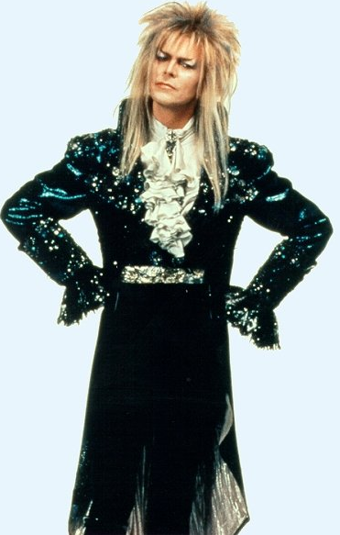
Questions?
You should be able to answer up through question 13 of the bio bases review sheet, and up through question 5 on HW1.
Notes:
50

