Slide 1
Psych 56L/ Ling 51:
Acquisition of Language
Lecture 11
Lexical Development III
Notes:
1

Slide 2
Announcements
Be working on HW2 (due 2/21/13)
- Note: Remember that working in a group can be very beneficial.
Be working on the lexical development review questions
Notes:
2

Slide 4
What does “gavagai” mean?
Gavagai!

Slide 5
What does “gavagai” mean?
Thumping
Rabbit?
Hopping
Mammal?
Scurrying
gray rabbit?
Animal?
Stay!
Carrot eater?
Look!
vegetarian?
Ears?
Meal!
Long ears?
Rabbit only until eaten!
Is it gray?
Cheeks and left ear!
Fluffy?
What a cutie!
That’s not a dog!

Slide 6
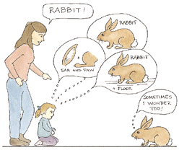
Same problem the child faces

Slide 7

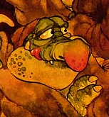

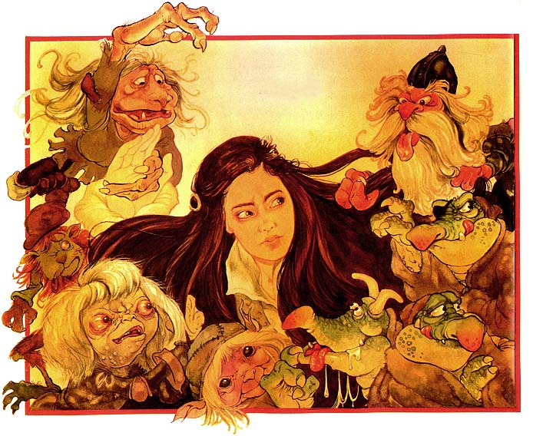
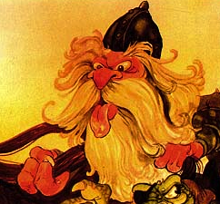

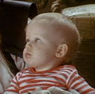
A little more context…
“Look! There’s a goblin!”
Goblin = ????
Notes:
7

Slide 8
The Mapping Problem
Even if something is explicitly labeled in the input (“Look! There’s a goblin!”), how does the child know what specifically that word refers to? (Is it the head? The feet? The staff? The combination of eyes and hands? Attached goblin parts?…)
Quine (1960): An infinite number of hypotheses about word meaning are possible given the input the child has. That is, the input underspecifies the word’s meaning.
Notes:
8

Slide 9
So how do children figure it out? Obviously, they do….

Slide 10
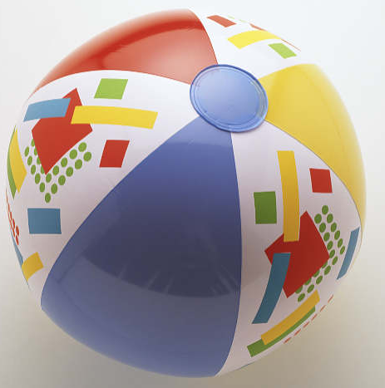
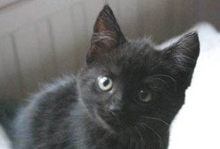

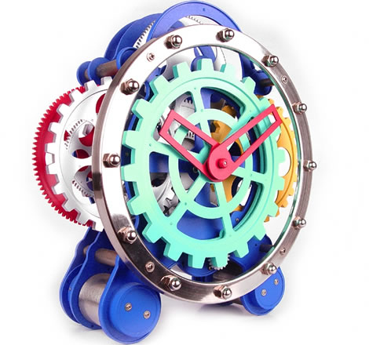
One solution: fast mapping
Children begin by making an initial fast mapping between a new word they hear and its likely meaning. They guess, and then modify the guess as more input comes in.
Experimental evidence of fast mapping
(Carey & Bartlett 1978, Dollaghan 1985, Mervis & Bertrand 1994, Medina, Snedecker,Trueswell, & Gleitman 2011)
ball
kitty
bear
[unknown]

Slide 11
One solution: fast mapping
Children begin by making an initial fast mapping between a new word they hear and its likely meaning. They guess, and then modify the guess as more input comes in.
Experimental evidence of fast mapping
(Carey & Bartlett 1978, Dollaghan 1985, Mervis & Bertrand 1994, Medina, Snedecker,Trueswell, & Gleitman 2011)
ball
“Can I have the ball?”
kitty
bear
[unknown]
Notes:
11

Slide 12
One solution: fast mapping
Children begin by making an initial fast mapping between a new word they hear and its likely meaning. They guess, and then modify the guess as more input comes in.
Experimental evidence of fast mapping
(Carey & Bartlett 1978, Dollaghan 1985, Mervis & Bertrand 1994, Medina, Snedecker,Trueswell, & Gleitman 2011)
ball
“Can I have the zib?”
kitty
bear
20 months
[unknown]
Notes:
12

Slide 13
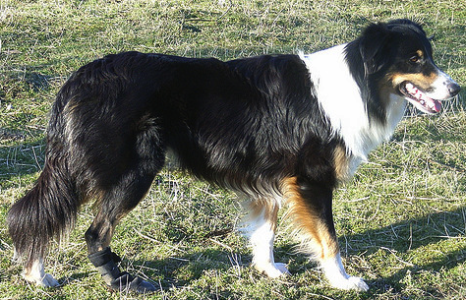
One solution: fast mapping
However, fast mapping is not something unique to humans. Other animals, such as dogs, are capable of doing this too.
Border collie fast mapping
[~6 minutes, up through 2:15 for demonstration of fast mapping]
(National Geographic video)
http://www.youtube.com/watch?v=D7Tyig9Azlk
[~4 minutes, up through 1:50 for demonstration of fast mapping]
(ABC News special)
http://www.youtube.com/watch?v=_6479QAJuz8

Slide 14
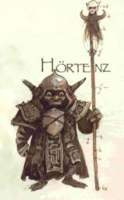
Knowing what to guess
Lexical constraints
Whole-object assumption: new word refers to entire object, rather than some subset of it
Goblin =
Notes:
14

Slide 15
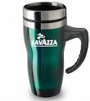
Knowing what to guess
Lexical constraints
Mutual-exclusivity assumption: assume new word does not overlap in meaning with known word (can be used to overcome whole-object assumption)
Handle = some part
of the cup
“Look! You can see the handle!”
Known: cup
Notes:
15

Slide 16

Knowing what to guess
Lexical constraints
Mutual-exclusivity assumption: assume new word does not overlap in meaning with known word (can be used to overcome whole-object assumption)…not without its own problems (overlapping labels for the same referent)
Siamese = ????
“Look at the kitty! He’s a siamese!”
Known: kitty
Notes:
16

Slide 17

Knowing what to guess
Social Cues
Speakers will look at the novel thing they’re talking about: assume new word refers to object of speaker’s gaze (children do this by 18 months – Baldwin 1991)
“Look at the siamese!”
Siamese = ????
Known as “kitty”
Notes:
17

Slide 18
Knowing what to guess
Social Cues
Speakers will look at the novel thing they’re talking about: assume new word refers to object of speaker’s gaze (children do this by 18 months – Baldwin 1991)
“Look at the siamese!”
Siamese = ????
Known as “kitty”
Notes:
18

Slide 19
Knowing what to guess
Social Cues
Speakers will look at the novel thing they’re talking about: assume new word refers to object of speaker’s gaze (children do this by 18 months – Baldwin 1991)
“Look at the siamese!”
Siamese = ????
Known as “kitty”
Notes:
19

Slide 20
Knowing what to guess
Social Cues
Speakers will look at the novel thing they’re talking about: assume new word refers to object of speaker’s gaze (children do this by 18 months – Baldwin 1991)
“Look at the siamese!”
Siamese = =
Known as “kitty”
Notes:
20

Slide 21
Knowing what to guess
Social Cues
Brooks & Meltzoff 2008 (the utility of social cues): 10-month-olds who follow the gaze of the speaker (and look longer at the target object) have faster vocabulary growth.
“Look at the siamese!”
Siamese = =
Known as “kitty”

Slide 22
Knowing what to guess
Clues from the input
Speakers generally talk to children about the here and now (Quine’s problem is not nearly so serious in child-directed speech)
“Look at the siamese!”
(Not “I just took her to the vet yesterday. Poor thing’s been sick all of last week.”)
Notes:
22

Slide 23
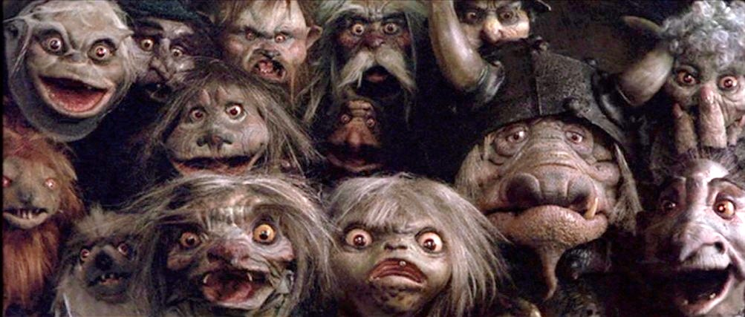
Knowing what to guess
Clues from the input
Speakers also sometimes provide explicit correction for meaning, and provide additional information about the word’s meaning.
“Can I see the bugs again?”
“Those are goblins, honey, not bugs. Goblins live in the Labyrinth and occasionally take naughty children away.”
Notes:
23

Slide 24
Carey & Bartlett 1978
Children can use input to figure out which aspect of their experience is being lexicalized
“What colors are these?”
Notes:
24

Slide 25
Carey & Bartlett 1978
Children can use input to figure out which aspect of their experience is being lexicalized
“red”
“yellow”
“green”
“green”
“blue”
Notes:
25

Slide 26
Carey & Bartlett 1978
Children can use input to figure out which aspect of their experience is being lexicalized
“a blue tray”
“a chromium tray”
Note: none of the children knew either the word “olive” as a color or the word “chromium” as a property
Notes:
26

Slide 27
Carey & Bartlett 1978
Children can use input to figure out which aspect of their experience is being lexicalized
“Bring me the chromium tray; not the blue one, the chromium one.”
Notes:
27

Slide 28
Carey & Bartlett 1978
Children can use input to figure out which aspect of their experience is being lexicalized
Children learned to give the olive tray.
Notes:
28

Slide 29
Carey & Bartlett 1978
Children can use input to figure out which aspect of their experience is being lexicalized
5 weeks later…
“What colors are these?”
Notes:
29

Slide 30
Carey & Bartlett 1978
Children can use input to figure out which aspect of their experience is being lexicalized
5 weeks later…
“red”
“yellow”
“green”
????
“blue”
Via input (contrast with blue), children figured out that “chromium” referred to a color the same way that blue does…
“I don’t know”
[other previously unused color term like “gray”]
Notes:
30

Slide 31
Carey & Bartlett 1978
Children can use input to figure out which aspect of their experience is being lexicalized
5 weeks later…
“red”
“yellow”
“green”
????
“blue”
…and also that the dark green-ish color had a different name from “green”
“I don’t know”
[other previously unused color term like “gray”]
Notes:
31

Slide 32
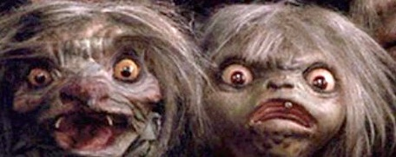
Knowing what to guess
Clues from the syntactic structure
Different grammatical categories (nouns, verb, etc.) tend to have different meanings. Once children have identified some grammatical categories (after ~14 months), they can use the syntactic structure (how words appear together) as a clue to meaning.
“Those are goblins.”
goblins = noun
nouns = objects
goblins =
Notes:
32

Slide 33
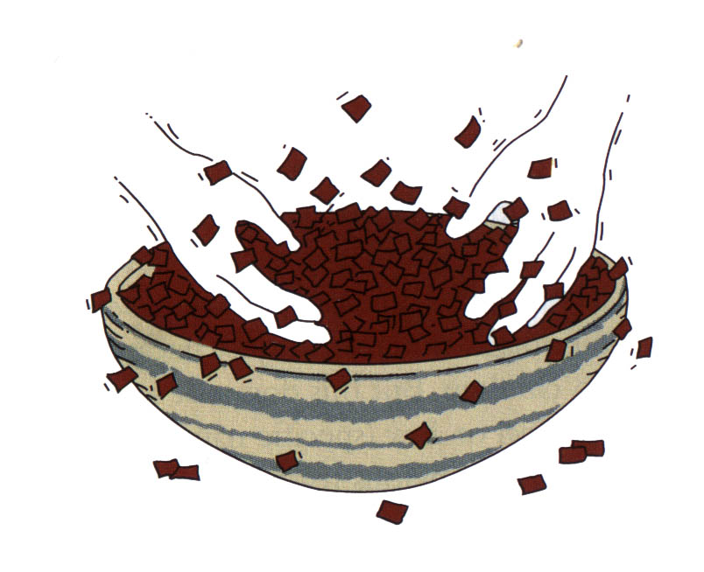
Knowing what to guess
Clues from the syntactic structure
He’s sebbing!
seb = verb
verb = action
seb
Brown, 1957

Slide 34
Knowing what to guess
Clues from the syntactic structure
Look – a seb!
seb = noun with “a”
noun = countable object like “bowl”
seb
Brown, 1957

Slide 35
Knowing what to guess
Clues from the syntactic structure
Look – some seb!
seb = noun with “some”
noun = mass substance like “stuff”
seb
Brown, 1957

Slide 36


Knowing what to guess
Clues from the syntactic structure
Experimental evidence with 4-year-olds (Gelman & Markman 1985)
“Find the fep one.”
Notes:
36

Slide 37
Knowing what to guess
Clues from the syntactic structure
Experimental evidence with 4-year-olds (Gelman & Markman 1985)
“Find the fep one.”
the__ one = adjective
adjective = property (like spotted)
fep =~ spotted
Notes:
37

Slide 38
Knowing what to guess
Clues from the syntactic structure
Experimental evidence with 4-year-olds (Gelman & Markman 1985)
“Find the fep one.”
the__ one = adjective
adjective = property (like spotted)
fep =~ spotted
Notes:
38

Slide 39
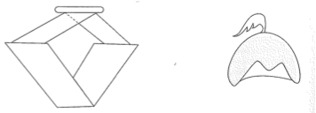
Knowing what to guess
Clues from the syntactic structure
Experimental evidence with 4-year-olds (Gelman & Markman 1985)
“Now find the zib.”
Notes:
39

Slide 40
Knowing what to guess
Clues from the syntactic structure
Experimental evidence with 4-year-olds (Gelman & Markman 1985)
“Now find the zib.”
the__ = noun
noun = object
zib =~ new object that’s more familiar
Notes:
40

Slide 41
Knowing what to guess
Clues from the syntactic structure
Experimental evidence with 4-year-olds (Gelman & Markman 1985)
“Now find the zib.”
the__ = noun
noun = object
zib =~ new object that’s more familiar
Notes:
41

Slide 42
Knowing what to guess
Syntactic Bootstrapping Hypothesis: primarily using the syntactic structure to get to meaning
Naigles (1990): 2-yr-olds can use syntactic structure to guess aspects of word meaning, even the difference between transitive and intransitive verbs
Transitive: The rabbit is gorping the duck.
(expectation: rabbit is doing something to the duck)
Intransitive: The rabbit and the duck are gorping.
(expectation: rabbit and duck doing actions separately)
Notes:
42

Slide 43
Knowing what to guess
Syntactic Bootstrapping Hypothesis: primarily using the syntactic structure to get to meaning
Gertner, Fisher, & Eisengart (2006): even before children are 2 years old, they know the subject of an English sentence should be the one doing the action (the agent)
Wugs hug blicks.
(expectation: the ones doing the hugging are wugs)

Slide 44
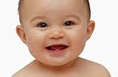
Knowing what to guess
Syntactic Bootstrapping Hypothesis: primarily using the syntactic structure to get to meaning
Gordon (2003): 10-month-old children are sensitive to the fact that events (which we indicate with verbs) have key participants (which correspond to subjects and objects in adult language). This is the precursor to realizing the mapping from sentence form to meaning.

Slide 45
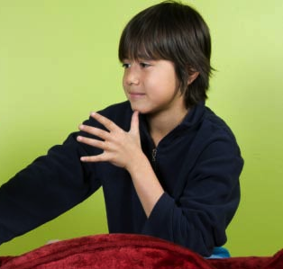
Knowing what to guess
Syntactic Bootstrapping Hypothesis: primarily using the syntactic structure to get to meaning
Goldin-Meadow & Mylander (1998): Children seem to naturally translate their prelinguistic understanding of events into linguistic structures. Studies of deaf children who are forced to create their own home-sign systems show that they systematically use syntactic position to signal semantic roles like agent.

Slide 46
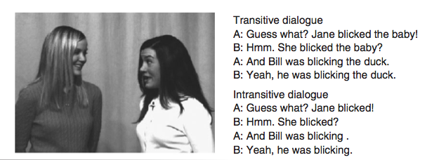
Knowing what to guess
Syntactic Bootstrapping Hypothesis: primarily using the syntactic structure to get to meaning
Yuan & Fisher (2009), Scott & Fisher (2009): 2-year-olds can keep track of the syntactic structures in which a verb appears and use that to infer a verb’s meaning.
Example verb: kiss
Example verb: sneeze

Slide 47
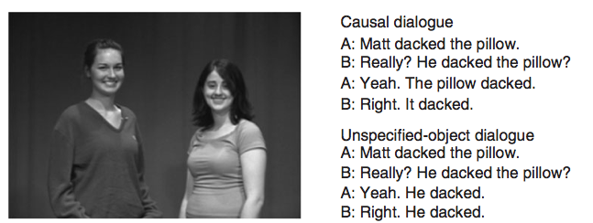
Knowing what to guess
Syntactic Bootstrapping Hypothesis: primarily using the syntactic structure to get to meaning
Yuan & Fisher (2009), Scott & Fisher (2009): 2-year-olds can keep track of the syntactic structures in which a verb appears and use that to infer a verb’s meaning.
Example verb: melt
Example verb: eat

Slide 48
Knowing what to guess
Syntactic Bootstrapping Hypothesis: primarily using the syntactic structure to get to meaning
Alishahi & Pyykkönen (2011): The ability to track and combine multiple contexts of a word and infer its meaning seems to work much better for verbs than for nouns, given realistic child-directed speech (the Brown corpus from the CHILDES database). A&P speculate that this may be because nouns are not as dependent on syntactic context in order to learn their meaning (for example, nouns may be observable objects).

Slide 49
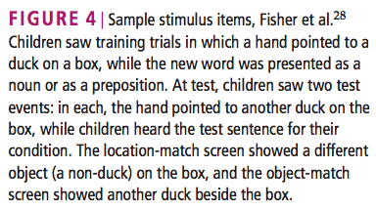
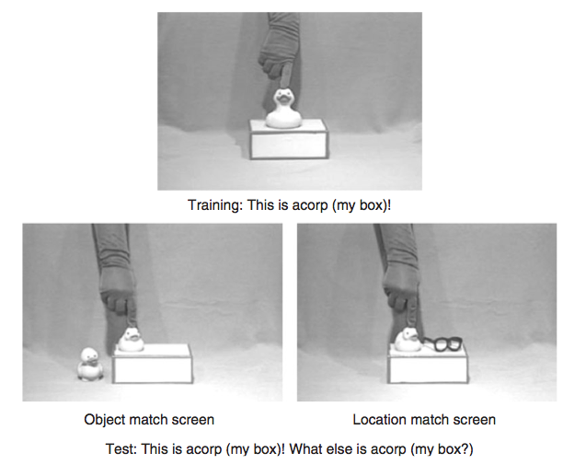
Knowing what to guess
Syntactic Bootstrapping Hypothesis: primarily using the syntactic structure to get to meaning
Fisher, Klingler, & Song (2006)
Noun context: This is acorp.

Slide 50
Knowing what to guess
Syntactic Bootstrapping Hypothesis: primarily using the syntactic structure to get to meaning
Fisher, Klingler, & Song (2006)
Preposition context: This is acorp my box.

Slide 51
Knowing what to guess
Syntactic Bootstrapping Hypothesis: primarily using the syntactic structure to get to meaning
Fisher, Klingler, & Song (2006)
At test, those trained with the noun-context (this is acorp) looked at the object match (inferred it was an object).

Slide 52
Knowing what to guess
Syntactic Bootstrapping Hypothesis: primarily using the syntactic structure to get to meaning
Fisher, Klingler, & Song (2006)
At test, those trained with the preposition-context (this is acorp my box) looked at the location match (inferred it was a relationship between objects).

Slide 53
Getting a sense of how a child might feel
From But n Ben A-Go-Go, Matthew Fitt (2000), p.85
But his hert cawed him on. He nou had the information he had been tryin tae jalouse on his ain aw these years. Or pairt o it onywey. A whusper. A hauf truth. An the time had come tae mak siccar. He would meet with Broon an tak fae him whit wis needed.
Some contextual clues available (syntactic bootstrapping + known words).

Slide 54
Getting a sense of how a child might feel
From But n Ben A-Go-Go, Matthew Fitt (2000), p.85
But his heart called him on. He now had the information he had been trying to jalouse on his ain all these years. Or part of it anyway. A whisper. A half truth. And the time had come to make siccar. He would meet with Broon and take fae him what was needed.
Add in knowledge of “near-words” that sound close to recognizable words.
Remaining: jalouse, ain, siccar, fae?

Slide 55
Getting a sense of how a child might feel
From But n Ben A-Go-Go, Matthew Fitt (2000), p.85
But his heart called him on. He now had the information he had been trying to jalouse on his own all these years. Or part of it anyway. A whisper. A half truth. And the time had come to make siccar. He would meet with Broon and take from him what was needed.
Guess common words by their position in the sentence (syntactic bootstrapping).
Still remaining: jalouse, siccar?
What are your guesses as to what these words mean? Why?

Slide 56
Lexical Development Recap
Children have to figure out what concept a word refers to. They may have different learning strategies they use when hearing a word for a first time, such as the whole-object assumption and mutual-exclusivity assumption. While these are helpful, they may lead to errors sometimes.
Children may benefit from a number of different sources of information, including social knowledge and knowledge of syntactic structure.
Notes:
56

Slide 57
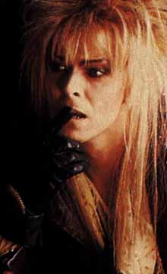
Questions?
You should be able to do all the questions on HW2 and all the review questions for lexical development.
Notes:
57

