Slide 1
Psych 56L/ Ling 51: Acquisition of Language
Lecture 1
Introduction

Slide 2
Administrivia
Instructor:
Lisa Pearl, Department of Cognitive Sciences
lpearl@uci.edu
http://www.socsci.uci.edu/~lpearl
Office Hours: Tuesdays 2:00-3:30pm in SBSG 2314

Slide 3
Administrivia
Teaching Assistants:
Lawrence Phillips
Department of Cognitive Sciences
lawphill@uci.edu
Office Hours: M & T 11am – 12:30pm
Location: SBSG 2221
Nicole Winter
Department of Cognitive Sciences
wintera@uci.edu
Office Hours: W 10am – 11:30am
Th 2:30pm – 4pm
Location: SSL 334C

Slide 4
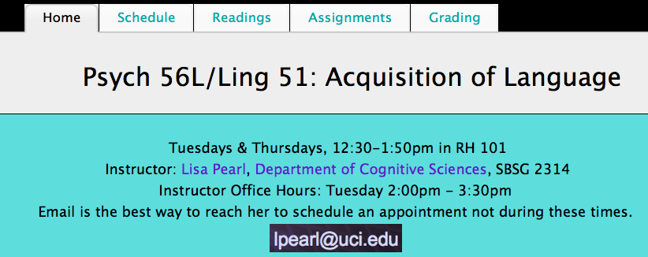
Administrivia
Class web page:
http://www.socsci.uci.edu/~lpearl/courses/psych56L_2013win/index.html
Accessible from EEE, as well. Contains overview, schedule, readings, course assignment descriptions, and grading policies.

Slide 5
Administrivia
Reference readings will be from “The Acquisition of Language” coursebook by Lisa Pearl, which contains selections from three different textbooks
along with a few other book excerpts, articles, and video links:

Slide 6
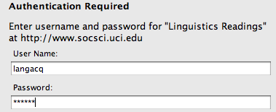
Administrivia
Some reference readings (usually articles) will require a username and password to access.
User Name = langacq
Password = models

Slide 7
Administrivia
Assignments
Homework:
Three throughout the quarter, available through EEE. Collaboration is allowed and highly encouraged. In fact, take a minute to introduce yourself to some people around you who might form a homework/study group with. You may turn in one assignment per group of collaborators – just make sure the names and student IDs of all the collaborators are included in it.

Slide 8
Administrivia
Assignments
Homework:
Late homework will be accepted according to the late policy listed in the assignments section on the class webpage. If you cannot turn in the homework on time, take advantage of the policy to get some credit for your assignment. Seriously.

Slide 9
Administrivia
Exams
Midterm exam:
There will be an online midterm exam on 2/07/13, available through EEE. It will cover the material in weeks 1-4. Review questions will be available for each topic covered in class, and there will be a midterm review in class 2/05/13. Midterm exam questions will come from the homeworks and the review questions.
The midterm exam will be open-note, but non-collaborative.
If you are found collaborating with other classmates during the midterm exam, you will receive a 0.
For details of the online exam policy and procedure, see the course webpage. We will also go over these during the midterm review.

Slide 10
Administrivia
Exams
Final exam:
There will be an online final exam on 3/22/13, available through EEE. It will cover the material in weeks 1-10, with a strong focus on the material in weeks 6 - 10. Review questions will be available for each topic covered in class, and there will be a final exam review in class on 3/14/13. Exam questions will come from the homeworks and the review questions.
The final exam will be open-note, but non-collaborative.
If you are found collaborating with other classmates during the final exam, you will receive a 0.
For details of the online exam policy and procedure, see the course webpage. We will also go over these during the final review.

Slide 11
Administrivia
Grades
Homework: 50%
Midterm Exam: 20%
Final Exam: 30%
Your grades will be determined by approximately this scale:
96.50-100.00: A+ 83.50-86.49: B …
93.50-96.49: A 80.00-83.49: B-
90.00-93.49: A- 76.50-79.99: C+
86.50-89.99: B+ 73.50-76.49: C

Slide 12
Administrivia
Extra Credit
You can earn up to 3 percentage points of extra credit three ways. (See the class web page under the “assignments” tab for more details.)
Participate as a human subject in a language science experiment webgame (30 items = half a percentage point).
Participate as a human subject in social science experiments for up to 3 hours (half an hour = half a percentage point).
(3) Write a four page paper about a topic in language acquisition.

Slide 13
Administrivia
Schedule
“This is our wonderfully ambitious schedule. We’ll attempt to keep with it, but it is subject to modification.”
Topics:
Intro to Language Learning (1/8 – 1/10) [2]
Biological Bases of Language (1/15 – 1/22) [3]
Sounds (1/24 – 1/31) [3]
Words (2/12 – 2/19) [3]
Sentences (2/21 – 2/28) [3]
Language & Cognition (3/5 – 3/7) [2]
Language in Special Populations (3/12) [1]

Slide 14
What is language?
A language is a system of signals, such as voice sounds, gestures or written symbols, that encode or decode information.
Human languages are usually referred to as natural languages, and the science of studying them is linguistics.
The term "animal languages" is often used for non-human languages. Most researchers agree that these are not as complex or expressive as human language; they may better be described as animal communication. Some researchers argue that there are significant differences separating human language from the communication of other animals, and that the underlying principles are unrelated.

Slide 15
Knowledge of Language
It’s so natural for us to produce and comprehend language that we often don’t think about what an accomplishment this is.
Or how we learned language
in the first place.

Slide 16
“The Linguistic Genius of Babies”
http://www.ted.com/talks/patricia_kuhl_the_linguistic_genius_of_babies.html
(up through 10:07)

Slide 17
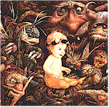
About Language
Language is a complex system of knowledge that all children learn by listening to native speakers in their surrounding environment.
It includes sound structure, word structure, word meaning, sentence structure, mapping from sentence structure to meaning, unspoken rules of conversation…
Notes:
17

Slide 18
About Language
Language is a complex system of knowledge that all children learn by listening to native speakers in their surrounding environment.
It includes sound structure, word structure, word meaning, sentence structure, mapping from sentence structure to meaning, unspoken rules of conversation…
Stress pattern
go blins
Individual sounds (in IPA)
Notes:
18

Slide 19
About Language
Language is a complex system of knowledge that all children learn by listening to native speakers in their surrounding environment.
It includes sound structure, word structure, word meaning, sentence structure, mapping from sentence structure to meaning, unspoken rules of conversation…
goblin (plural) = goblin + s
go blins
Notes:
19

Slide 20
About Language
Language is a complex system of knowledge that all children learn by listening to native speakers in their surrounding environment.
It includes sound structure, word structure, word meaning, sentence structure, mapping from sentence structure to meaning, unspoken rules of conversation…
goblins
goblin (plural) = goblin + s
go blins
Notes:
20

Slide 21
About Language
Language is a complex system of knowledge that all children learn by listening to native speakers in their surrounding environment.
It includes sound structure, word structure, word meaning, sentence structure, mapping from sentence structure to meaning, unspoken rules of conversation…
Goblins like children.
goblins
goblin (plural) = goblin + s
go blins
Notes:
21

Slide 22
About Language
Language is a complex system of knowledge that all children learn by listening to native speakers in their surrounding environment.
It includes sound structure, word structure, word meaning, sentence structure, mapping from sentence structure to meaning, unspoken rules of conversation…
Don’t goblins like children?
Goblins like children.
goblins
goblin (plural) = goblin + s
go blins
Notes:
22

Slide 23
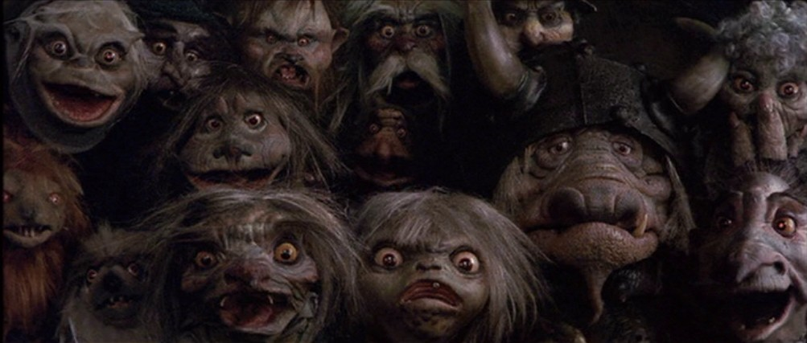
Some Terminology
Phonology: sounds and sound system of the language
Lexicon & Lexical Semantics: Words and associated knowledge (word forms, word meanings, etc.)
Morphology: system for combining units of meaning together (goblin + [plural] = goblins)
go blins
goblins =
(not koblins)
Notes:
23

Slide 24
Some Terminology
Syntax: system for combining words into sentences
Pragmatics: knowledge of language use
Goblins like children.
Don’t goblins like children? = surprise if the answer is ‘no’
(expectation is that the answer is ‘yes’)
Use this question format to show expectation of a ‘yes’ answer.
Notes:
24

Slide 25
Kids Do Amazing Things
Much of the linguistic system is already known by age 3.
…when kids can’t tie their own shoes
or reliably recognize “4”.
What kids are doing: extracting patterns and making generalizations from the surrounding data mostly without explicit instruction.
Terminology: Patterns or “rules” of language = grammar
Notes:
25

Slide 26
How do we know they’re not only imitating or being taught?
Imitation certainly is useful for learning some aspects of language, such as learning that the sequence of sounds “cat” refers to a furry, purring pet.
However, children can’t learn how to understand and produce full sentences by imitating what they hear and repeating it word for word.
Why not?
One reason: Most sentences are novel – you understand and produce them on the fly, and may never have heard them before.

Slide 27
How do we know they’re not only imitating or being taught?
Also, it turns out that children are bad at imitating sentences where they don’t know some of the words (so how could they learn those words by imitating them?):
“The cat is hungry” becomes “Cat hungry.”
In addition, children don’t often repeat word-for-word what adults around them say.

Slide 28
How do we know they’re not only imitating or being taught?
(From Martin Braine)
Child: Want other one spoon, Daddy.
Father: You mean, you want the other spoon.
Child: Yes, I want other one spoon, please Daddy.
Father: Can you say “the other spoon”?
Child: Other…one…spoon.
Father: Say “other”.
Child: Other.
Father: “Spoon.”
Child: Spoon.
Father: “Other spoon.”
Child: Other…spoon. Now give me other one spoon?
Notes:
28

Slide 29
How do we know they’re not only imitating or being taught?
It’s also unlikely children learn by being explicitly taught. This is because once we go beyond the most superficial things (like “cat” is a furry, purring pet), most of our knowledge is subconscious. We know it – but we don’t know how we know it or why it’s so.

Slide 30
Knowledge of Language & Hidden Rules
Some examples from language:
You know that…
…strop is a possible word of English, while stvop isn’t.

Slide 31
Knowledge of Language & Hidden Rules
Some examples from language:
You know that…
…to ask about “Jack” in the sentence
“You think that Jack did it”,
you can’t ask it this way:
“Who do you think that did it?”
(Instead: “Who do you think did it?”)

Slide 32
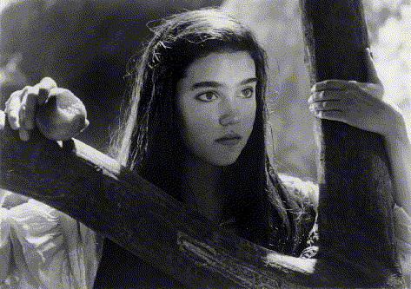
Knowledge of Language & Hidden Rules
Some examples from language:
You know that…
…In “She ate the peach while Sarah was reading”, she ≠Sarah
but she can be Sarah in all of these:
Sarah ate the peach while she was reading.
While she was reading, Sarah ate the peach.
While Sarah was reading, she ate the peach.

Slide 33
Knowledge of Language & Hidden Rules
Some examples from language:
You know that…
…the ‘s’ in ‘cats’ sounds different from the ‘s’ in goblins
cats: ‘s’ = /s/
goblins: ‘s’ = /z/

Slide 34
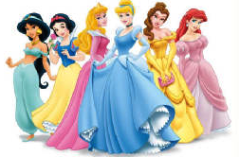
Knowledge of Language & Hidden Rules
Some examples from language:
You know that…
… contracted forms like “wanna” and “gonna” can’t always replace their respective full forms “want to” and “going to”.
You get to choose who you will rescue.
“Who do you want to rescue?”
“Who do you wanna rescue?”
You get to choose who will do the rescuing.
“Who do you want to do the rescuing?”
* “Who do you wanna do the rescuing?”

Slide 35
Knowledge of Language & Hidden Rules
Some examples from language:
You know that…
… contracted forms like “wanna” and “gonna” can’t always replace their respective full forms “want to” and “going to”.
You get to choose who you will rescue.
“Who do you want to rescue?”
“Who do you wanna rescue?”
You get to choose who will do the rescuing.
“Who do you want to do the rescuing?”
* “Who do you wanna do the rescuing?”

Slide 36
Knowledge of Language & Hidden Rules
Some examples from language:
You know that…
… contracted forms like “wanna” and “gonna” can’t always replace their respective full forms “want to” and “going to”.
You get to choose who you will rescue.
“Who are you going to rescue?”
“Who are you gonna rescue?”
“I’m going to the witch’s lair to rescue her.”
* “I’m gonna the witch’s lair to rescue her.”

Slide 37
Knowledge of Language & Hidden Rules
Some examples from language:
You know that…
… contracted forms like “wanna” and “gonna” can’t always replace their respective full forms “want to” and “going to”.
You get to choose who you will rescue.
“Who are you going to rescue?”
“Who are you gonna rescue?”
“I’m going to the witch’s lair to rescue her.”
* “I’m gonna the witch’s lair to rescue her.”

Slide 38
What about learning by explicit correction?
Even if the knowledge is subconscious, couldn’t parents teach children these rules of language by explicitly correcting them when they say something wrong?

Slide 39
What about learning by explicit correction?
Even if the knowledge is subconscious, couldn’t parents teach children these rules of language by explicitly correcting them when they say something wrong?
The problem: parents don’t correct their children that often about the form of the language. Instead, they tend to correct when the meaning is incorrect.
Child: “Her curl my hair.”
Parent: “Uh huh.”
Child: “There’s an animal farmhouse.”
Parent: “No, that’s a lighthouse.”

Slide 40
What about learning by implicit correction?
Parents may provide implicit correction by offering alternative language forms when a child has said something incorrect. In effect, the parents provide a good example of language use for children without explicitly correcting them. This is called a recast.
Child: The dog runned really fast, Daddy.
Parent: Yeah, he ran really fast, didn’t he?

Slide 41
What about learning by implicit correction?
However, parents don’t provide recasts all the time or all that consistently. One study looking at interactions between 2-year-olds and their mothers showed that they only made recasts after 26.3% of incorrect sentences. The rest of the time, they didn’t bother.
Also, sometimes parents will repeat children’s incorrect utterances if they agree with the meaning of them! This would seem to reinforce the incorrect language usage.
Child: Read book.
Mother: Alright, you read book.
(instead of read the book)

Slide 42
What about learning by implicit correction?
Still, recasts can be very helpful when they offer a direct and immediate contrast between the child’s way of saying something and the correct way. Saxton et al. (1998) found that children learned more quickly when they were given recasts.
Recasts may help speed up learning, but probably aren’t responsible for learning all knowledge about language.

Slide 43
About the Input
Properties of motherese (speech adults use with children):
(1) very few grammatical errors (good example of correct grammar usage)
(2) topics are about the here and now (easier to link words to meanings)
(3) adults tend to use gestures to secure children’s attention (easier to link words to meanings)

Slide 44
About the Input
Properties of motherese (speech adults use with children):
(4) speech is repetitious (easier to remember when you have a short attention span)
(5) adults will often expand children’s utterances (learning how to convey the meaning they want by example)
“Milk.” “You want some milk?”

Slide 45
About the Input
Properties of motherese (speech adults use with children):
(6) prosodic features are exaggerated, and pauses tend to occur at phrase boundaries (helping to identify how words cluster together into larger units like phrases)
“The brave older sister (pause) went to rescue (pause) her little baby brother Toby.”
“The brave older sister” = noun phrase
“her little baby brother Toby” = noun phrase
Noun phrase indicator: Can replace with pronoun
“The brave older sister” = she
“her little baby brother Toby” = him

Slide 46
About the Input
While motherese can’t solve all language acquisition problems, this doesn’t mean that it and explicit language instruction aren’t good things.
Children who attend day care centers with more one-on-one contact with an adult acquire language more rapidly than children who get less one-on-one adult contact (Hoff 2006).
Older children (who receive all of their parents’ child-directed speech) generally develop language earlier than later-born children (who have to share it with their siblings) (Hoff-Ginsberg 1998).

Slide 47
About the Input
While motherese can’t solve all language acquisition problems, this doesn’t mean that it and explicit language instruction aren’t good things.
21-month-olds learn new words better from child-directed speech, as compared to adult-directed speech (Ma et al. 2011).
Experimental evidence: children who practiced wh-questions learned to produce those wh-questions better (Valian & Lyman 2003).

Slide 48
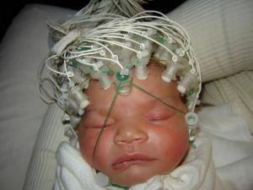
About the Input
Motherese can also help jumpstart the language parts of the brain (Beauchemin, Gonzalez-Frankenberger, Tremblay, Vannasing, Martinez-Montes, Belin, Beland, Francoeur, Carceller, Wallois, and Lassonde. 2010. Mother and Stranger: An Electrophysiological Study of Voice Processing in Newborns.)
Just 24 hours after birth, the sound of a mother’s voice specifically activates the language processing and motor circuits of the brain (moreso even than another female voice).

Slide 49
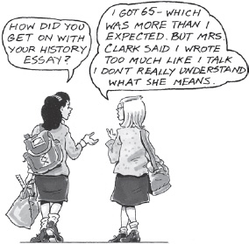
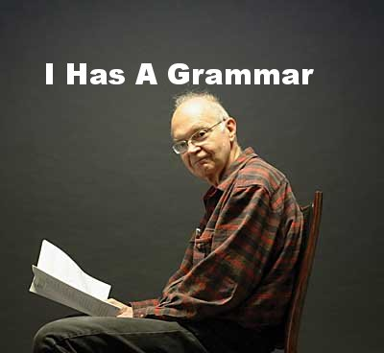
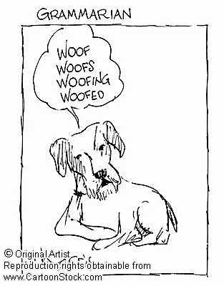
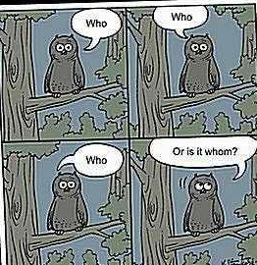
What’s being learned:
Patterns or “rules” of language = grammar

Slide 50
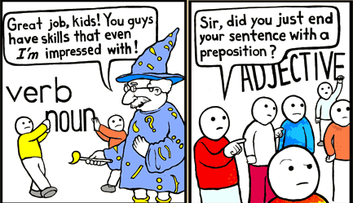
A distinction: Prescriptive vs. Descriptive Grammar Rules
Prescriptive: what you have to be taught in school, what is prescribed by some higher “authority”. You don’t learn this just by listening to native speakers talk.
“Don’t end a sentence with a preposition.”
“ ‘Ain’t’ is not a word.”

Slide 51
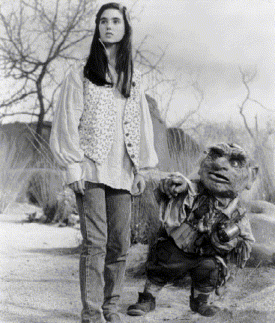
A distinction: Prescriptive vs. Descriptive Grammar Rules
Descriptive: what you pick up from being a native speaker of the language, how people actually speak in their day-to-day interactions. You don’t have to be explicitly taught to follow these rules.
The dwarf is who Sarah first talked with.
“You’re horrible!” “No, I ain’t - I’m Hoggle!”

Slide 52
Possible objections to a mental rule set
“Why should I believe I store a set of rules unconsciously in my mind? I just understand sentences because they make sense.”

Slide 53
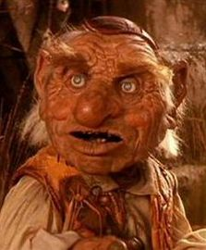
Possible objections to a mental rule set
“Why should I believe I store a set of rules unconsciously in my mind? I just understand sentences because they make sense.”
But why do some sentences make sense and others don’t?
Hoggle has two jewels.
*Two Hoggle jewels has.

Slide 54
Possible objections to a mental rule set
Why can we recognize patterns even when some of the words are unknown?
‘Twas brillig, and the slithy toves
did gyre and gimble in the wabe...

Slide 55
Possible objections to an unconscious rule set
“When I talk, the talk just comes out - I’m not consulting any rule set.”

Slide 56
Possible objections to an unconscious rule set
“When I talk, the talk just comes out - I’m not consulting any rule set.”
Analogy: wiggling your fingers
When you want to wiggle your fingers, you “just wiggle them”.
But your finger-wiggling intention was turned into commands sent by your brain to your muscles, and you’re never conscious of the process unless something interferes with it. Nonetheless, there is a process, even if you’re not aware of it.

Slide 57
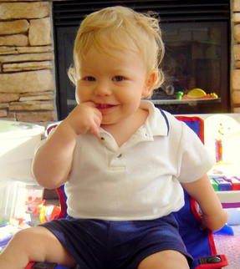
Timeline of Language Development: Year 1
phonology
vocal play
canonical
babbling
lexicon
recognition of
own name
first word
grammar

Slide 58
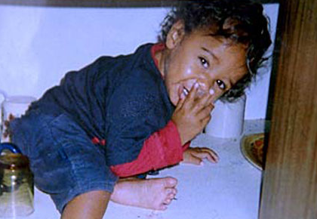
Timeline of Language Development: Year 2
phonology
reorganization
& consolidation of sound system
lexicon
50 word productive vocabulary
vocabulary “spurt”
grammar
first word combinations

Slide 59
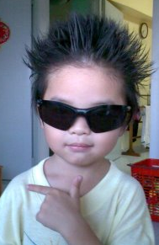
Timeline of Language Development: Year 3-3.5
phonology
lexicon
500 word productive vocabulary
increasing length of word combinations
adding grammatical morphemes
grammar
complex multi-clause utterances
negatives and questions

Slide 60
Why study language development?
The big picture, theoretically speaking:
“Cognitive scientists now agree that it is necessary to understand how the mind works in order to explain human behavior, but they do not agree on how the mind works. The study of language acquisition still plays a central role in the debate over how to characterize human cognition, for the same reason that language acquisition played a central role in the cognitive revolution. That is, it is so difficult to explain how language acquisition is possible that accounting for language acquisition is a test not likely to be passed by inaccurate cognitive theories.” – Hoff (2008), p.8

Slide 61
Why study language development?
More on the big picture:
“…there is the challenge of explaining why language has the particular properties that it does (the problem of language design) and how those properties emerge so reliably in the course of early childhood (the problem of language acquisition). It is the search for answers to these two problems that makes work in linguistics central to the larger enterprise of cognitive science.” – O’Grady (2012)

Slide 62
Why study language development?
More practically speaking, applications of language development research:
(1) Understanding how normal language development proceeds so that we can help children who have problems with their language development (language pathology)
(2) Understanding how learning more than one language works, and how to best teach children who are learning multiple languages simultaneously (language pedagogy)

Slide 63
The Interaction of theory & practice
These two areas aren’t always separate - insights from one can help understanding in the other.
Example: Research on children with autism
(Tager-Flusberg, 1994, 2007)
Autistic children have severe communicative deficiencies. However, they still acquire language structure.
Implication: Learning language involves more than learning how to fulfill a need to communicate.
What this means: applied language development research influences understanding of the process of language development

Slide 64
Recap: Big picture
Knowledge of language includes knowledge of many different systems.
Our language knowledge consists of many implicit rules (which we call a grammar), which means we probably can’t explicitly teach children these rules.
Children do get some help on what the correct forms are by listening to motherese and recasts in the input.
In language acquisition, we care about the acquisition of descriptive rather than prescriptive rules of grammar.
Studying language development can help us understand cognition in general, as well as issues in language pathology and language pedagogy.

Slide 65
Questions?
Recommendation: Start looking over the review questions and HW1 (due 1/24/13). You should be able to do up through 9 on the introductory review questions and up through 2 on HW1.

