Slide 1
Psych 56L/ Ling 51: Acquisition of Language
Lecture 14
Development of Complex Syntax

Slide 2
Announcements
HW 3 is due 3/1 (next Tuesday)
Be working on review questions for syntax and morphology
Reminder: No class on Thursday 3/3

Slide 3
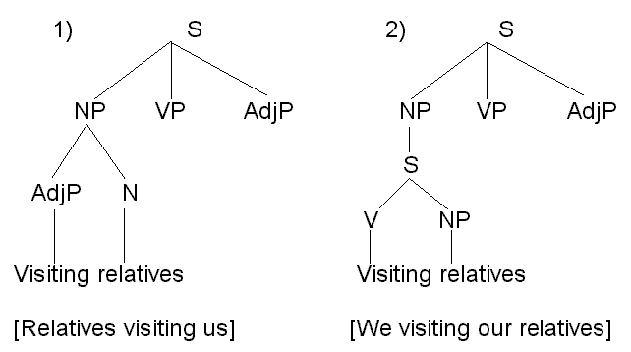
What sentences mean

Slide 4
Passives
Passives are tricky because the subject of the sentence is the “undergoer” of the action (rather than the “doer” as it is in active sentences).
Active sentence:
Sarah saved Tobey.
Subject Verb Object
Passive equivalent:
Tobey was saved by Sarah.
Subject Verb
semantically “light” verb
doer “by” phrase

Slide 5
Passives
Children usually start producing passives when they are three years old.
Some example passives & the ages when they were produced:
“Do you think the flower’s supposed to be picked by somebody?” (2;10)
“So it can’t be cleaned?” (3;2)
“I don’t want the bird to get eated.” (3;7)
“She brought her inside so she won’t get all stinked up by the skunk.” (4;1)

Slide 6
Passives
In fact, children seem to over-produce passives, applying a “passive” rule to verbs that (some) adults wouldn’t make passive.
Passive rule =~ be/get + VERB + en/ed
Some example over-produced passives:
“…they won’t get staled.” (3;6)
“The tiger will come and eat David and then he will be died.” (4;0)
“I want these pancakes to be sugared.” (4;2)
“Why is the laundry place stayed open all night?” (4;3)

Slide 7
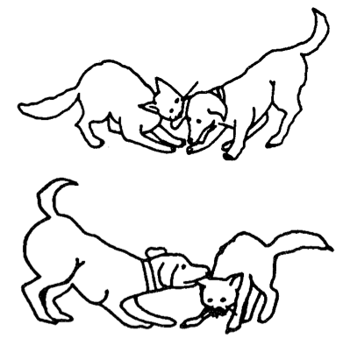
Passives
Still, despite producing passives spontaneously, children seem to have persistent trouble understanding passive sentences.
Standard comprehension task:
Which of these pictures shows
“The dog is bitten by the cat”?
Children under age five usually do very poorly on these tasks, getting less than 50% right (worse than guessing)! Part of the trouble is that they can’t use world knowledge to help figure it out.

Slide 8
Passives
Eventually, children learn to notice the more subtle signals that of a passive sentence – the light verb, the participle (-en/-ed) ending, and sometimes the “doer” by phrase.
Standard comprehension task:
Which of these pictures shows
“The dog is bitten by the cat”?
But it does take awhile…

Slide 9
Silent Things
Some sentences allow other sentences inside of them:
We know something.
We know children eventually acquire language.
Here, the sentence “children eventually acquire language” acts like the direct object of the verb know.

Slide 10
Silent Things
Sometimes, certain verbs will allow partial or incomplete sentences to follow them:
The girl tried to save her brother.
The king hopes to win the game.
The goblins wanted to keep the boy.
The dwarf decided to help the girl.

Slide 11
Silent Things
Sometimes, certain verbs will allow partial or incomplete sentences to follow them:
Implied Subject
The girl tried to save her brother.
The king hopes to win the game.
The goblins wanted to keep the boy.
The dwarf decided to help the girl.
the girl
the king
the goblins
the dwarf
The subject of the embedded clause (the sentence following the main verb) is implied, not overtly stated.

Slide 12
More complicated silent things
Sometimes there is more than one potential noun phrase that could act as the implied subject of the embedded clause:
Jareth told Hoggle to give the peach to Sarah.
Who’s giving the peach – Jareth or Hoggle?
Hoggle promised Jareth that he would.
Who would – Jareth or Hoggle?

Slide 13
More complicated silent things
Sometimes there is more than one potential noun phrase that could act as the implied subject of the embedded clause:
Jareth told Hoggle to give the peach to Sarah.
Who’s giving the peach – Jareth or Hoggle?
Adults say: Hoggle (Object of main clause)
Hoggle promised Jareth that he would.
Who would – Jareth or Hoggle?
Adults say: Hoggle (Subject of main clause)

Slide 14
More complicated silent things
How do we test what kids think?
Carol Chomsky (1969): testing 5 to 10-year-old children
After making sure children understood the meaning of promise, she asked them to act out sentences like the following:
“Bozo tells Donald to hop up and down. Make him do it.”
Who’s hopping? Adults: Donald
“Bozo promises Donald to hop up and down. Make him do it.”
Who’s hopping? Adults: Bozo

Slide 15
More complicated silent things
How do we test what kids think?
Carol Chomsky (1969): testing 5 to 10-year-old children
After making sure children understood the meaning of promise, she asked them to act out sentences like the following:
“Bozo tells Donald to hop up and down. Make him do it.”
Who’s hopping? Adults: Donald
Kids: Donald
“Bozo promises Donald to hop up and down. Make him do it.”
Who’s hopping? Adults: Bozo
Kids: Donald
Initial child strategy: Pick nearest potential subject.

Slide 16
More complicated silent things
How do we test what kids think?
Kids must eventually learn that promise does not behave like tell – the implied subject of the embedded clause is the subject of the main clause, not the object of the main clause. They may learn this through repeated exposures to promise.
“Bozo tells Donald to hop up and down. Make him do it.”
Who’s hopping? Adults: Donald
Kids: Donald
“Bozo promises Donald to hop up and down. Make him do it.”
Who’s hopping? Adults: Bozo
Kids: Donald
Bozo!

Slide 17
More complicated silent things
Sentences that have both an implied subject and implied object.
The girl is eager to see .
Who/what is doing the seeing (subject of see)?
Who/what is being seen (object of see)?

Slide 18
More complicated silent things
Sentences that have both an implied subject and implied object.
The girl is eager to see .
Who/what is doing the seeing (subject of see)?
The girl.
Who/what is being seen (object of see)?

Slide 19
More complicated silent things
Sentences that have both an implied subject and implied object.
The girl is eager to see .
Who/what is doing the seeing (subject of see)?
The girl.
Who/what is being seen (object of see)?
Something unspecified.

Slide 20
More complicated silent things
Sentences that have both an implied subject and implied object.
The girl is eager to see .
Who/what is doing the seeing (subject of see)?
The girl.
Who/what is being seen (object of see)?
Something unspecified.
This sentence means approximately something like
“The girl is eager to see (something).”

Slide 21
More complicated silent things
Sentences that have both an implied subject and implied object.
The girl is easy to see .
Who/what is doing the seeing (subject of see)?
Who/what is being seen (object of see)?

Slide 22
More complicated silent things
Sentences that have both an implied subject and implied object.
The girl is easy to see .
Who/what is doing the seeing (subject of see)?
Who/what is being seen (object of see)?
The girl.

Slide 23
More complicated silent things
Sentences that have both an implied subject and implied object.
The girl is easy to see .
Who/what is doing the seeing (subject of see)?
Someone not mentioned.
Who/what is being seen (object of see)?
The girl.

Slide 24
More complicated silent things
Sentences that have both an implied subject and implied object.
The girl is easy to see .
Who/what is doing the seeing (subject of see)?
Someone not mentioned.
This sentence means the same thing as
“It is easy (for someone) to see the girl.”
Who/what is being seen (object of see)?
The girl.

Slide 25
More complicated silent things
Sentences that have both an implied subject and implied object.
The girl is easy to see .
How can we tell what children’s interpretations are for these kinds of sentences?

Slide 26
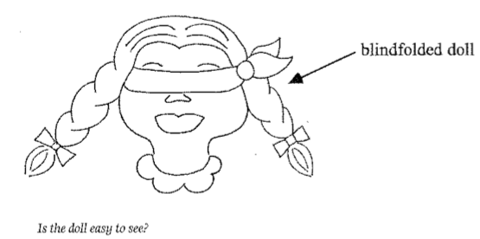
More complicated silent things
Carol Chomsky (1969)
“Is the doll easy to see?”
Adults say yes, since the doll is in plain sight. What do children say?

Slide 27
More complicated silent things
Carol Chomsky (1969)
“Is the doll easy to see?”
Some say yes:
Ann C. (8;8): “Easy”
Experimenter: “Could you make her hard to see?”
Ann C: “In the dark.”

Slide 28
More complicated silent things
Carol Chomsky (1969)
“Is the doll easy to see?”
However, more than a third say no.
Eric (5;2): “Hard to see.”
Experimenter: “Will you make her easy to see?”
Eric: “Okay.” (He removes the blindfold.)

Slide 29
More complicated silent things
Carol Chomsky (1969)
“Is the doll easy to see?”
Child misinterpretation:
“Is the doll easy to see ?”
(Mis)Interpretation: “Is it easy for the doll to see (something)?”

Slide 30
More complicated silent things
Carol Chomsky (1969)
“Is the doll easy to see?”
Child misinterpretation:
“Is the doll easy to see ?”
Children probably need more exposure to these kinds of constructions (is easy to, is hard to, …) in order to learn the correct interpretation.

Slide 31
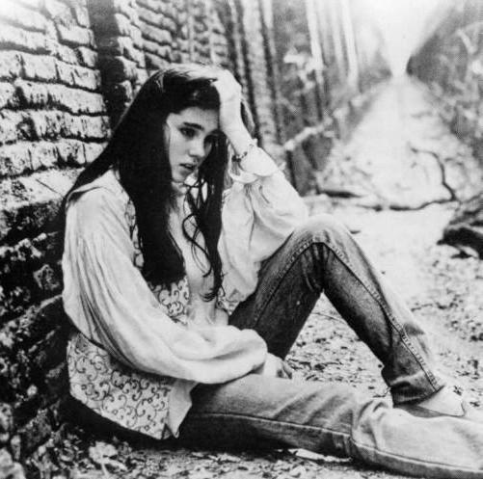
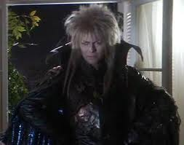
Pronouns
Pronouns are energy-saving devices that allow us to refer to someone or something (whose identity we know) without using a name (like “Sarah” or “Jareth”) or other noun phrase (like “the girl” or “a very impressive goblin king”).
Sarah though that she could save her brother.
Jareth was surprised the girl summoned him, and resolved to show her he was a very impressive goblin king.

Slide 32
Pronouns
Young children seem to know how to use pronouns – they like to use them if a preceding noun has already established what they refer to.
Imitation task results with 2 ½ and 3-year-old children (Lust 1981):
Experimenter says a sentence with two names:
“Because Sam was thirsty, Sam drank some soda.”
Child replaces second name with a pronoun:
“Because Sam was thirsty, he drank some soda.”

Slide 33
Pronouns
Young children seem to know how to use pronouns – they like to use them if a preceding noun has already established what they refer to.
Imitation task results with 2 ½ and 3-year-old children (Lust 1981):
Experimenter says a sentence with a pronoun before a name:
“Because he was thirsty, Sam drank some soda.”
Child replaces name and pronoun so name comes first:
“Because Sam was thirsty, he drank some soda.”

Slide 34
Trickier Pronouns
Reflexive pronouns have different forms than “plain” pronouns
myself me, I herself she, her
yourself you itself it
himself he, him ourselves we, us
themselves they, them

Slide 35
Trickier Pronouns
Reflexive pronouns behave differently than “plain” pronouns: they are interpreted differently
Jareth thought that Hoggle tricked himself.
= Jareth thought that Hoggle tricked Hoggle.
Jareth thought that Hoggle tricked him.
= Jareth thought that Hoggle tricked Jareth.

Slide 36
Trickier Pronouns
Reflexive pronouns behave differently than “plain” pronouns: they are interpreted differently
Jareth thought that Hoggle tricked himself.
= Jareth thought that Hoggle tricked Hoggle.
Jareth thought that Hoggle tricked him.
= Jareth thought that Hoggle tricked Jareth.

Slide 37
Trickier Pronouns
Reflexive pronouns behave differently than “plain” pronouns: they are interpreted differently
Jareth thought that Hoggle tricked himself.
Jareth thought that Hoggle tricked him.
Rule: Reflexive pronouns must refer to a noun phrase inside the same clause while regular pronouns must not.
must refer to NP in same clause
must not refer to NP in same clause, but can refer to NP in different clause

Slide 38
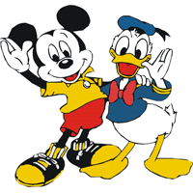
Trickier Pronouns
How can we test when children learn this distinction?
Act-Out Task:
“Donald thinks that Mickey Mouse scratched himself. Show me what Mickey did.”
“Donald thinks that Mickey Mouse scratched him. Show me what Mickey did.”

Slide 39
Trickier Pronouns
How can we test when children learn this distinction?
Act-Out Task:
“Donald thinks that Mickey Mouse scratched himself. Show me what Mickey did.”
(Action: Mickey scratches Mickey)
“Donald thinks that Mickey Mouse scratched him. Show me what Mickey did.”
(Action: Mickey scratches Donald)

Slide 40
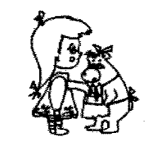
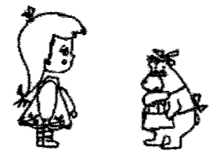
Trickier Pronouns
How can we test when children learn this distinction?
Comprehension Task (Chien & Wexler 1990):
“Here’s a picture of Mama Bear and Goldilocks.”
or
“Is Mama Bear touching her?”
Children who understand plain pronouns will answer
YES
NO

Slide 41
Trickier Pronouns
How can we test when children learn this distinction?
Comprehension Task (Chien & Wexler 1990):
“Here’s a picture of Mama Bear and Goldilocks.”
or
“Is Mama Bear touching herself?”
Children who understand reflexive pronouns will answer
NO
YES

Slide 42
Trickier Pronouns
Children between the ages of 3 and 5 years old often do fairly well on the interpretation of reflexive pronouns.
“Here’s a picture of Mama Bear and Goldilocks.”
or
“Is Mama Bear touching herself?”
NO
YES

Slide 43
Trickier Pronouns
However, these same children seem to have trouble with plain pronouns – they’ll interpret them as reflexive.
“Here’s a picture of Mama Bear and Goldilocks.”
or
“Is Mama Bear touching her?”
NO
YES

Slide 44
Trickier Pronouns
Interestingly, even though children mistakenly interpret plain pronouns as reflexive, they don’t seem to make this mistake in their own productions.
Bloom et al. (1991): Looking at 100,000 spontaneous utterances of three children, beginning at age 2.
me and myself were used correctly 95% of the time.
This suggests that children know the distinction between some reflexive and plain pronouns (as evidenced in their own productions), but they have trouble making this distinction for the pronouns tested in the experiments. Perhaps the experiments aren’t good at really getting at children’s knowledge? (Conroy et al 2009: previous results due to experimental artifact)

Slide 45
Trickier Pronouns
Evidence for incomplete knowledge? Children do seem to have trouble using plain pronouns in ways that make it easy to understand what these pronouns refer to.
An excerpt from a four-year-old’s description of a picture:
“…she’s sitting on the seat airplane…she’s giving something to a girl, now she’s looking at a book…now she’s putting the thing up high.”
So what’s the problem with this description?

Slide 46
Trickier Pronouns
Evidence for incomplete knowledge? Children do seem to have trouble using plain pronouns in ways that make it easy to understand what these pronouns refer to.
An excerpt from a four-year-old’s description of a picture:
“…she’s sitting on the seat airplane…she’s giving something to a girl, now she’s looking at a book…now she’s putting the thing up high.”
So what’s the problem with this description? The first she refers to a girl and the second she refers to a woman. This would be a bit strange for an adult to say, unless there was some indication that the second she is different (perhaps by pointing at the new referent).

Slide 47
Quantifiers
Quantifiers are words that express quantities, like a, some, every, none, and most.
When two (or more) quantifiers are in a sentence, they interact semantically to determine the sentence’s meaning.
Everyone saw a movie last night.

Slide 48
Quantifiers
Quantifiers are words that express quantities, like a, some, every, none, and most.
When two (or more) quantifiers are in a sentence, they interact semantically to determine the sentence’s meaning.
Everyone saw a movie last night.
every >> a:
For every person p, that person saw a movie m.
Compatible with this situation:
Lisa watched Labyrinth, Joseph watched Troy, and Benjamin watched Serenity.

Slide 49
Quantifiers
Quantifiers are words that express quantities, like a, some, every, none, and most.
When two (or more) quantifiers are in a sentence, they interact semantically to determine the sentence’s meaning.
Everyone saw a movie last night.
a >> every:
For a movie m, every person saw m.
Compatible with this situation:
Lisa, Joseph, and Benjamin watched Labyrinth.

Slide 50
Quantifiers
Quantifiers are words that express quantities, like a, some, every, none, and most.
When two (or more) quantifiers are in a sentence, they interact semantically to determine the sentence’s meaning.
Someone teases everyone. (Don’t let it get you down!)

Slide 51
Quantifiers
Quantifiers are words that express quantities, like a, some, every, none, and most.
When two (or more) quantifiers are in a sentence, they interact semantically to determine the sentence’s meaning.
Someone teases everyone. (Don’t let it get you down!)
some >> every:
For some person p, p teases every (other) person.
Compatible with this situation:
Jareth teases Sarah, Jareth teases Hoggle, and Jareth teases Ludo.

Slide 52
Quantifiers
Quantifiers are words that express quantities, like a, some, every, none, and most.
When two (or more) quantifiers are in a sentence, they interact semantically to determine the sentence’s meaning.
Someone teases everyone. (Don’t let it get you down!)
every >> some:
For every person p, some (other) person p’ teases them.
Compatible with this situation:
Jareth teases Hoggle, Sarah teases Sir Didymus, and Hoggle teases Sarah.

Slide 53
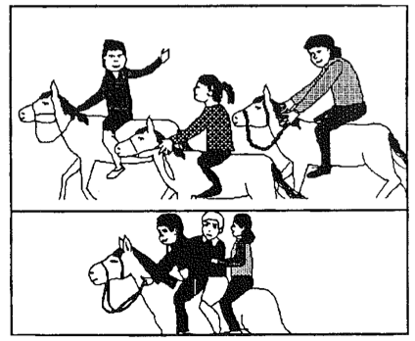
Quantifiers
Testing children: Picture task (Roeper & DeVilliers 1991)
“Is every child riding a horse?”
every >> a
a >> every
Children as young as three answer “yes”, showing they understand either interpretation.

Slide 54
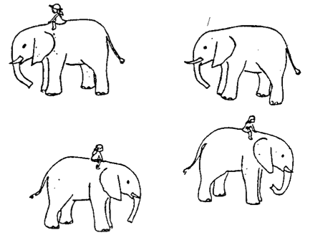
Quantifiers
However, children seem to have trouble sometimes (Philip 1991)
“Is every girl riding an elephant?”
every >> a

Slide 55
Quantifiers
However, children seem to have trouble sometimes (Philip 1991)
“Is every girl riding an elephant?”
every >> a
Children answer “no” – and say that this is not true because there is one elephant not being ridden!
Potential issue: Children are much more sensitive to the context of a question. It’s somewhat strange to ask about something that’s obvious from the picture – like whether each girl is riding an elephant.

Slide 56
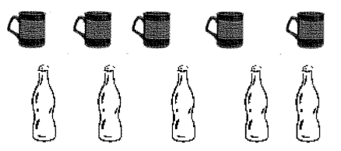
Quantifiers
A more context-friendly setup (Crain et al. 1996)
Story: A mother talks with her two daughters about whether they should drink soda or hot cider after skiing. The girls express a preference for soda, but are persuaded by their mother’s example to have cider.
“Did every skier drink a cup of apple cider?”
(Not apparent from the picture what happened – children have to recall from the story what happened.)

Slide 57
Quantifiers
Crain et al. 1996: Children between the ages of three and five years old responded “yes” (just like adults would). This suggests that young children’s previous issues with interpreting these kinds of questions stems from an issue in the experimental setup. Specifically, children are sensitive to the pragmatics of asking a question (don’t ask if it’s obvious). If a question violates this rule, children search for an alternative meaning for the question.
“Did every skier drink a cup of apple cider?”
(Not apparent from the picture what happened – children have to recall from the story what happened.)

Slide 58
Recap
Children must learn to interpret sentences that contain constructions that can be difficult to interpret just by using simple strategies, such as passives and sentences with implied subjects and implied objects.
Pronouns can also be difficult, since there are different rules of interpretation for plain pronouns and reflexive pronouns.
Quantifiers are also more difficult since they can interact with each other to form the interpretation of a sentence. In many cases, the meaning of the sentence is ambiguous since more than one interpretation is possible.
Sometimes, the errors children make seem to reflect a genuine lack of knowledge. Other times, they may be due to experimental design, rather than an actual lack of knowledge.

Slide 59
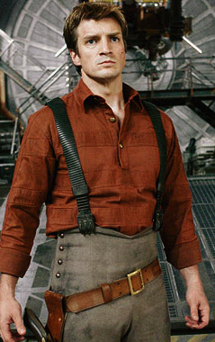
Questions?
You should be able to do all the review questions for morphology & syntax, and answer all the questions for HW3.

