Slide 1
Psych 156A/ Ling 150:
Acquisition of Language II
Lecture 8
Word Meaning 1

Slide 2
Announcements
Pick up your HW1 if you haven’t yet
Review questions available for word meaning
Be working on HW2 (due 5/15/12)
- Note: Remember that working in a group can be very beneficial.
Midterm review in class on 5/3/12
Midterm exam during class on 5/8/12
Notes:
2

Slide 4
What does “gavagai” mean?
Gavagai!

Slide 5

What does “gavagai” mean?
Thumping
Rabbit?
Hopping
Mammal?
Scurrying
gray rabbit?
Animal?
Stay!
Carrot eater?
Look!
vegetarian?
Ears?
Meal!
Long ears?
Rabbit only until eaten!
Is it gray?
Cheeks and left ear!
Fluffy?
What a cutie!
That’s not a dog!

Slide 6
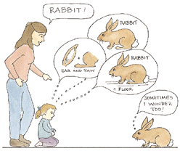
Same problem the child faces

Slide 7

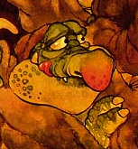

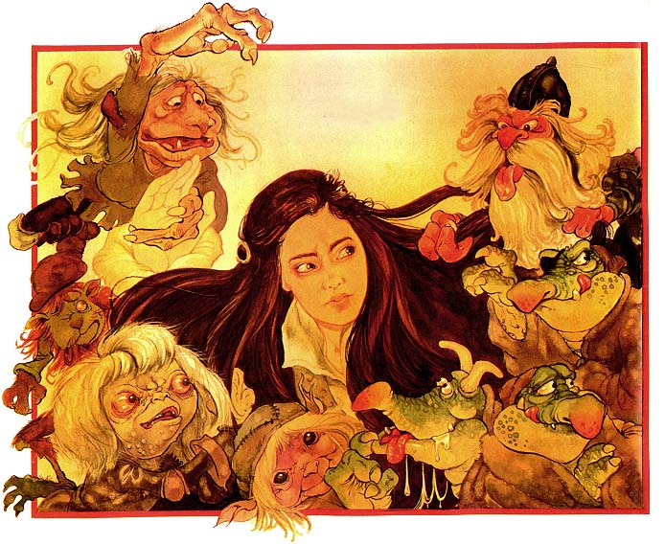
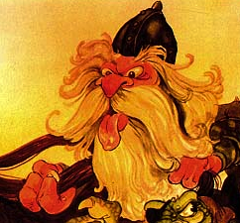

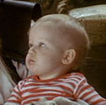
A little more context…
“Look! There’s a goblin!”
Goblin = ????
Notes:
7

Slide 8
The Mapping Problem
Even if something is explicitly labeled in the input (“Look! There’s a goblin!”), how does the child know what specifically that word refers to? (Is it the head? The feet? The staff? The combination of eyes and hands? Attached goblin parts?…)
Quine (1960): An infinite number of hypotheses about word meaning are possible given the input the child has. That is, the input underspecifies the word’s meaning.
Notes:
8

Slide 9
So how do children figure it out? Obviously, they do….

Slide 10
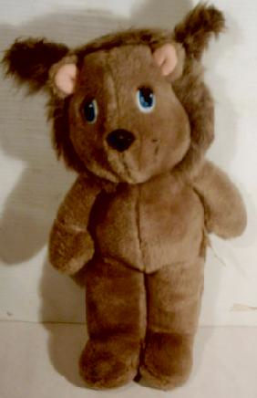
Computational Problem
“I love my daxes.”
Dax = that specific toy, teddy bear, stuffed animal, toy, object, …?

Slide 11
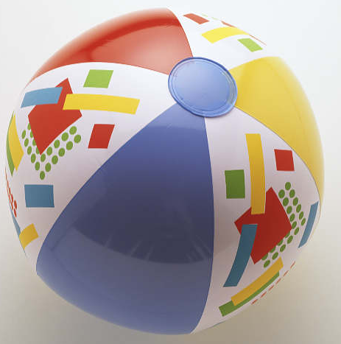
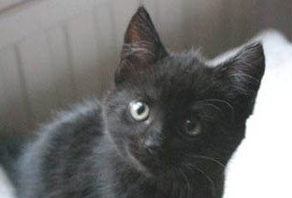

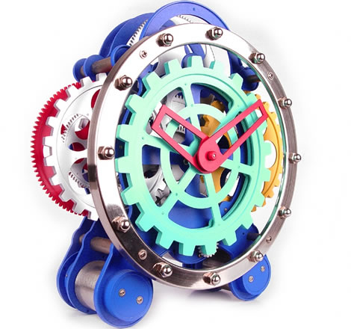
One solution: fast mapping
Children begin by making an initial fast mapping between a new word they hear and its likely meaning. They guess, and then modify the guess as more input comes in.
Experimental evidence of fast mapping
(Carey & Bartlett 1978, Dollaghan 1985, Mervis & Bertrand 1994, Medina,Snedecker, Trueswell, & Gleitman 2011)
ball
kitty
bear
[unknown]

Slide 12
One solution: fast mapping
Children begin by making an initial fast mapping between a new word they hear and its likely meaning. They guess, and then modify the guess as more input comes in.
Experimental evidence of fast mapping
(Carey & Bartlett 1978, Dollaghan 1985, Mervis & Bertrand 1994, Medina,Snedecker, Trueswell, & Gleitman 2011)
ball
“Can I have the ball?”
kitty
bear
[unknown]
Notes:
12

Slide 13
One solution: fast mapping
Children begin by making an initial fast mapping between a new word they hear and its likely meaning. They guess, and then modify the guess as more input comes in.
Experimental evidence of fast mapping
(Carey & Bartlett 1978, Dollaghan 1985, Mervis & Bertrand 1994, Medina,Snedecker, Trueswell, & Gleitman 2011)
ball
“Can I have the zib?”
kitty
bear
20 months
[unknown]
Notes:
13

Slide 14
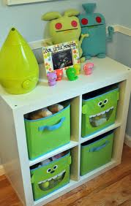
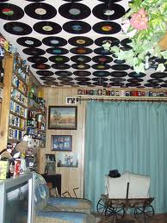

A slight problem…
“…not all opportunities for word learning are as uncluttered as the experimental settings in which fast-mapping has been demonstrated. In everyday contexts, there are typically many words, many potential referents, limited cues as to which words go with which referents, and rapid attentional shifts among the many entities in the scene.” - Smith & Yu (2008)

Slide 15

A slight problem…
“…many studies find that children even as old as 18 months have difficulty in making the right inferences about the intended referents of novel words…infants as young as 13 or 14 months…can link a name to an object given repeated unambiguous pairings in a single session. Overall, however, these effects are fragile with small experimental variations often leading to no learning.” - Smith & Yu (2008)

Slide 16
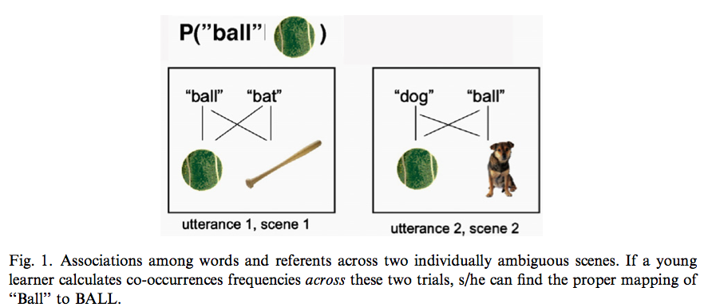
Cross-situational Learning
New approach: infants accrue statistical evidence across multiple trials that are individually ambiguous but can be disambiguated when the information from the trials is aggregated.

Slide 17
How does learning work?
Bayesian inference is one way.
In Bayesian inference, the belief in a particular hypothesis (H) (or the probability of that hypothesis), given the data observed (D) can be calculated the following way:
P(H | D) = P(D | H) * P(H)
P(D)

Slide 18
How does learning work?
Bayesian inference is one way.
In Bayesian inference, the belief in a particular hypothesis (H) (or the probability of that hypothesis), given the data observed (D) can be calculated the following way:
P(H | D) = P(D | H) * P(H)
P(D)
Posterior probability of hypothesis H, given that data D have been observed

Slide 19
How does learning work?
Bayesian inference is one way.
In Bayesian inference, the belief in a particular hypothesis (H) (or the probability of that hypothesis), given the data observed (D) can be calculated the following way:
P(H | D) = P(D | H) * P(H)
P(D)
Posterior probability
Likelihood of seeing data D, given that H is true

Slide 20
How does learning work?
Bayesian inference is one way.
In Bayesian inference, the belief in a particular hypothesis (H) (or the probability of that hypothesis), given the data observed (D) can be calculated the following way:
P(H | D) = P(D | H) * P(H)
P(D)
Posterior probability
Prior probability of hypothesis H
Likelihood

Slide 21
How does learning work?
Bayesian inference is one way.
In Bayesian inference, the belief in a particular hypothesis (H) (or the probability of that hypothesis), given the data observed (D) can be calculated the following way:
P(H | D) = P(D | H) * P(H)
P(D)
Probability of observing the data, no matter what hypothesis is true
Posterior probability
Prior
Likelihood

Slide 22
How does learning work?
Bayesian inference is one way.
In Bayesian inference, the belief in a particular hypothesis (H) (or the probability of that hypothesis), given the data observed (D) can be calculated the following way:
P(H | D) = P(D | H) * P(H)
Σ P(D|h)*P(h)
h
Probability of observing the data, no matter what hypothesis is true:
Calculate by summing over all hypotheses
Posterior probability
Prior
Likelihood

Slide 23
How does learning work?
Bayesian inference is one way.
In Bayesian inference, the belief in a particular hypothesis (H) (or the probability of that hypothesis), given the data observed (D) can be calculated the following way:
P(H | D) = P(D | H) * P(H)
Σ P(D|h)*P(h)
h
data
Posterior probability
Prior
Likelihood

Slide 24
Cross-situational Learning
Let’s apply Bayesian inference to this scenario.

Slide 25

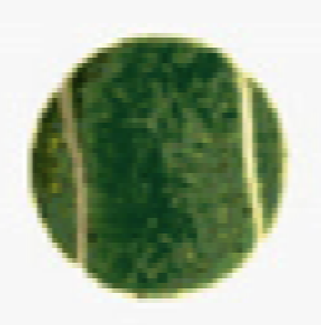
Cross-situational Learning
Let’s apply Bayesian inference to this scenario.
Posterior probability that “ball” refers to

Slide 26
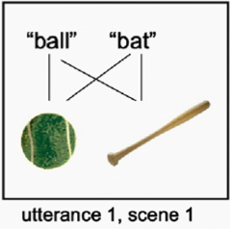
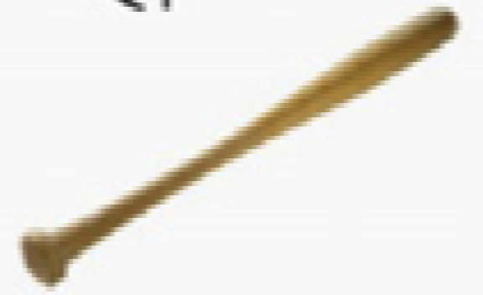
Cross-situational Learning
Let’s apply Bayesian inference to this scenario.
Observable data
Hypothesis 1 (H1): “ball” =
Since there are two hypotheses in the hypothesis space at this point
P(H1) = 1/2 = 0.5
P(H2) = 1/2 = 0.5
Hypothesis 2 (H2): “ball” =

Slide 27
Cross-situational Learning
Let’s apply Bayesian inference to this scenario.
Observable data
Hypothesis 1 (H1): “ball” =
If this is the only data available,
P(D | H1) = would this be observed if H1 were true? Yes. Therefore p(D | H1) = 1.0.
P(D | H2) = would this be observed if H2 were true? Yes. Therefore p(D | H2) = 1.0.
Hypothesis 2 (H2): “ball” =

Slide 28
Cross-situational Learning
Let’s apply Bayesian inference to this scenario.
Observable data
Hypothesis 1 (H1): “ball” =
If this is the only data available,
P(D) = Σ P(D | h) P(h) =
P(D | H1) * P(H1) = 1.0 * 0.5 = 0.5
P(D | H2) * P(H2) = 1.0 * 0.5 = 0.5
so
Σ P(D | h) P(h) = 0.5 + 0.5 = 1.0
Hypothesis 2 (H2): “ball” =
h
h

Slide 29
Cross-situational Learning
Let’s apply Bayesian inference to this scenario.
Observable data
Hypothesis 1 (H1): “ball” =
If this is the only data available,
= P(D | H1) * P(H1)
P(D)
= 1.0 * 0.5 = 0.5
1.0
Hypothesis 2 (H2): “ball” =
This feels intuitively right, since “ball” could refer to either object, given this data point.

Slide 30
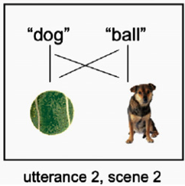

Cross-situational Learning
Let’s apply Bayesian inference to this scenario.
Observable data
Hypothesis 1 (H1): “ball” =
Since there are three hypotheses in the hypothesis space at this point
P(H1) = 1/3 = 0.33
P(H2) = 1/3 = 0.33
P(H3) = 1/3 = 0.33
Hypothesis 2 (H2): “ball” =
Hypothesis 3 (H3): “ball” =

Slide 31
Cross-situational Learning
Let’s apply Bayesian inference to this scenario.
Observable data
If this is the only data available,
P(D | H1) = would this be observed if H1 were true? Yes. Therefore p(D | H1) = 1.0.
Hypothesis 1 (H1): “ball” =
Hypothesis 2 (H2): “ball” =
Hypothesis 3 (H3): “ball” =

Slide 32
Cross-situational Learning
Let’s apply Bayesian inference to this scenario.
Observable data
If this is the only data available,
P(D | H2) = would this be observed if H2 were true? No. (Why would “ball” be said in the second scene?) Therefore p(D | H2) = 0.0.
P(D | H3) = would this be observed if H3 were true? No. (Why would “ball” be said in the first scene?) Therefore p(D | H3) = 0.0.
Hypothesis 1 (H1): “ball” =
Hypothesis 2 (H2): “ball” =
Hypothesis 3 (H3): “ball” =

Slide 33
Cross-situational Learning
Let’s apply Bayesian inference to this scenario.
Observable data
If this is the only data available,
P(D) = Σ P(D | h) P(h) =
P(D | H1) * P(H1) = 1.0 * 0.33 = 0.33
P(D | H2) * P(H2) = 0.0 * 0.33 = 0.0
P(D | H3) * P(H3) = 0.0 * 0.33 = 0.0
so
Σ P(D | h) P(h) = 0.33 + 0.0 + 0.0 = 0.33
Hypothesis 1 (H1): “ball” =
Hypothesis 2 (H2): “ball” =
h
Hypothesis 3 (H3): “ball” =
h

Slide 34
Cross-situational Learning
Let’s apply Bayesian inference to this scenario.
Observable data
Hypothesis 1 (H1): “ball” =
If this is the only data available,
= P(D | H1) * P(H1)
P(D)
= 1.0 * 0.33 = 1.0
0.33
Hypothesis 2 (H2): “ball” =
Hypothesis 3 (H3): “ball” =
This feels intuitively right, since “ball” could only refer to the ball, when these two scenes are reconciled with each other.

Slide 35
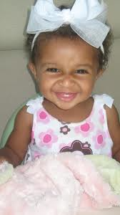
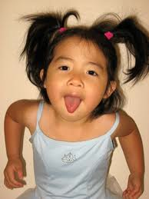
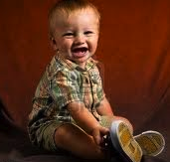
Smith & Yu (2008)
Yu & Smith (2007): Adults seem able to do cross-situational learning (in experimental setups).
Smith & Yu (2008) ask: Can 12- and 14-month-old infants do this? (Relevant age for beginning word-learning.)

Slide 36
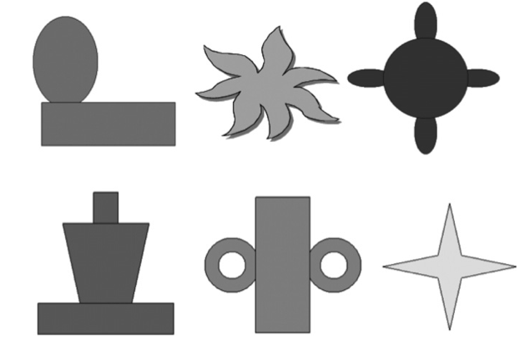
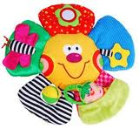
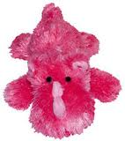
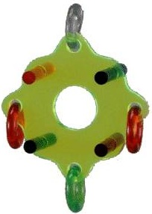
Smith & Yu (2008): Experiment
Infants were trained on six novel words obeying phonotactic probabilities of English: bosa, gasser, manu, colat, kaki, regli
These words were associated with six brightly colored shapes
(sadly greyscale in the paper)
Figure from paper
What the shapes are probably more like

Slide 37
Smith & Yu (2008): Experiment
Training: 30 slides with 2 objects named with two words (total time: 4 min)
manu
colat
Example training slides
bosa
manu

Slide 38
Smith & Yu (2008): Experiment
Testing: 12 trials with one word repeated 4 times and 2 objects (correct one and distracter) present
manu
manu
manu
manu
Which one does the infant think is manu? That should be the one the infant prefers to look at.

Slide 39
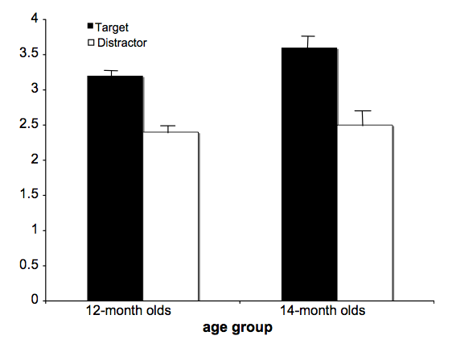
Smith & Yu (2008): Experiment
Results: Infants preferentially look at target over distracter, and 14-month-olds looked longer than 12-month-olds. This means they were able to tabulate distributional information across situations.
Implication: 12 and 14-month-old infants can do cross-situational learning

Slide 40
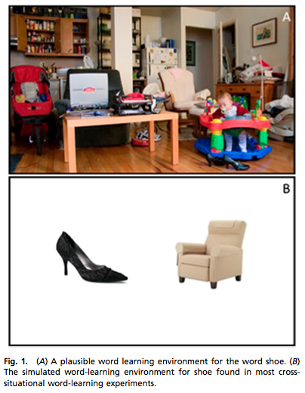
Something to think about…
The real world isn’t necessarily as simple as these experimental setups - often times, there will be many potential referents.

Slide 41
Something else to think about…
Having more referents may not be a bad thing.
Why not?
It’s easier for the correct associations to emerge from spurious associations when there are more object-referent pairing opportunities. Let’s see an example of this.

Slide 42



Why more may not always be harder…
Suppose there are six objects total, the amount used in the Smith & Yu (2008) experiment.
First, let’s consider their condition, where two objects are shown at a time. Let’s say we get three slides/scenes of data.
“manu”
“colat”
“bosa”
“gasser”
“kaki”
“regli”

Slide 43
Why more may not always be harder…
Suppose there are six objects total, the amount used in the Smith & Yu (2008) experiment.
Can we tell whether “manu” refers to or ?
No - both hypotheses are equally compatible with these data.
“manu”
“colat”
“bosa”
“gasser”
“kaki”
“regli”

Slide 44
Why more may not always be harder…
Suppose there are six objects total, the amount used in the Smith & Yu (2008) experiment.
Now, let’s consider a more compex condition, where four objects are shown at a time. Let’s say we get three slides/scenes of data.
“manu”
“colat”
“bosa”
“regli”
“bosa”
“gasser”
“manu”
“colat”
“manu”
“gasser”
“kaki”
“regli”

Slide 45
Why more may not always be harder…
Suppose there are six objects total, the amount used in the Smith & Yu (2008) experiment.
Can we tell whether “manu” refers to or or or ?
Well, the first slide isn’t helpful in distinguishing between these four hypotheses…
“manu”
“colat”
“bosa”
“regli”
“bosa”
“gasser”
“manu”
“colat”
“manu”
“gasser”
“kaki”
“regli”

Slide 46
Why more may not always be harder…
Suppose there are six objects total, the amount used in the Smith & Yu (2008) experiment.
Can we tell whether “manu” refers to or or or ?
The second slide suggests “manu” can’t be - otherwise, that object would appear in the second slide.
“manu”
“colat”
“bosa”
“regli”
“bosa”
“gasser”
“manu”
“colat”
“manu”
“gasser”
“kaki”
“regli”

Slide 47
Why more may not always be harder…
Suppose there are six objects total, the amount used in the Smith & Yu (2008) experiment.
Can we tell whether “manu” refers to or or ?
The third slide suggests “manu” can’t be or - otherwise, those objects would would appear in the third slide.
“manu”
“colat”
“bosa”
“regli”
“bosa”
“gasser”
“manu”
“colat”
“manu”
“gasser”
“kaki”
“regli”

Slide 48
Why more may not always be harder…
Suppose there are six objects total, the amount used in the Smith & Yu (2008) experiment.
Therefore, “manu” is .
This shows us that having more things appear (and be named) at once actually offers more opportunities for the correct associations to emerge.
“manu”
“colat”
“bosa”
“regli”
“bosa”
“gasser”
“manu”
“colat”
“manu”
“gasser”
“kaki”
“regli”

Slide 49
Recap: Word-Meaning Mapping
Cross-situational learning, which relies on distributional information across situations, can help children learn which words refer to which things in the world.
One way to implement the reasoning process behind cross-situation learning is Bayesian inference.
Experimental evidence suggests that infants are capable of this kind of reasoning in controlled experimental setups.

Slide 50

Questions?
Use the remaining time to work on HW2 and the review questions for word meaning. You should be able to do up through question 5 on HW2 and up through question 4 on the review questions.

