Slide 1
Psych 156A/ Ling 150: Acquisition of Language II
Lecture 5
Sounds of Words

Slide 2
Announcements
Be working on HW1 (due 4/19/12)
Be working on review questions for sounds and sounds of words
Read Saffran, Aslin, & Newport (1996) for next time

Slide 3
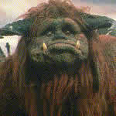
Word Forms
Computational Problem:
Map variable word signals to more abstract word forms
friends
“friends”
fwiends
friends

Slide 4
What’s Involved in Word Learning
Word learning: mapping between concept, word, and word’s variable acoustic signal
“goblin”

Slide 5
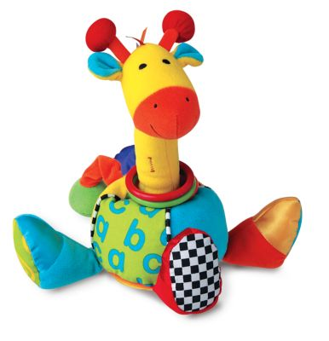
Word Learning Experiment (Stager & Werker 1997)
Learning nonsense words that are minimal pairs (differ by one phoneme): ‘bih’ vs. ‘dih’. Comparing against words that are not: ‘lif’ vs. ‘neem’
“Switch” Procedure: measures looking time
…this is a bih…look at the bih
Habituation
Same:
look at the bih!
Switch:
look at the dih!
Test

Slide 6
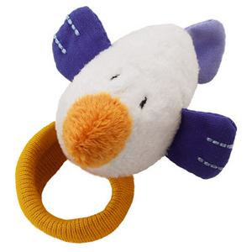
Word Learning Experiment (Stager & Werker 1997)
14-month-olds
…this is a dih…look at the dih
…this is a bih…look at the bih
Habituation
Same:
look at the bih!
Switch:
look at the dih!
Test

Slide 7
Word Learning Experiment (Stager & Werker 1997)
14-month-olds
No looking time difference = 14-month-olds didn’t notice the difference!

Slide 8
Word Learning Experiment (Stager & Werker 1997)
8-month-olds &
14-month-olds
…this is a bih…look at the bih
Habituation
Same:
look at the bih!
Switch:
look at the dih!
Test

Slide 9
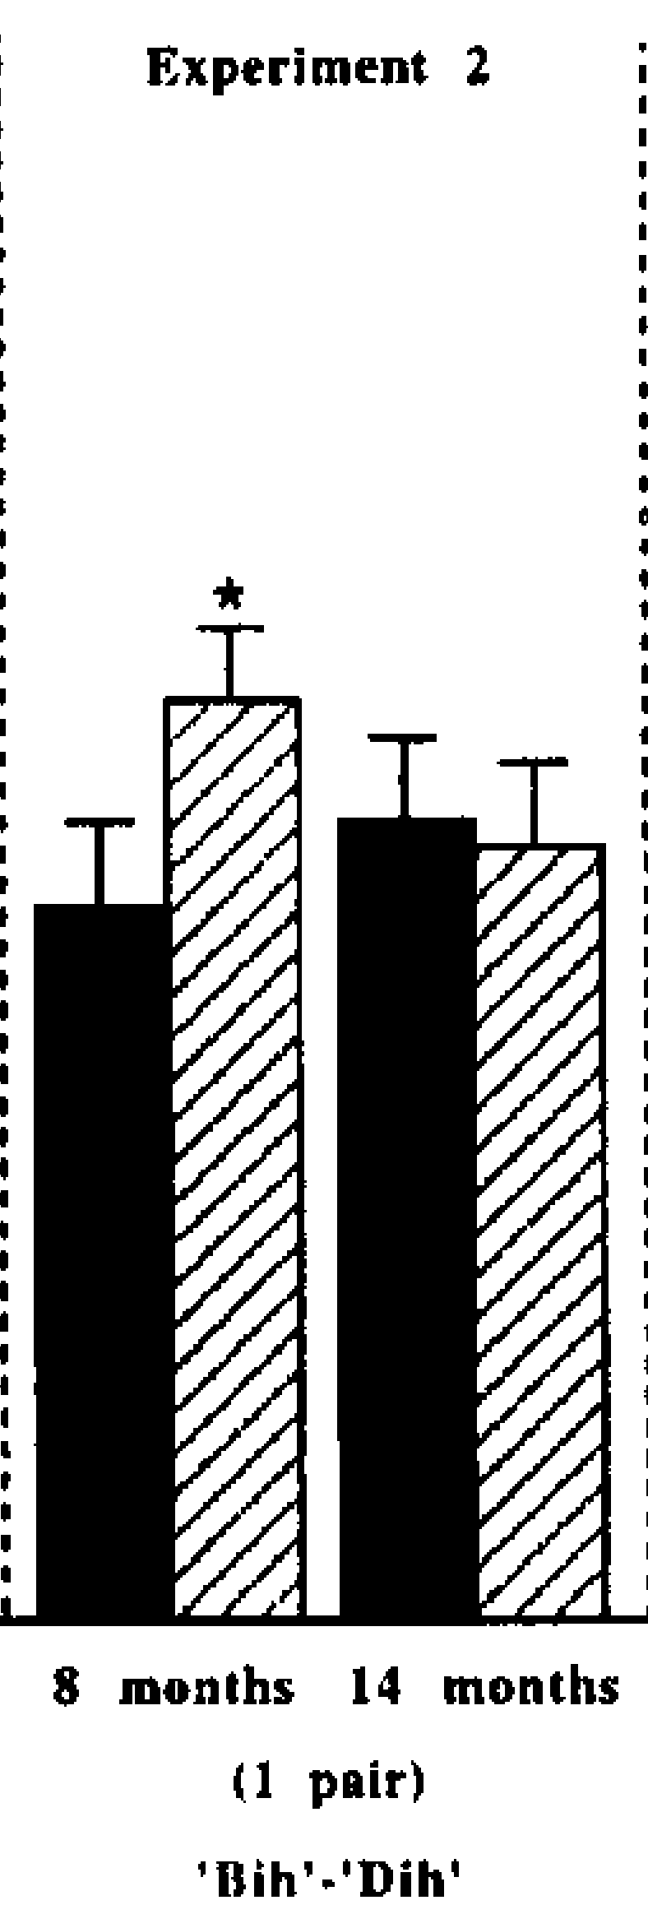
Word Learning Experiment (Stager & Werker 1997)
8-month-olds &
14-month-olds
No difference in looking time = 14-month-olds didn’t notice the difference again!

Slide 10
Word Learning Experiment (Stager & Werker 1997)
8-month-olds &
14-month-olds
But 8-month-olds did!
They have a difference in looking time. They look longer at the “bih” object when it is labeled “dih” - so they must know “b” and “d” are different.

Slide 11
Word Learning Experiment (Stager & Werker 1997)
14-month-olds
…this is a lif…look at the lif
Habituation
Same:
look at the lif!
Switch:
look at the neem!
Test

Slide 12
Word Learning Experiment (Stager & Werker 1997)
14-month-olds
Here, the 14-month-olds look longer at the “lif” object when it’s labeled “neem”. They notice the difference.

Slide 13
Word Learning Experiment (Stager & Werker 1997)
14-month-olds
Infants unlikely to associate label with checkerboard pattern (that is, to treat it like a word that has a referent/meaning)
…this is a bih…look at the bih
Habituation
Same:
look at the bih!
Switch:
look at the dih!
Test

Slide 14
Word Learning Experiment (Stager & Werker 1997)
14-month-olds
Here, the 14-month-olds look longer at the “bih” “object” when it’s labeled “dih”. They notice the difference.

Slide 15
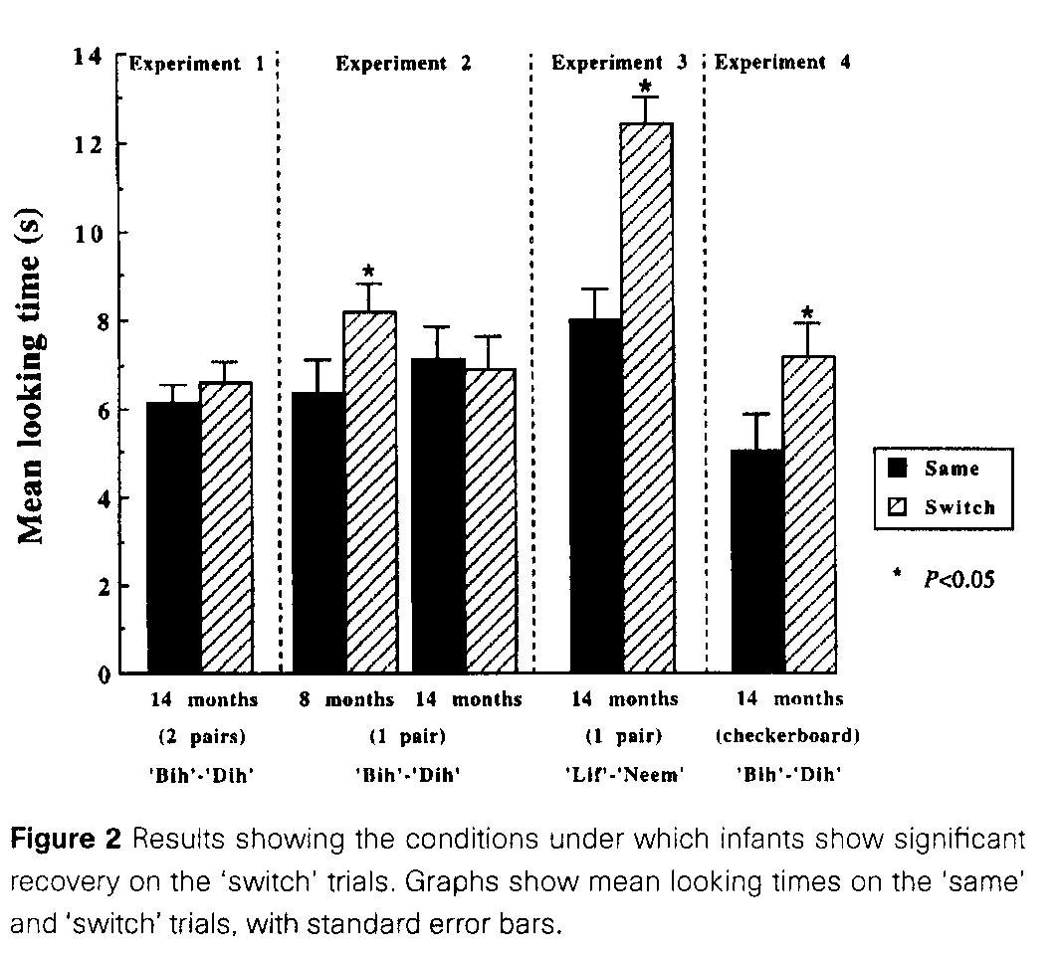
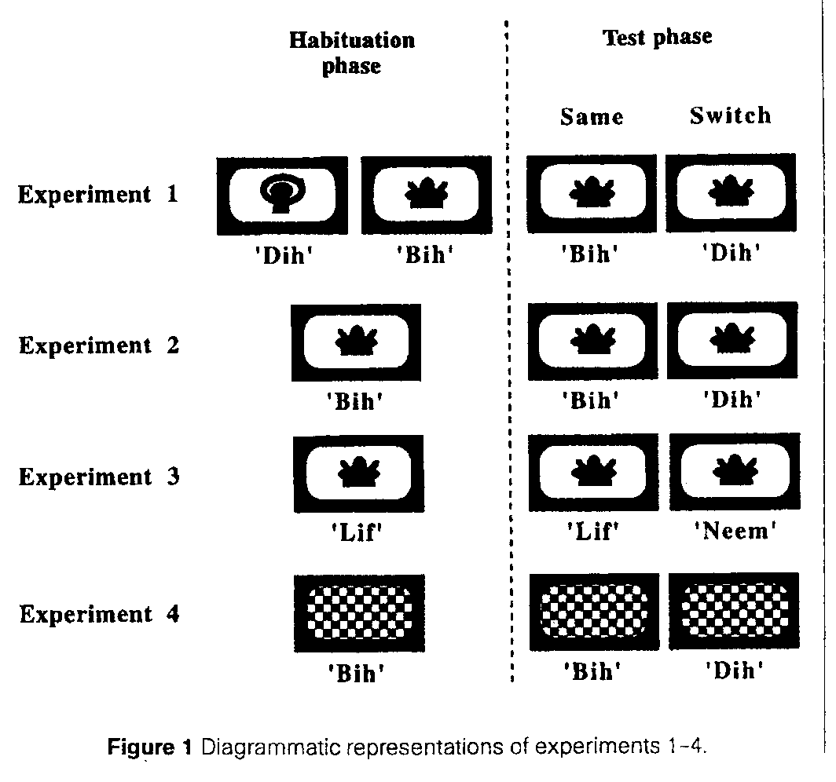
Word Learning Experiment (Stager & Werker 1997)
Key: Experiment 2 vs 4

Slide 16
Key Findings
14-month-olds can discriminate the minimally contrasting words (Expt. 4)
…but they fail to notice the minimal change in the sounds when they are paired with objects, i.e., when they are words with associated meaning (Expt. 2)
They can perform the task, when the words are more distinct (Expt. 3)
Therefore, 14-month-olds use more detail to represent sounds than they do to represent words!

Slide 17
What’s going on?
They fail specifically when the task requires word-learning
They do know the sounds…but they fail to use the detail needed for minimal pairs to store words in memory
What’s going on?
Is this true for all words?
When do they learn to do this?
What triggers the ability to do this?

Slide 18
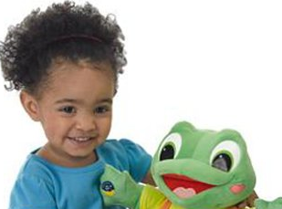
What children may be doing
One idea: Encode detail only if necessary
If children have small vocabularies, it may not take so much detail to distinguish one word from another. (baby, cookie, mommy, daddy…)
Neighborhood structure idea: When a child knows two words that differ only by a single phoneme (like “cat” and “bat”), more attention to detail is required to distinguish them.
Prediction: The content of children’s vocabulary drives their ability to notice the difference between words that differ minimally (ex: by a single phoneme)

Slide 19
Going with the neighborhood idea, look at Stager & Werker (1997)
“bih” and “dih” are too close (they differ only by one phoneme), and 14-month-old kids don’t know any words close enough to motivate attention to the “b”/“d” difference when word-learning
…this is a bih…look at the bih
Habituation
Same:
look at the bih!
Switch:
look at the dih!
Test

Slide 20
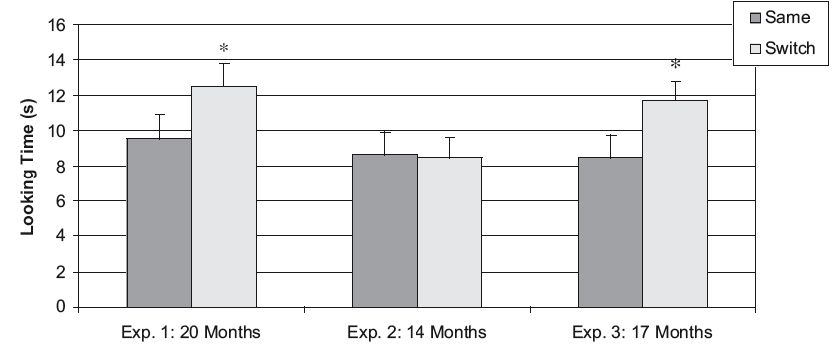
Werker et al. 2002: Vocabulary Size Matters
Same:
look at the bih!
Switch:
look at the dih!
Stager-Werker task
Test

Slide 21
Werker et al. 2002: Vocabulary Size Matters
Same:
look at the bih!
Switch:
look at the dih!
Stager-Werker task
Test
20-month-olds notice

Slide 22
Werker et al. 2002: Vocabulary Size Matters
Same:
look at the bih!
Switch:
look at the dih!
Stager-Werker task
Test
14 month-olds don’t

Slide 23
Werker et al. 2002: Vocabulary Size Matters
Same:
look at the bih!
Switch:
look at the dih!
Stager-Werker task
Test
17-month-olds do

Slide 24
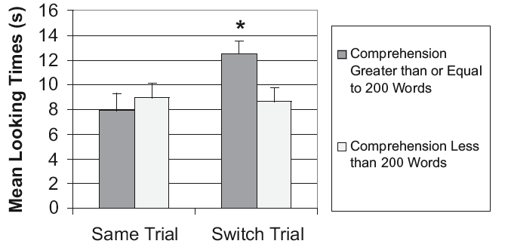
Werker et al. 2002: Vocabulary Size Matters
Zoom in on the 17-month-olds

Slide 25
Werker et al. 2002: Vocabulary Size Matters
Zoom in on the 17-month-olds
Those with a small vocabulary look like 14-month-olds - they can’t tell the difference for a novel word they haven’t heard much.

Slide 26
Werker et al. 2002: Vocabulary Size Matters
Zoom in on the 17-month-olds
Those with a large vocabulary look like 20-month-olds - they can tell the difference for a novel word, even though they haven’t heard it much.

Slide 27
Werker et al. 2002: Vocabulary Size Matters
Zoom in on the 17-month-olds
Implication: Performance on Stager-Werker task with novel words does depend on how many words the child knows.

Slide 28
More vocabulary = more necessary distinctions
Werker et al. 2002: Performance on Stager-Werker task with novel words depends on how many words the child knows.
Implication: The content of children’s vocabulary drives their ability to notice the difference between words that differ minimally (ex: by a single phoneme)
Prediction: This should apply to familiar words too. Specifically, children with small vocabularies should have trouble noticing phonemic differences in familiar words.

Slide 29
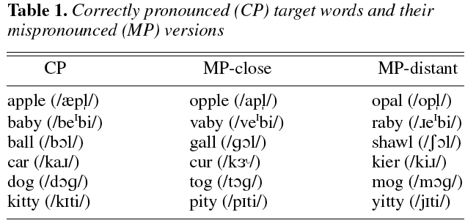
Swingley & Aslin 2002: Familiar Word Tests
But English 14-month-olds noticed the difference between correct pronunciations and mispronunciations when the words were familiar!
Maybe these 14-month-olds just happen to have large vocabularies?

Slide 30
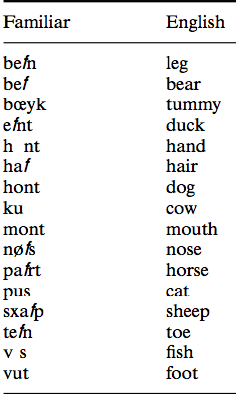
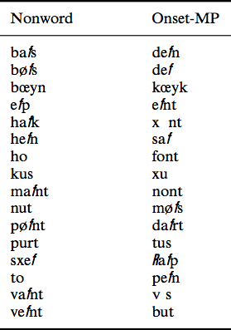
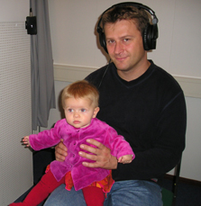
Swingley 2005: Familiar Words for Younger Children
(Dutch) 11-month-olds noticed the difference between correct pronunciations and mispronunciations when the words were familiar (Headturn Procedure: tests ability to hear sound differences)

Slide 31
Swingley 2005: Familiar Words for Younger Children
(Dutch) 11-month-olds noticed the difference between correct pronunciations and mispronunciations when the words were familiar (Headturn Procedure: tests ability to hear sound differences)
But this is before they’ve likely learned many words…so it probably isn’t just the number of words they know (and which words they know) that drives the detailed representations of the sounds in the words.
Point: Vocabulary can’t be the only thing determining children’s ability to distinguish the sounds of words. So what’s the problem with the 14-month-olds in the Stager-Werker task?

Slide 32
Was the task too hard for 14-month-olds?
Yoshida, Fennell, Swingley, & Werker (2009)
Maybe the problem with the 14-month-old infants was that the switch task was too hard - they have to be very confident that the close mispronunciation of the new word (dih for novel word bih) is not actually close enough
What would happen if we habituated 14-month-old children the usual way for the Switch procedure, but then tested them a different way that didn’t require them to be as confident about the correct pronunciation of a word’s form?

Slide 33
The Visual Choice Task “Preferential Looking”
Golinkoff, Hirsh-Pasek, Cauley & Gordon 1987
A two-alternative forced choice looking task that compares visual fixations to target and distractor objects
“Where’s the dog?”
Familiar object better match for familiar word

Slide 34
The Visual Choice Task “Preferential Looking”
Golinkoff, Hirsh-Pasek, Cauley & Gordon 1987
A two-alternative forced choice looking task that compares visual fixations to target and distractor objects
“Where’s the tog?”
Novel object is a better match for novel word form
and importantly familiar object is a poor match - infant knows familiar word.

Slide 35
Yoshida, Fennell, Swingley, & Werker (2009)
Novel labels
“bin”
“din”
14-month-old infants look significantly more at the correct novel object - they do have detail for words!
Test: 14-month-olds
“Where’s the bin?”

Slide 36
The problem with the Stager-Werker Task
Maybe the problem with the 14-month-olds in the Stager-Werker task was that they encoded the phonetic forms with low confidence. So, when tested on the original switch task, they didn’t have enough confidence in their representation of the novel form to realize it was the wrong label for the novel object.
Yoshida et al. 2009: “Calling a din object by the word bin is not good pronunciation to the 14-month-old, but neither is it categorically incorrect.”

Slide 37
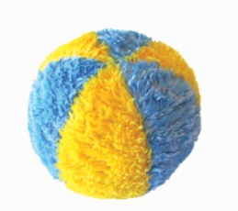
Why does having a familiar word help?
Idea: Children build up more confidence in the word form the more times they hear it.
{p/b/d/g}{a/o/u}{l/r} = “pall”, “dor”
… “gull”, “ball”
(p/b}{a}{l/r} = “pall”, “ball”,
… “bar”, “par”
{b}{a}{l} = “ball”

Slide 38
Recap: Sounds, Words, and Detail
Word-learning is very hard for younger children, so detail seems to be initially missed when they first learn words.
Many exposures are needed to learn detailed word forms at the earliest stages of word-learning.
When children are tested with a visual choice task, they show more knowledge of detailed word forms than when they are tested with a Switch procedure task.

Slide 39
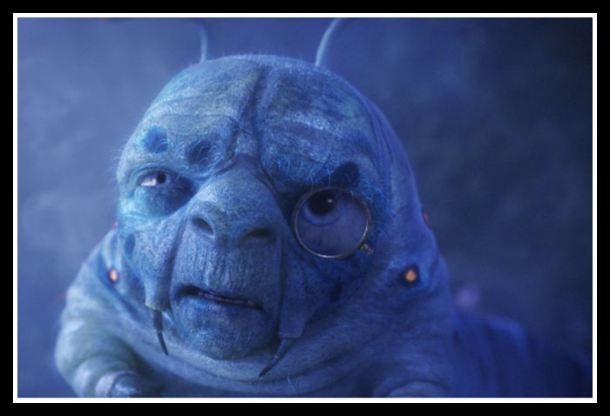
Questions?
You should be able to do all the questions on HW1 and all the review questions for sounds & sounds of words.

