Slide 1
Psych 156A/ Ling 150: Acquisition of Language II
Lecture 15
Introduction to Language Structure

Slide 2
Announcements
Please pick up HW1 and HW2 if you haven’t done so yet
HW3 is due by the end of class today
Review questions are available for structure
Online course evaluations are available for this class - please fill them out! :)

Slide 3
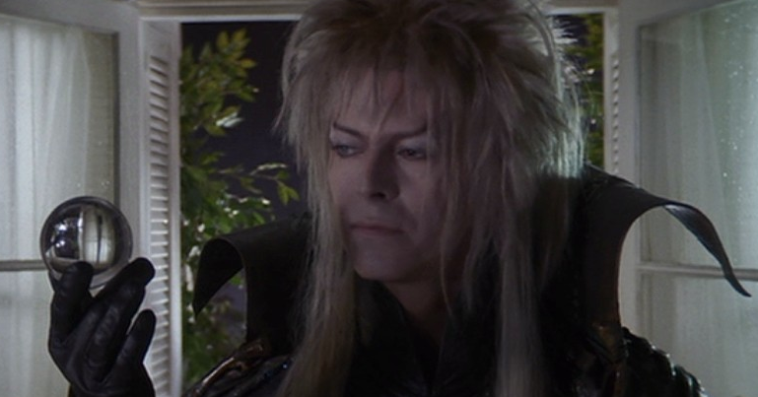
Computational Problem: Figure out the order of words (syntax)
Jareth juggles crystals
Subject Verb Object
Noun Verb Noun
NP NP
Depends on grammatical categories like Nouns and Verbs (and their associated phrases (NP)), but also on more precise distinctions like Subjects and Objects.
Some Noun Phrase distinctions:
Subject = usually the agent/actor of the action, “doer”: Jareth
Object = usually the recipient of the action, “done to”: crystals

Slide 4
Computational Problem: Figure out the order of words (syntax)
Jareth juggles crystals
Subject Verb Object
Important idea: The observable word order speakers produce (like Subject Object Verb) is the result of a system of word order rules that speakers unconsciously use when they speak. This system of word order rules is called syntax.

Slide 5
Computational Problem: Figure out the order of words (syntax)
Jareth juggles crystals
Subject Verb Object
One way to generate Subject Verb Object order:
The linguistic system specifies that order as the general pattern of the language. An example of this kind of system is English.
English
Subject Verb Object

Slide 6
Computational Problem: Figure out the order of words (syntax)
Jareth juggles crystals
Subject Verb Object
Another way to generate Subject Verb Object order:
The linguistic system specifies Subject Object Verb as the general pattern, but the Verb in main clauses moves to the second position and some other phrase (like the Subject) moves to the first position. An example language like this is German.
German
Subject Object Verb

Slide 7
Computational Problem: Figure out the order of words (syntax)
Jareth juggles crystals
Subject Verb Object
Another way to generate Subject Verb Object order:
The linguistic system specifies Subject Object Verb as the general pattern, but the Verb in main clauses moves to the second position and some other phrase (like the Subject) moves to the first position. An example language like this is German.
movement rules
German
____ Verb Subject Object _{Verb}

Slide 8
Computational Problem: Figure out the order of words (syntax)
Jareth juggles crystals
Subject Verb Object
Another way to generate Subject Verb Object order:
The linguistic system specifies Subject Object Verb as the general pattern, but the Verb in main clauses moves to the second position and some other phrase (like the Subject) moves to the first position. An example language like this is German.
movement rules
German
Subject Verb _{Subject} Object _{Verb}

Slide 9
Computational Problem: Figure out the order of words (syntax)
Jareth juggles crystals
Subject Verb Object
A third way to generate Subject Verb Object order:
The linguistic system specifies Subject Object Verb as the general pattern, but the Object moves after the Verb in certain contexts (the Object is unexpected information). Kannada is a language like this.
Kannada
Subject Object Verb

Slide 10
Computational Problem: Figure out the order of words (syntax)
Jareth juggles crystals
Subject Verb Object
A third way to generate Subject Verb Object order:
The linguistic system specifies Subject Object Verb as the general pattern, but the Object moves after the Verb in certain contexts (the Object is unexpected information). Kannada is a language like this.
movement rule
Kannada
Subject _{Object} Verb Object

Slide 11
Computational Problem: Figure out the order of words (syntax)
Jareth juggles crystals
Subject Verb Object
German
English
Subject Verb Object
Subject Verb _{Subject} Object _{Verb}
Kannada
Subject _{Object} Verb Object
The learning problem: How do children know which system their language uses?

Slide 12
Computational Problem: Figure out the order of words (syntax)
Jareth juggles crystals
Subject Verb Object
German
English
Subject Verb Object
Subject Verb _{Subject} Object _{Verb}
Kannada
Subject _{Object} Verb Object
This is a hard question!
Children only see the output of the system (the observable word order of Subject Verb Object).

Slide 13
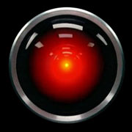
Humans are good at language - how good are computers?

Slide 14
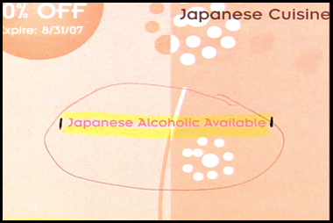
Translation is not so easy: more than just word-by-word
http://www.nbc.com/nbc/The_Tonight_Show_with_Jay_Leno/headlines/

Slide 15
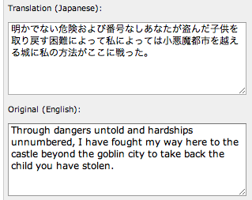
Translation is not so easy: more than just word-by-word
http://www.worldlingo.com/en/products_services/worldlingo_translator.html

Slide 16
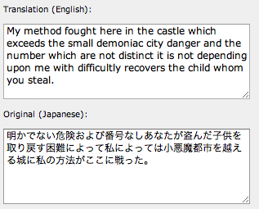
Translation is not so easy: more than just word-by-word
http://www.worldlingo.com/en/products_services/worldlingo_translator.html
Word-by-word translation to Japanese is poor. Japanese structure is very different from English structure at this level.

Slide 17
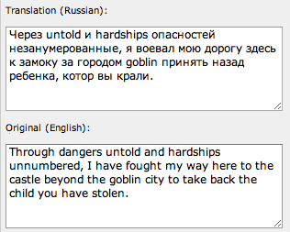
Translation is not so easy: more than just word-by-word
http://www.worldlingo.com/en/products_services/worldlingo_translator.html

Slide 18
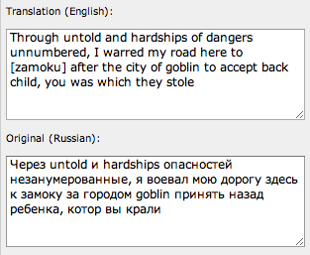
Translation is not so easy: more than just word-by-word
http://www.worldlingo.com/en/products_services/worldlingo_translator.html
Translation is not as poor. Russian structure is not as different from English structure at this level, though it is still different.

Slide 19
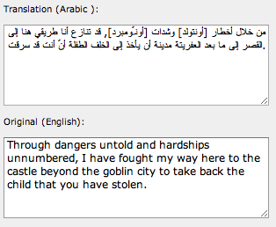
Translation is not so easy: more than just word-by-word
http://www.worldlingo.com/en/products_services/worldlingo_translator.html

Slide 20
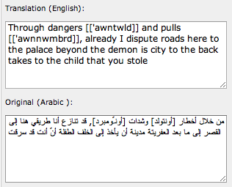
Translation is not so easy: more than just word-by-word
http://www.worldlingo.com/en/products_services/worldlingo_translator.html
The translation is fairly poor. Arabic structure is fairly different from English structure at this level.

Slide 21
Solving the Language Problem (Artificial Intelligence)
HAL 9000 from 2001: A Space Odyssey (1968)
Perfect production and comprehension of English.
1960s: Language not considered one of the “hard” problems of artificial intelligence.
2010: Still not very close to human-like performance.
http://www.research.att.com/~ttsweb/tts/demo.php

Slide 22
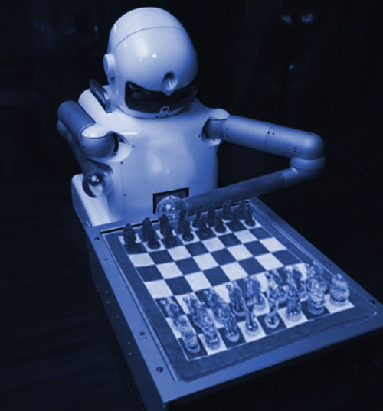
Solving the Language Problem (Artificial Intelligence)
Contrast: Chess-playing.
In 1997, a program named Deep Blue beat the reigning world champion in chess. It did this by having enough computational resources to investigate every move option before it actually made the chess move. This shows that computers’ poor performance on language is not about insufficient computational power, since there is enough computational power to solve the chess-playing problem (which some people might consider a very difficult problem).

Slide 23
Solving the Language Problem (Artificial Intelligence)
Update for 2011 on a machine’s abilities to do what humans do:
Man vs. Machine (Watson) in Jeopardy
& how hard a problem language comprehension and production is
http://www.youtube.com/watch?v=dr7IxQeXr7g
(approximately 9 min video)

Slide 24
About Human Knowledge: Language & Variation

Slide 25
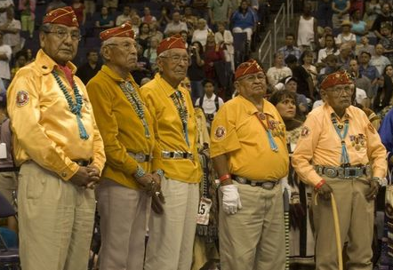
Navajo Code Talkers
Crucial crytographic method used in World War II
http://en.wikipedia.org/wiki/Code_talker#Use_of_Navajo
“…Johnston saw Navajo as answering the military requirement for an undecipherable code. Navajo was spoken only on the Navajo lands of the American Southwest, and its syntax and tonal qualities, not to mention dialects, made it unintelligible to anyone without extensive exposure and training. One estimate indicates that at the outbreak of World War II fewer than 30 non-Navajos could understand the language….”

Slide 26
Navajo Code Talker Paradox (Baker 2001)
English must be very different from Navajo
Japanese could decode English, but couldn’t decode Navajo when they didn’t know it was Navajo.
English must be similar to Navajo
English can be translated into Navajo and back with no loss of meaning. (Languages are not just a product of the culture - pastoral Arizona lifestyle couldn’t have prepared the code talkers for Pacific Island high tech warfare. Yet, translation was still possible.)

Slide 27
Types of Variation
Vocabulary
English “think” verbs: think, know, wonder, suppose, assume, …
Multiple types of the action verb “think”. Each has certain uses that are appropriate.
“I wonder whether the girl saved her little brother from the goblins.” [grammatical]
* “I suppose whether the girl saved her little brother from the goblins.” [ungrammatical]

Slide 28
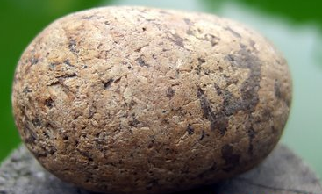
Types of Variation
Vocabulary
English “think” verbs: think, know, wonder, suppose, assume, …
Navajo “carry” verbs: depends on object being carried
aah (carry a solid round-ish object)
kaah (carry an open container with contents)
lé (carry a flexible object)

Slide 29
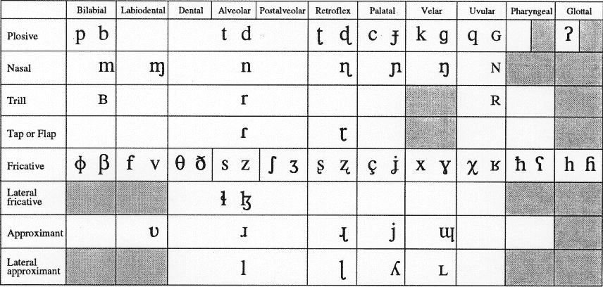
Types of Variation
Sounds: Each language uses a particular subset of the sounds in the International Phonetic Alphabet, which represents all the sounds used in all human languages. There’s often overlap (ex: “m”, “p” are used in many languages), but languages also may make use of the less common sounds.
less common English sounds: “th” [T], “th” [D]
less common Navajo sounds: “whispered l”, “nasalized a”, …

Slide 30
Types of Variation
Morphology (word forms)
English: invariant word forms
“the girl is crying”, “I am crying”
Navajo: no invariant forms (there may be 100-200 prefixes for verb stems)
At’ééd yicha. “Girl crying”
Yishcha. “I am crying”
(yi + sh + cha)
Ninááhwiishdlaad. “I am again plowing”
(ni + náá + ho + hi + sh + l + dlaad)

Slide 31
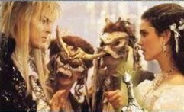
Types of Variation
Word order (syntax)
English: Subject Verb Object (invariant word order)
“The boy saw the girl”
Navajo: Subject Object Verb, Object Subject Verb
(varying word orders, meaning depends only on verb’s form)
Ashkii at’ééd yiyiiltsá
boy girl saw
“The boy saw the girl”
Ashkii at’ééd biilstá
boy girl saw
“The girl saw the boy”

Slide 32
Thinking About Syntactic Variation

Slide 33
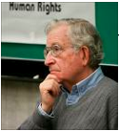
Similarities & Differences: Parameters
Chomsky: Different combinations of different basic elements (parameters) would yield the observable languages (similar to the way different combinations of different basic elements in chemistry yield many different-seeming substances).
Big Idea: A relatively small number of syntax parameters yields a large number of different languages’ syntactic systems.

Slide 34
Similarities & Differences: Parameters
Chomsky: Different combinations of different basic elements (parameters) would yield the observable languages (similar to the way different combinations of different basic elements in chemistry yield many different-seeming substances).
Big Idea: A relatively small number of syntax parameters yields a large number of different languages’ syntactic systems.
5 different parameters of variation

Slide 35
Similarities & Differences: Parameters
Chomsky: Different combinations of different basic elements (parameters) would yield the observable languages (similar to the way different combinations of different basic elements in chemistry yield many different-seeming substances).
Big Idea: A relatively small number of syntax parameters yields a large number of different languages’ syntactic systems.
2 different parameter values of one parameter

Slide 36
Similarities & Differences: Parameters
Chomsky: Different combinations of different basic elements (parameters) would yield the observable languages (similar to the way different combinations of different basic elements in chemistry yield many different-seeming substances).
Big Idea: A relatively small number of syntax parameters yields a large number of different languages’ syntactic systems.
Total languages that can be represented = 2⁵ = 32

Slide 37
Similarities & Differences: Parameters
Big Idea: A relatively small number of syntax parameters yields a large number of different languages’ syntactic systems.
English
Japanese
Tagalog
Navajo
French
…

Slide 38
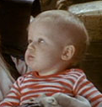
Learning Language Structure
Chomsky: Children are born knowing the parameters of variation. This is part of Universal Grammar. Input from the native linguistic environment determines what values these parameters should have.

Slide 39
Learning Language Structure
Chomsky: Children are born knowing the parameters of variation. This is part of Universal Grammar. Input from the native linguistic environment determines what values these parameters should have.
English

Slide 40
Learning Language Structure
Chomsky: Children are born knowing the parameters of variation. This is part of Universal Grammar. Input from the native linguistic environment determines what values these parameters should have.
Japanese

Slide 41
Learning Language Structure
Chomsky: Children are born knowing the parameters of variation. This is part of Universal Grammar. Input from the native linguistic environment determines what values these parameters should have.
Navajo

Slide 42
Generalizations About Language Structure

Slide 43
Greenberg’s Word Order Generalizations
Navajo
Japanese

Slide 44
Greenberg’s Word Order Generalizations
Navajo
Japanese
Basic word order:
Subject Object Verb
Ashkii at’ééd yiyiiltsá
boy girl saw
“The boy saw the girl”
Basic word order:
Subject Object Verb
Jareth-ga Hoggle-o butta
Jareth Hoggle hit
“Jareth hit Hoggle”

Slide 45
Greenberg’s Word Order Generalizations
Navajo
Japanese
Postpositions:
Noun Phrase Postposition
‘éé’ biih náásdzá
clothing into I-got-back
“I got back into (my) clothes.”
Postpositions:
Noun Phrase Postposition
Jareth-ga Sarah to kuruma da
Jareth Sarah with car by
London ni itta
London to went
“Jareth went to London with Sarah by car.”

Slide 46
Greenberg’s Word Order Generalizations
Navajo
Japanese
Possessor before Possessed
Possessor Possession
Chidí bi-jáád
Car its-leg
“the car’s wheel”
Possessor before Possessed
Possessor Possession
Toby-no imooto-ga
Toby’s sister
“Toby’s sister”

Slide 47
Greenberg’s Word Order Generalizations
Navajo
Japanese
Basic word order:
Subject Object Verb
Basic word order:
Subject Object Verb
Postpositions:
Noun Phrase Postposition
Postpositions:
Noun Phrase Postposition
Possessor before Possessed
Possessor Possession
Possessor before Possessed
Possessor Possession
Despite the differences in the languages (and their cultural histories), both Japanese and Navajo are very similar when viewed through these three structural descriptions.

Slide 48
Greenberg’s Word Order Generalizations
English
Edo (Nigeria)

Slide 49
Greenberg’s Word Order Generalizations
English
Edo (Nigeria)
Basic word order:
Subject Verb Object
Sarah found Toby
Basic word order:
Subject Verb Object
Òzó mién Adésuwá
Ozo found Adesuwa

Slide 50
Greenberg’s Word Order Generalizations
English
Edo (Nigeria)
Prepositions:
Preposition Noun Phrase
Jareth gave the crystal to Sarah
Prepositions:
Preposition Noun Phrase
Òzó rhié néné ebé né Adésuwá
Ozo gave the book to Adesuwa

Slide 51
Greenberg’s Word Order Generalizations
English
Edo (Nigeria)
Possessed before Possessor
Possession Possessor
quest of Sarah
(alternative: Sarah’s quest)
Possessed before Possessor
Possession Possessor
Omo Ozó
child Ozo
“child of Ozo”

Slide 52
Greenberg’s Word Order Generalizations
English
Edo (Nigeria)
Basic word order:
Subject Verb Object
Basic word order:
Subject Verb Object
Prepositions:
Preposition Noun Phrase
Prepositions:
Preposition Noun Phrase
Possessed before Possessor
Possession Possessor
Possessed before Possessor
Possession Possessor
Again, despite the differences in the languages (and their cultural histories), both English and Edo are very similar when viewed through these three structural descriptions.

Slide 53
Greenberg’s Word Order Generalizations
Greenberg found forty-five “universals” of languages - patterns overwhelmingly followed by languages with unshared history (Navajo & Japanese, English & Edo)
Not all combinations are possible - some patterns rarely appear
Ex: Subject Verb Object language (English/Edo-like) + postpositions (Navajo/Japanese-like)
Moral: Languages may be more similar than they first appear “on the surface”, especially if we consider their structural properties.

Slide 54
One potential parameter
English
Italian
Subject Verb
“Jareth will come.”
Subject Verb
Jareth verrá
Jareth will-come
“Jareth will come.”
grammatical
grammatical
Notes:
54

Slide 55
One potential parameter
English
Italian
*Verb Subject
*Will arrive Jareth
Verb Subject
Verrá Jareth
Will-arrive Jareth
“Jareth will arrive”
ungrammatical
grammatical
Notes:
55

Slide 56
One potential parameter
English
Italian
*Verb
Will come
Verb
Verrá
He-will-come
“He will come”
ungrammatical
grammatical
Notes:
56

Slide 57
One potential parameter
English
Italian
Subject Verb
Subject Verb
*Verb Subject
Verb Subject
*Verb
Verb
These word order patterns might be fairly easy to notice. They involve the combinations of Subject and Verb that are grammatical in the language. A child might be able to notice the prevalence of some patterns and the absence of others.
Notes:
57

Slide 58
One potential parameter
Expletive subjects: words without content
(may be more difficult to notice)
English
Italian
Raining.
“It’s raining.”
Piove.
It-rains.
“It’s raining.”
Not okay to leave out expletive subject “it”.
Okay to leave out expletive subject “it”.
Notes:
58

Slide 59
One potential parameter
That-trace effect for subject questions
English
Italian
Who do you think (*that) will come?
Requires no “that” in embedded clause, despite allowing “that” in declaratives and object questions
I think (that) Hoggle will save Sarah.
Who did you think (that) Hoggle would save?
Notes:
59

Slide 60
One potential parameter
That-trace effect for subject questions
English
Italian
Credi che Jareth verrá.
You think that Jareth will-come.
“You think that Jareth will come.”
Che credi che __ verrá?
Who think-you that will-come?
“Who do you think will come?”
Allows “that” in the embedded clause of a subject question (and declarative clauses).
Notes:
60

Slide 61
One potential parameter
English
Italian
Subject Verb
Subject Verb
*Verb Subject
Verb Subject
Verb
*Verb
Not okay to leave out expletive subject “it”.
Okay to leave out expletive subject “it”.
Requires special action for embedded subject questions.
Does not require special action for embedded subject questions.
All these involve the subject in some way - coincidence?
Idea: No! There’s a language parameter involving the subject.
Notes:
61

Slide 62
The Value of Parameters: Learning the Hard Stuff by Noticing the Easy Patterns
English vs. Italian: Subject Parameter
English
Italian
Easier to notice
Subject Verb
Subject Verb
*Verb Subject
Verb Subject
Hard to notice
*Verb
Verb
Expletives
Piove.
It-rains.
It rains
Embedded Subject-question formation (easy to miss)
Who do you think (*that) will come?
Che credi che __ verrá?
Who think-you that will-come?
Notes:
62

Slide 63
The Value of Parameters: Learning the Hard Stuff by Noticing the Easy Patterns
English vs. Italian: Subject Parameter
Big idea: If all these structural patterns are generated from the same linguistic parameter (e.g. a “subject” parameter), then children can learn the hard-to-notice patterns (like the patterns of embedded subject questions) by being exposed to the easy-to-notice patterns (like the optional use of subjects with verbs). The hard-to-notice patterns are generated by one setting of the parameter, which children can learn from the easy-to-notice patterns.
Children’s knowledge of language structure variation is believed by linguistic nativists to be part of Universal Grammar, which children are born with.

Slide 64
Another possible parameter
Syntax: the Head Directionality parameter (Baker 2001, Cook & Newson 1996): heads of phrases (ex: Nouns of Noun Phrases, Verbs of Verb Phrases, Prepositions of Preposition Phrases) are consistently in either the leftmost or rightmost position
Japanese/Navajo: Head-Last
Verb Phrase:
Object Verb
VP
NP
Verb
Object
PP
Postpositions:
Noun Phrase Postposition
NP
P
Object
postposition
Notes:
64

Slide 65
Another possible parameter
Syntax: the Head Directionality parameter (Baker 2001, Cook & Newson 1996): heads of phrases (ex: Nouns of Noun Phrases, Verbs of Verb Phrases, Prepositions of Preposition Phrases) are consistently in either the leftmost or rightmost position
Edo/English: Head-First
VP
Verb Phrase:
Verb Object
Verb
NP
Object
Prepositions:
Preposition Noun Phrase
PP
P
NP
Preposition
Object
Notes:
65

Slide 66
Universal Grammar: Parameters
At this level of structural analysis (parameters), languages differ vary minimally from each other. This makes language structure much easier for children to learn. All they need to do is set the right parameter values for their language, based on the data that are easy to observe.
Japanese/Navajo
Edo/English
S
S
NP
VP
NP
VP
Subject
Verb
Subject
NP
Verb
NP
Object
Object
PP
PP
NP
P
P
NP
Object
postposition
preposition
Object

Slide 67
Questions?
You should be able to do up through question 9 on the structure review questions

